Slide 1
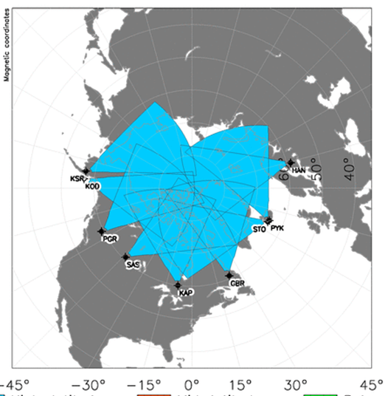
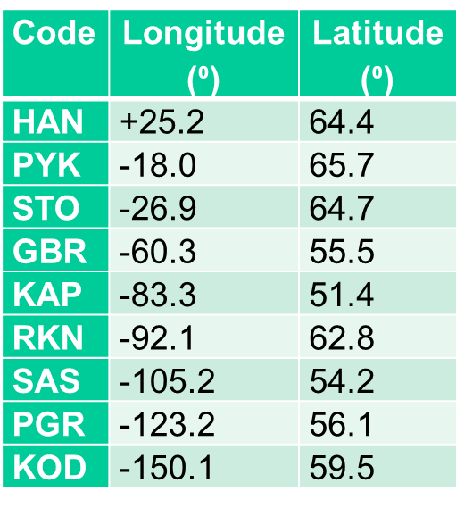
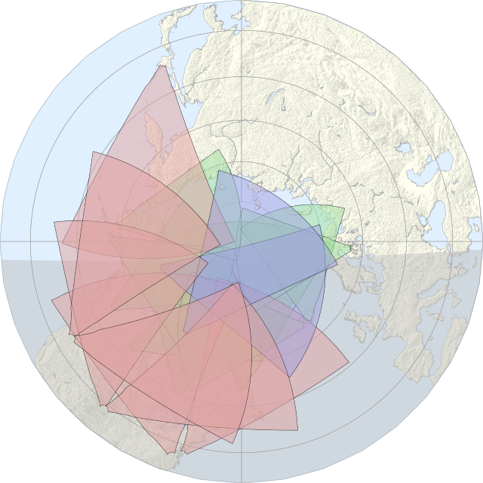
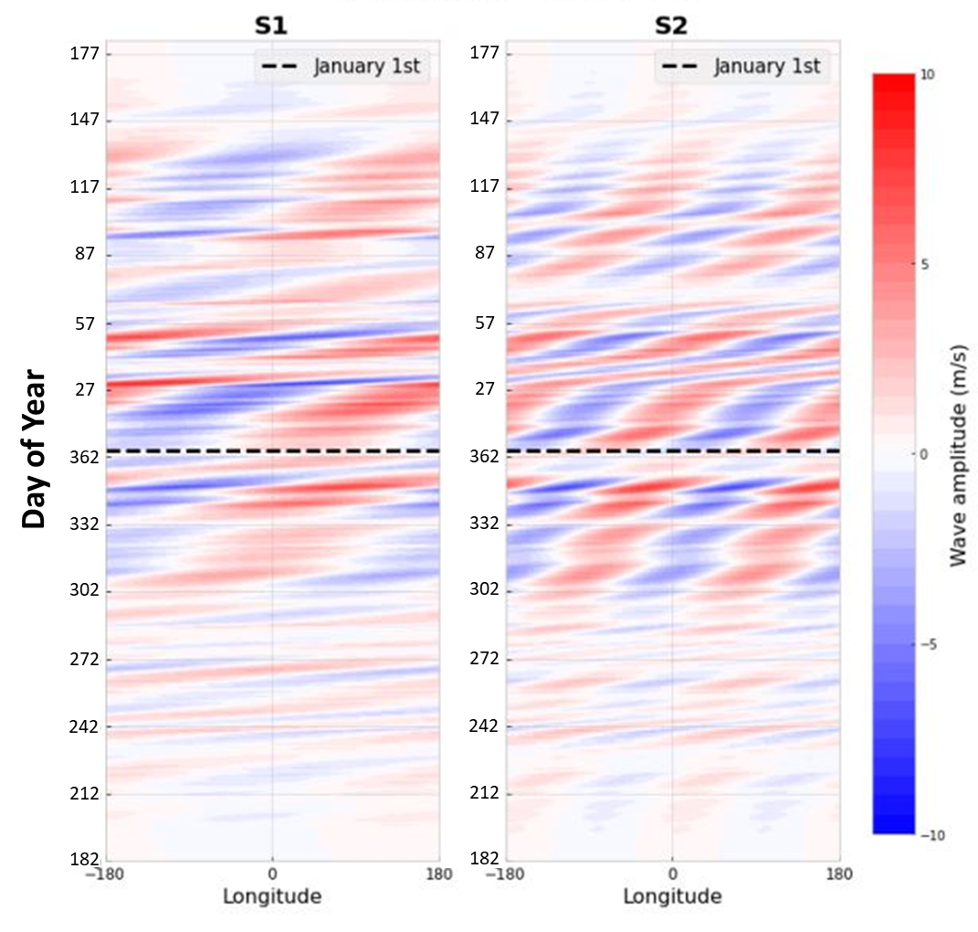
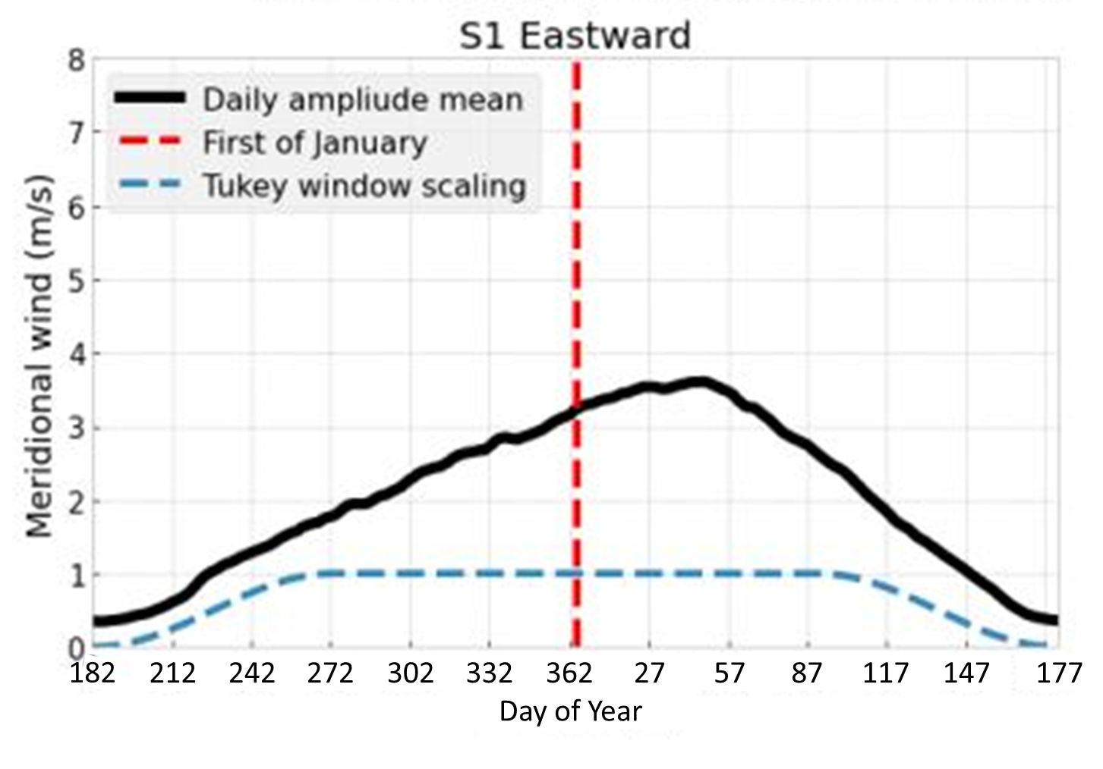
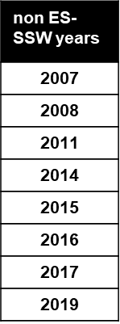
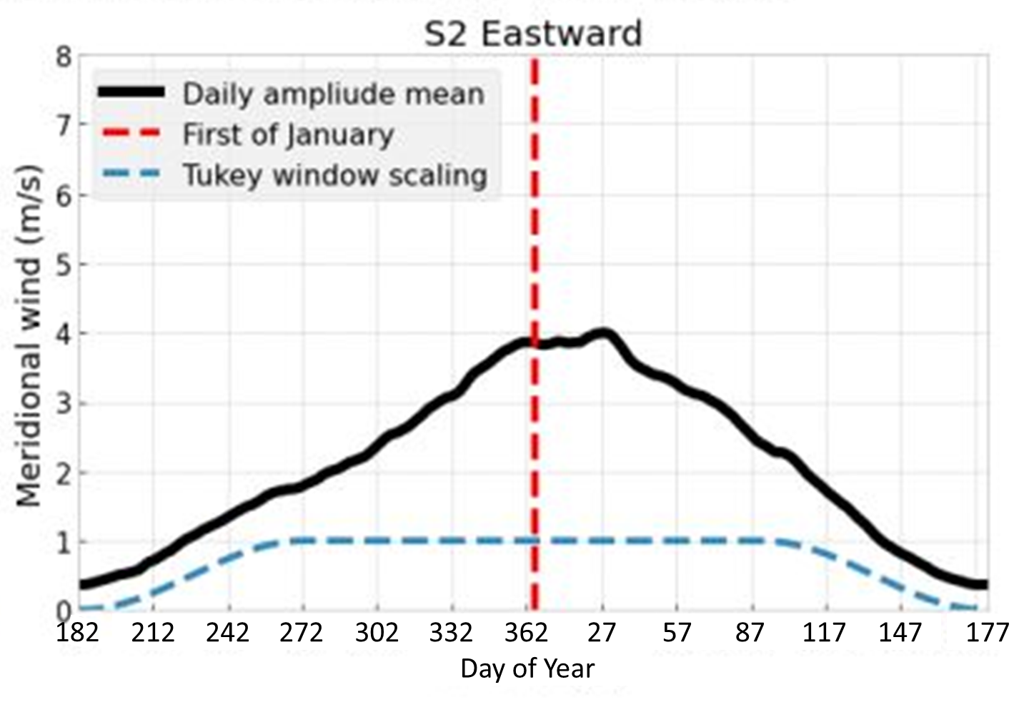
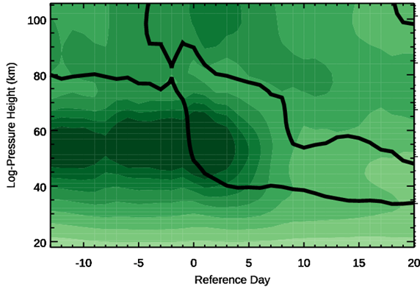
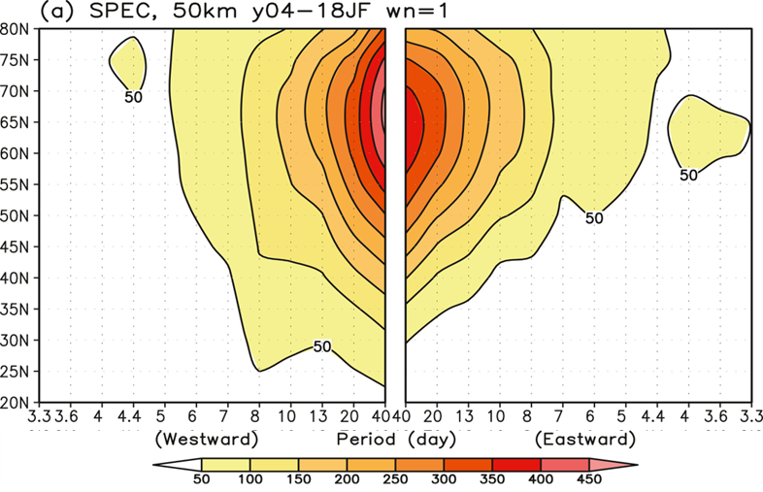
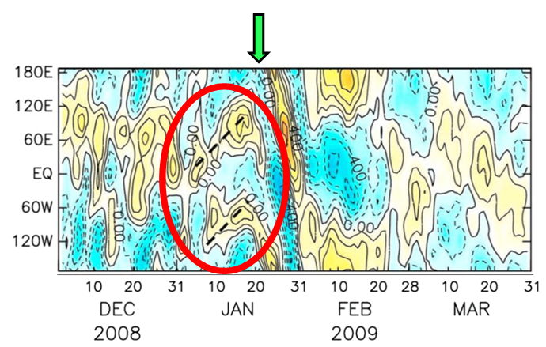
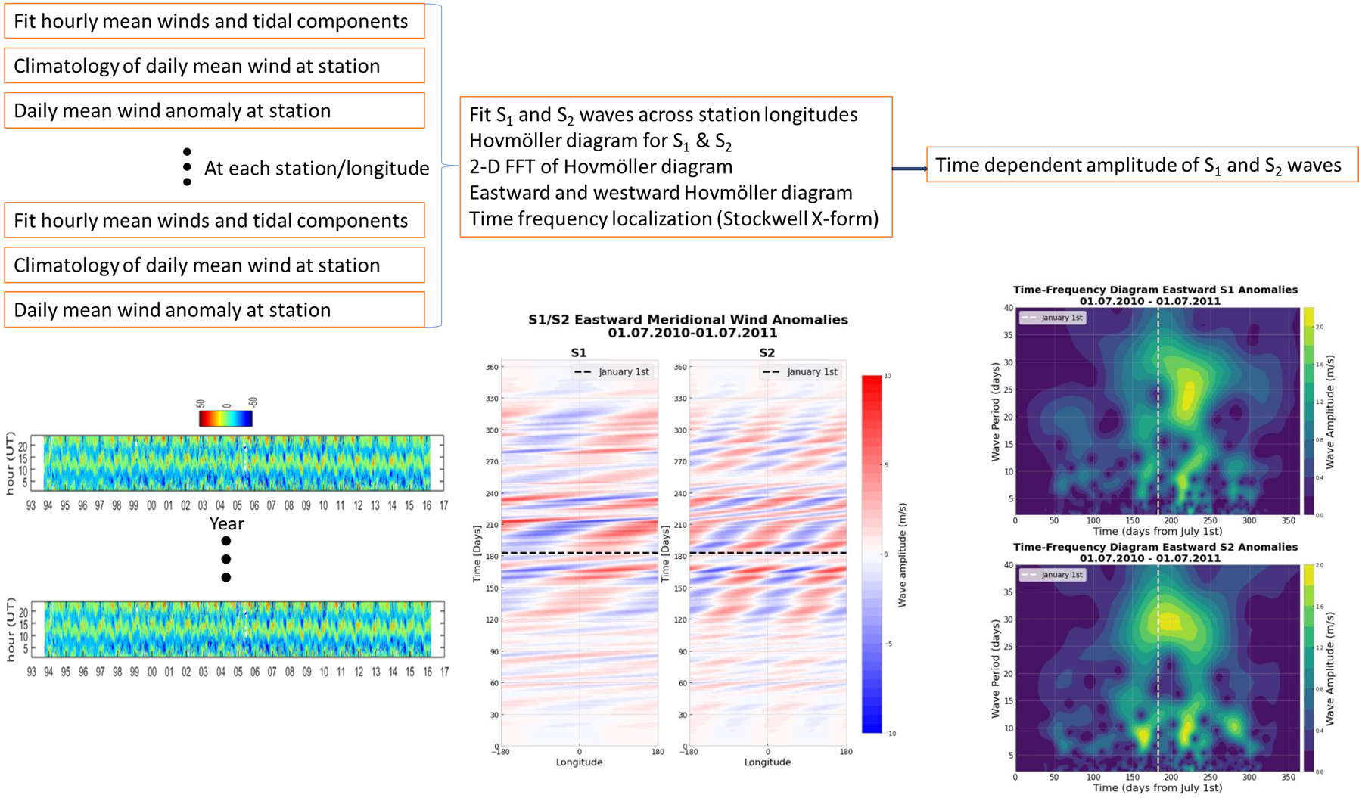
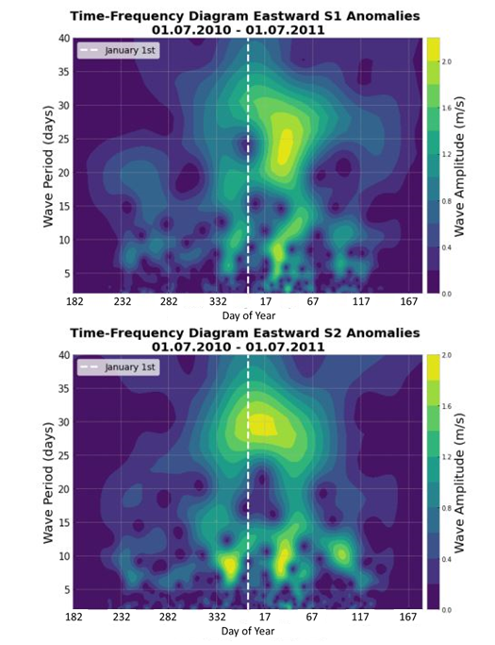
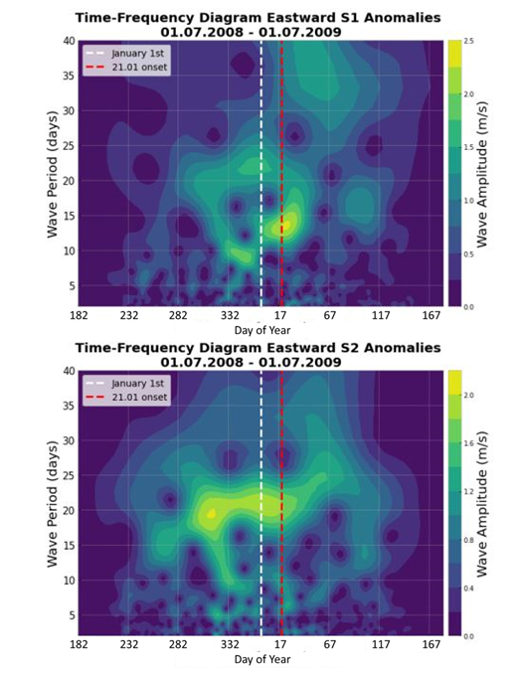
AS12-A002 Eastward Propagating Planetary Waves Observed Using the SuperDARN Meteor Radar Network
P.J. ESPY^{1,2}, T. Mirzaamin^{1,2},Y. Orsolini^{1,2}, C. T. Rhodes³
(1) Norwegian University of Science and Technology (NTNU), Trondheim, Norway.
(2) Birkeland Centre for Space Science (BCSS), Norway.
(3) Naval Research Laboratory, Space Science Division, United States
ABSTRACT
DATA AND METHOD
Eastward Planetary Waves-Climatology of non-SSW years
SSW Superposed Epoch Analysis (SEA)
An array of SuperDARN meteor radars were used to investigate the sources and characteristics of eastward propagating planetary waves (EPW) at 95 km and 65°N during wintertime. The radars provide daily mean meridional wind and their anomalies over 180° of longitude, and these anomalies were separated into eastward and westward waves to extract zonal wavenumber−1 (S₁) and wavenumber−2 (S₂) planetary wave (PW) components. A comparison between years with sudden stratospheric warming events (SSW) and years without was performed, and results verified using climatology and superposed epoch analyses (SPE). The results show eastward planetary waves enhancements during SSW are highly variable and are a ubiquitous feature near 90 km even in non-SSW years.
Data
The meteor wind data (representative of ~95 km altitude) from eight northern hemisphere mid-to-high latitude SuperDARN radars recorded from 2006 until 2020 have been used. The radars span over 180° of longitude over a small range of latitudes.
Method
A flow chart of the data analysis is shown at the top of the figure below, with the resulting data shown below. The hourly mean data at each station were fitted with a mean wind and 8-, 12-, 24-, and 48-hour tidal components over a 4-day window, which was shifted one day at a time. The mean wind component, free from tidal contamination, was then binned by day in the year to form each station’s climatology. The climatology is then subtracted from the daily mean wind to form the anomaly meridional wind at each station.
For each day, the anomaly wind at each station forms a longitudinal scan over 180° of longitude, to which S₁ and S₂ waves can be fitted. Each wave component can be plotted as a Hovmöller diagram, with wind anomaly as a function of longitude and time. The resulting data from the Hovmöller plot can be analysed with a 2-D FFT to separate the S₁ and S₂ planetary waves into their eastward and westward travelling components. These are reconstructed separately in an inverse FFT, and a time-series localization technique, in this case a Stockwell transform, was used to extract the daily evolution of the eastward waves, smoothed over the initial 4-day window.
.
Hovmöller and integrated amplitude climatology
The Hovmöller diagram of the eastward propagating S1 and S2 planetary waves for a winter without a major, elevated-stratopause SSW (2011) is shown below on the left. The FFT used to separate the eastward from the westward waves uses a Tukey window, which is unity from day 250 (2010) to 100 (2011). The meridional wind amplitude of the waves, averaged over the non-SSW years listed, is shown in the right panel for the S₁ (top) and S₂ (bottom) EPW.
Time frequency localization
At a fixed longitude in the Hovmöller plot, the time behaviour of the different frequency components is extracted using a time-frequency localization analysis. In this case, a Stockwell transform, based on the FFT but similar to a wavelet, is used.
Shown below are the analyses for two winters, 2010/11 where there were no major warmings, and 2008/09, where there was a major SSW with an elevated stratopause that occurred 21 Jan, 2009.
Each year’s time-frequency localization of EPW flux data was integrated over periods up to 40 days. The climatological seasonal variation shown previously was subtracted from each year to examine only the variations relative to climatology. The 5 years with major, elevated-stratopause SSW events were then aligned on the SSW onset date, and each day within ±30 days were coherently averaged over all events. The resulting superposed epoch analysis is shown below for the dates listed in the figure.
Additionally, the WACCM-SD modelling by Rhodes et al (2021) of the 2009 event is shown in the lower panel above, indicating the geopotential heigh anomalies associated with EPW during the event.
BACKGROUND
According to the Charney-Drazin criterion, EPWs can propagate upward through fast eastward zonal-mean background winds. They can also be generated in-situ in the middle atmosphere due to the shear instability of the southern hemisphere eastward polar-night jet. Additionally, instabilities associated with the double-jet meridional profile formed during Sudden Stratospheric Warming (SSW) by the polar night jet and the mesospheric subtropical jet can give rise to EPW in the mesosphere and lower thermosphere (MLT). As shown below, Iwao and Hirooka (2021) have been observed with significant amplitudes in the lower mesosphere using SABER satellite data:
As seen above, Ilda et al. (2014) have also shown these EPW to be enhanced at polar latitudes prior to sudden stratospheric warming events
While indicative, the spatial-temporal aliasing of satellite data requires long time windows to extract these waves, which precludes high temporal resolution of the evolution during SSW. Here we use an array of hourly mean meridional winds from high-latitude meteor radars to characterize the behaviour of EPW near the thermosphere at ~95 km both during SSW events and climatologically. The advantage of this technique is that the spatially fixed radar observations remove the spatial-temporal aliasing characteristic of satellite observations.
Station and meteor radar coverage of SD radarhttp://vt.superdarn.org/assets/img/fovsNmidlat.gif
Left: S₁ and S₂ EPW amplitudes from 1 July 2010 (bottom) to 1 July 2011 (top), a non-SSW year. Right: Smoothed climatology over all non-SSW years for S₁ and S₂ eastward waves
Eastward Planetary Waves: non-SSW compared to SSW
The upper panel shows the superposed epoch of the SSW events listed, while the lower panel shows the WACCM-SD geopotential height disturbance for the 2009 SSW due to EPW indicating an MLT enhancement after the SSW
SUMMARY
Ubiquitous Eastward Propagating Planetary Waves in MLT
The climatology of EPW presented here show that they are common feature of the wintertime MLT. Wave amplitudes for the S₁ EPW peak in mid-February, with peak amplitudes of ~3.8 m⋅s⁻¹. The predominant period for the S₁ is ~30-days, with periods less than 10 days appearing near the February peak. The S₂ EPW amplitudes peaks earlier, around mid-January, with slightly higher peak amplitudes of about 4 m⋅s⁻¹. The dominant wave period is near 25 days, and while this occurs near the climatological peak, periods < 10 days appear from December through March.
EPW enhancement in MLT during SSW events
During the 2009 SSW, EPW periods shift to shorter periods, 12 and 20 days for the S₁ and S₂, respectively. While the S₁ strengthens after SSW onset, the S₂ intensifies prior to the SSW. The superposition over 5 epochs indicates that the intensification of the S₁ 5 days after onset is persistent, whereas the pre-SSW S₂ is not as apparent. The individual epochs reveal that the 2012 event is an outlier, with little S₁ enhancement. While all epochs show weak strengthening of the S₂ post SSW, 2012 dominates the superposition with a strong, pre-SSW S₂ enhancement that flattens the SEA. Thus, it is likely that the S₁ is responsible for the post SSW enhancement in the MLT seen in the modelling work of Rhodes et al. (2021).
Geopotential amplitude in m.
Period-latitude sections of zonal wavenumber 1 PW amplitudes derived from SABER geopotential height data at 50 km for 40 days from January 16 to February 24 averaged from 2002 to 2018
From Iwao and Hirooka, doi: 10.1029/2020JD034195.
Enhanced EPW at 0.01 hPa prior to 2009 SSW observed in geopotential height anomalies (Based on SABER satellite observations of temperature).
From Iida et al., doi:10.1002/2013JD021252
REFERENCES
Left: S₁ (top) and S₂ (bottom) EPW amplitude and period for winter 2010/2011 a non-SSW year. Right: S₁ and S₂ EPW amplitude and period for winter 2008/2009 a major SSW year.
Iida, C, T. Hirooka, and N. Eguchi, doi: 10.1002/2013JD021252, 2014
Iwao, K. and T. Hirooka, doi: 10.1029/2020JD034195, 2021.
Rhodes, C.T., V. Limpasuvan, and Y. Orsolini, doi: 10.1029/2020JD033696, 2021.
ACKNOWLEDGMENTS
Funded by the Research Council of Norway under CoE Contract 223252/F50.

