Slide 1
Behaviour of the S1 and S2 Components of the Semidiurnal Tide in the MLT
Kåre Backer-Owe
Department of Physics
August 10, 2016

Slide 2
Overview
Introduction
Motivation and scope of thesis
SuperDARN data processing
Results
Conclusion

Slide 3
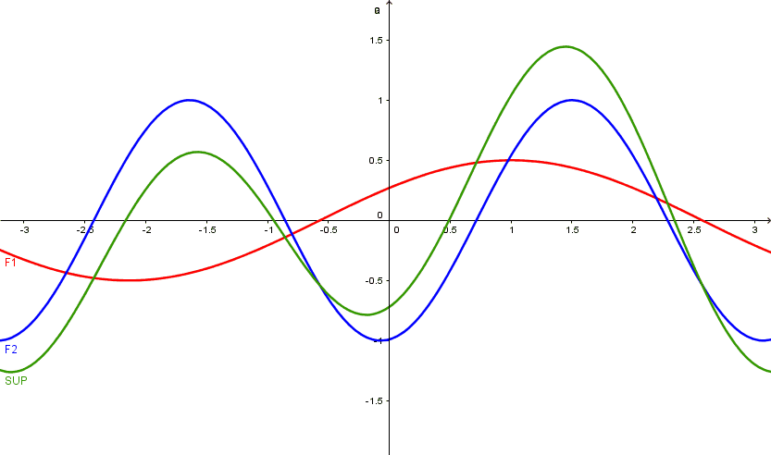
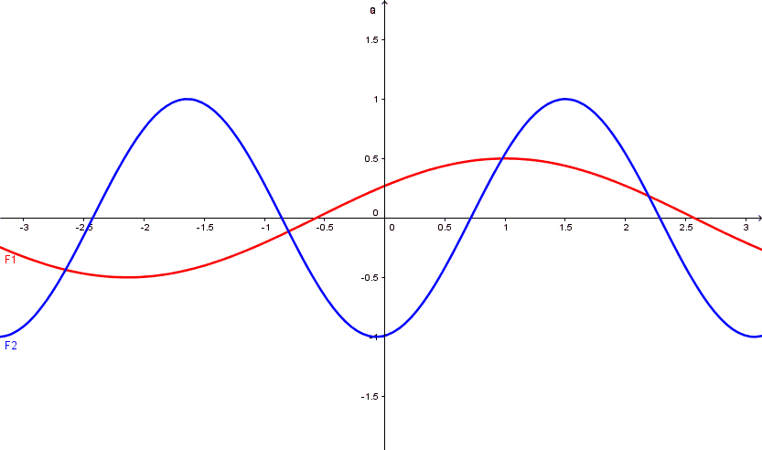
Introduction
Assumes semidiurnal tide (12h tide) only consists of wavenumber 1 and 2 components (S1 and S2).
Needs several stations spatially seperated measurements to determine the S1 and S2.

Slide 4
Motivation
Still many unanswered questions regarding spatial components of the tides.
Similar studies done sucessfully in the southern hemisphere. By e.g. Hibbins, Baumgaertner and Murphy.
Stray extracted tidal data to study planetary waves in here dissertation.

Slide 5
Scope of thesis
Climatology
Seasonal dependencies.
How much of the 12h tide is S1?
Differs from the southern hemisphere?
SSW
How does the S1 and S2 behave during SSW?
Auroral heating coupling to tides?
Aurora heating coupling to tides?
Trondheim 63°N
SSW

Slide 6
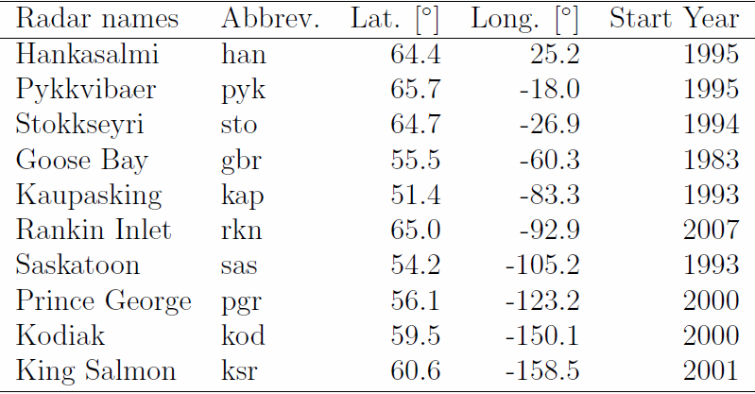
Data analysis – SuperDARN
Longitudinal chain of up to 10 radars.
Simultanious measurements at different longitudes at ~95 km.
«Ground-based satellite»
No spatial-temporal aliasing
Data from 2000-2008
http://vt.superdarn.org/assets/img/fovs_m.NH.gif
Notes:
When wanting to study spatial components of global-scale atmospheric waves spatial-temporal aliasing is a problem.
Single station measurement yields temporal wind data.
Satellite measurements (TIMED) 60 days to be over same place at same local time.

Slide 7
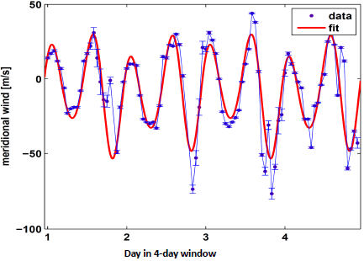
Data analysis – Wind data to 12h tide
4-day segments.
Fitting mean wind and tidal components (8h, 12h, 24h) and 48h.

Slide 8
Data analysis – Wind data to 12h tide
Notes:
Shifting the 4-day segment one day at a time resulting in the 12h daily amplitude at that station.
Get the amplitudes of the semidiurnal tide at each location.

Slide 9
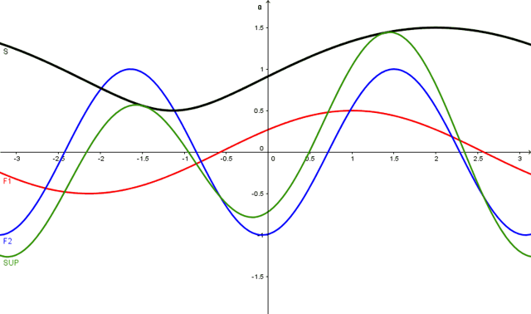
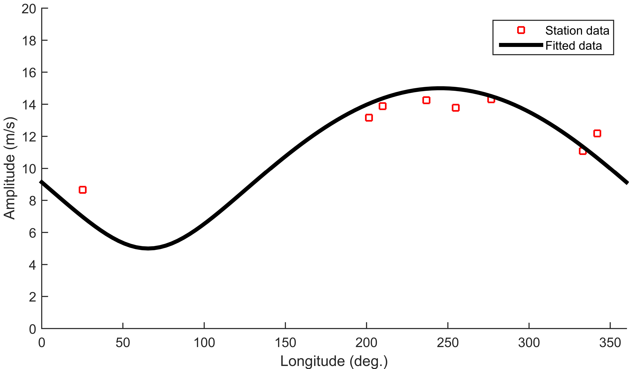
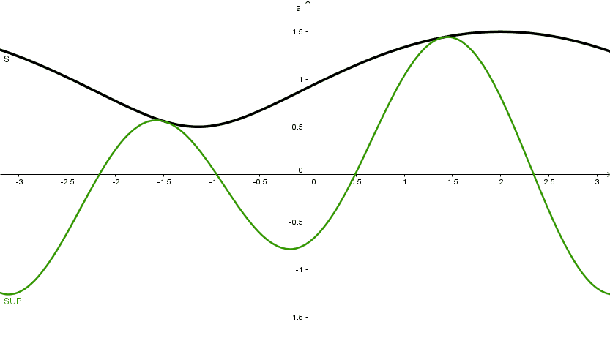
Data analysis – S1 and S2

Slide 10
Results – S1 & S2 amplitude data
S1
S2
Vary from year to year
The S2 shows the largest amplitudes.
At times S1 amplitude similar to the S2, hence making up half the 12h amplitude.

Slide 11
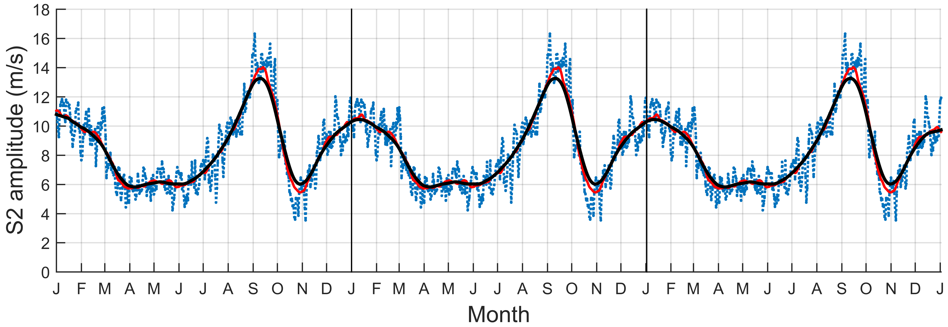
Results – Climatology
31 day boxcar (red) and triangular (black) smoothing of average raw data (blue).
Notes:
Repeated to smooth out climatology

Slide 12
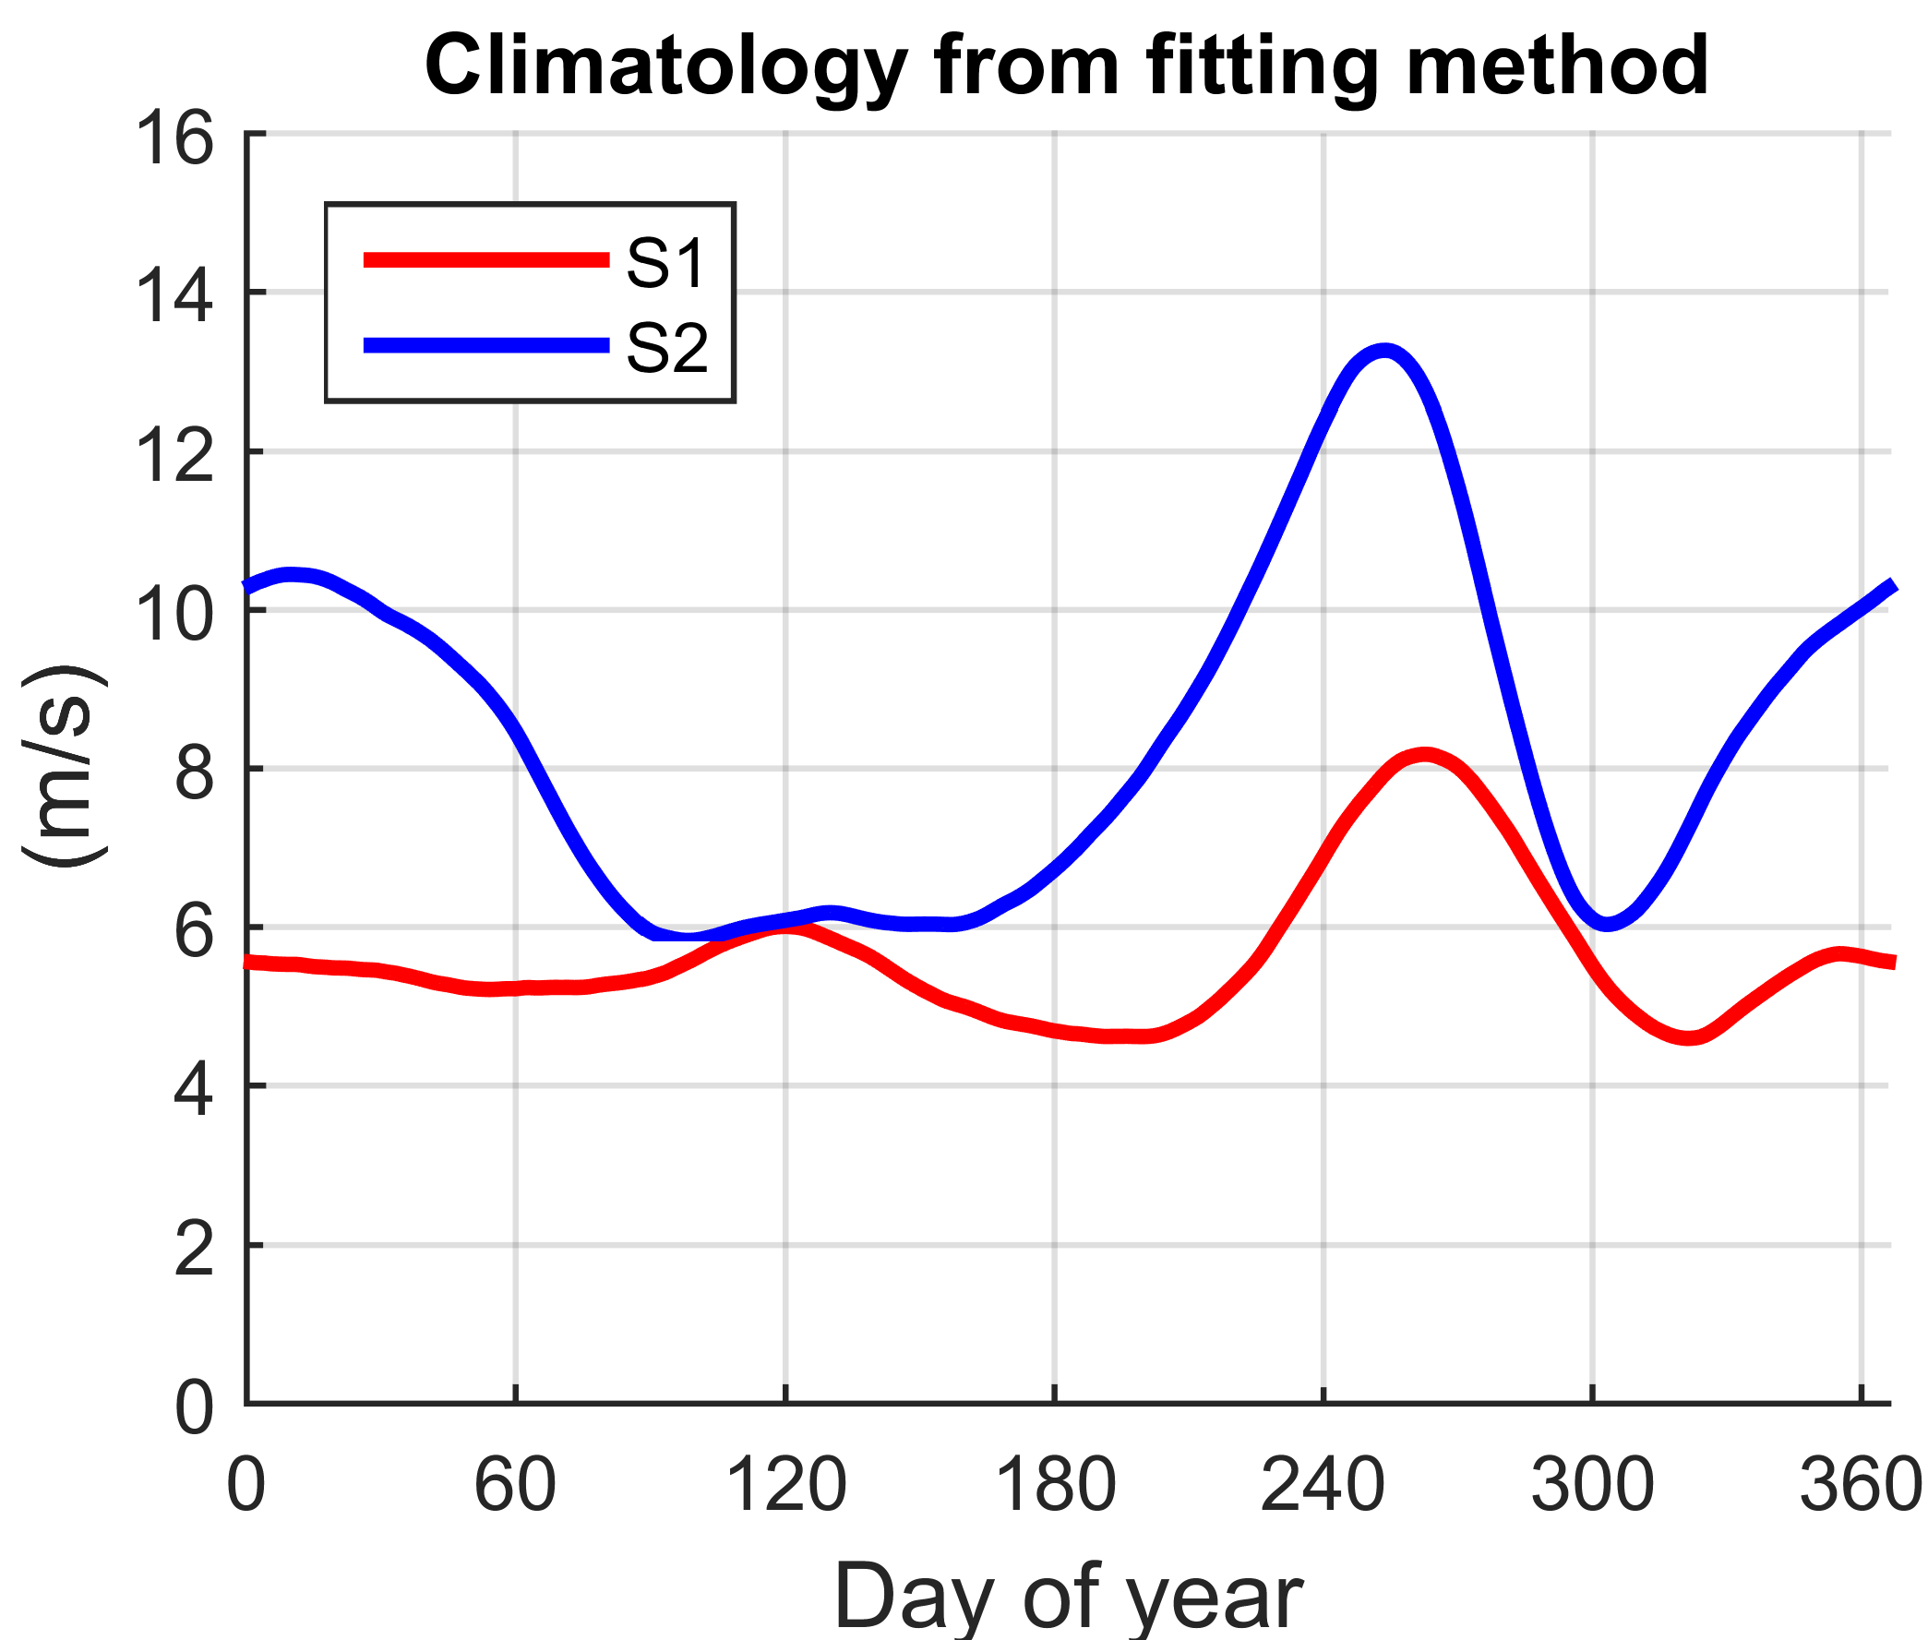
Results – Climatology
Maximums around fall equinox for both S1 and S2.
Maximum in winter for the S2.
Equal in spring, early summer, and late fall.
Used to calculate anomaly data.

Slide 13
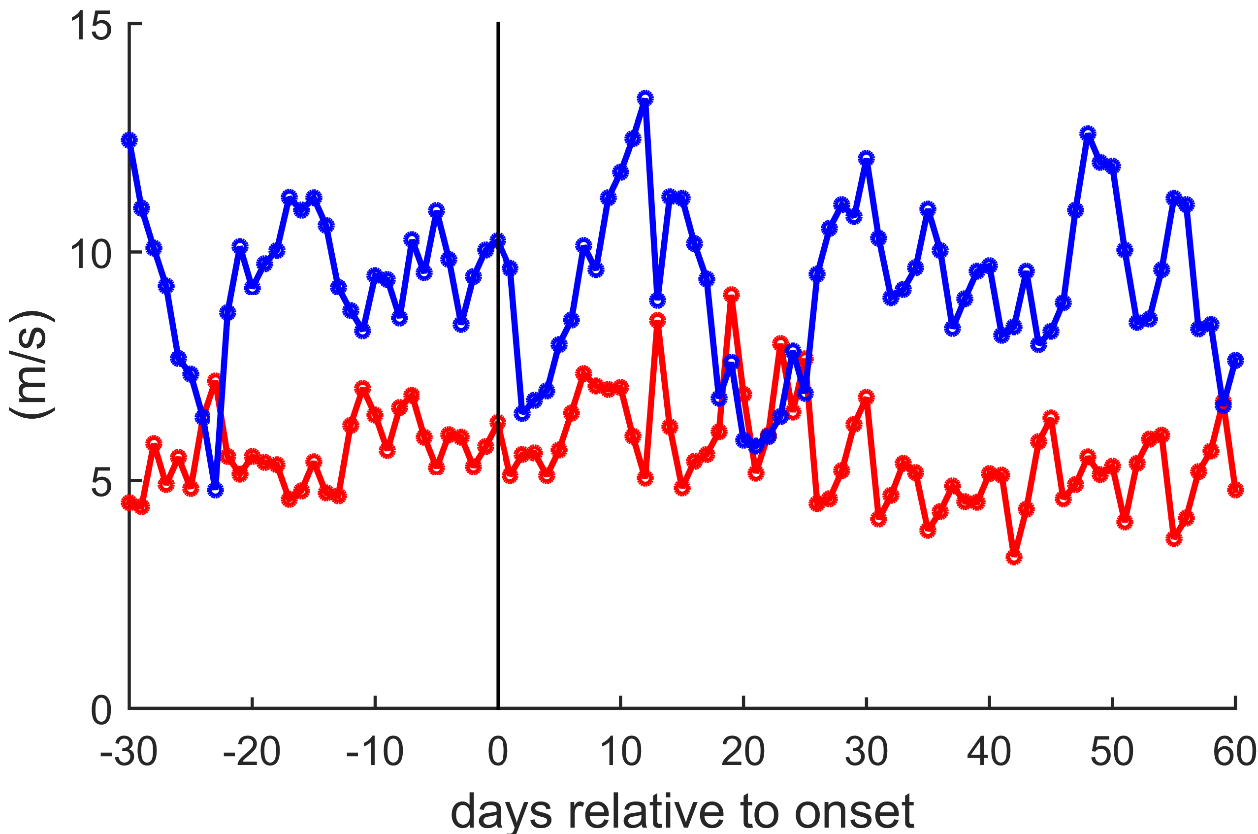
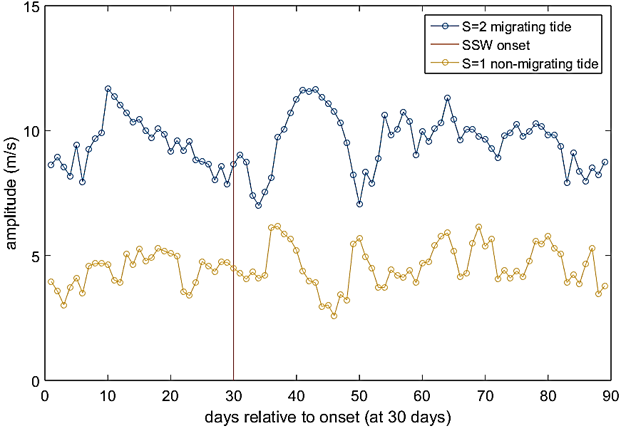
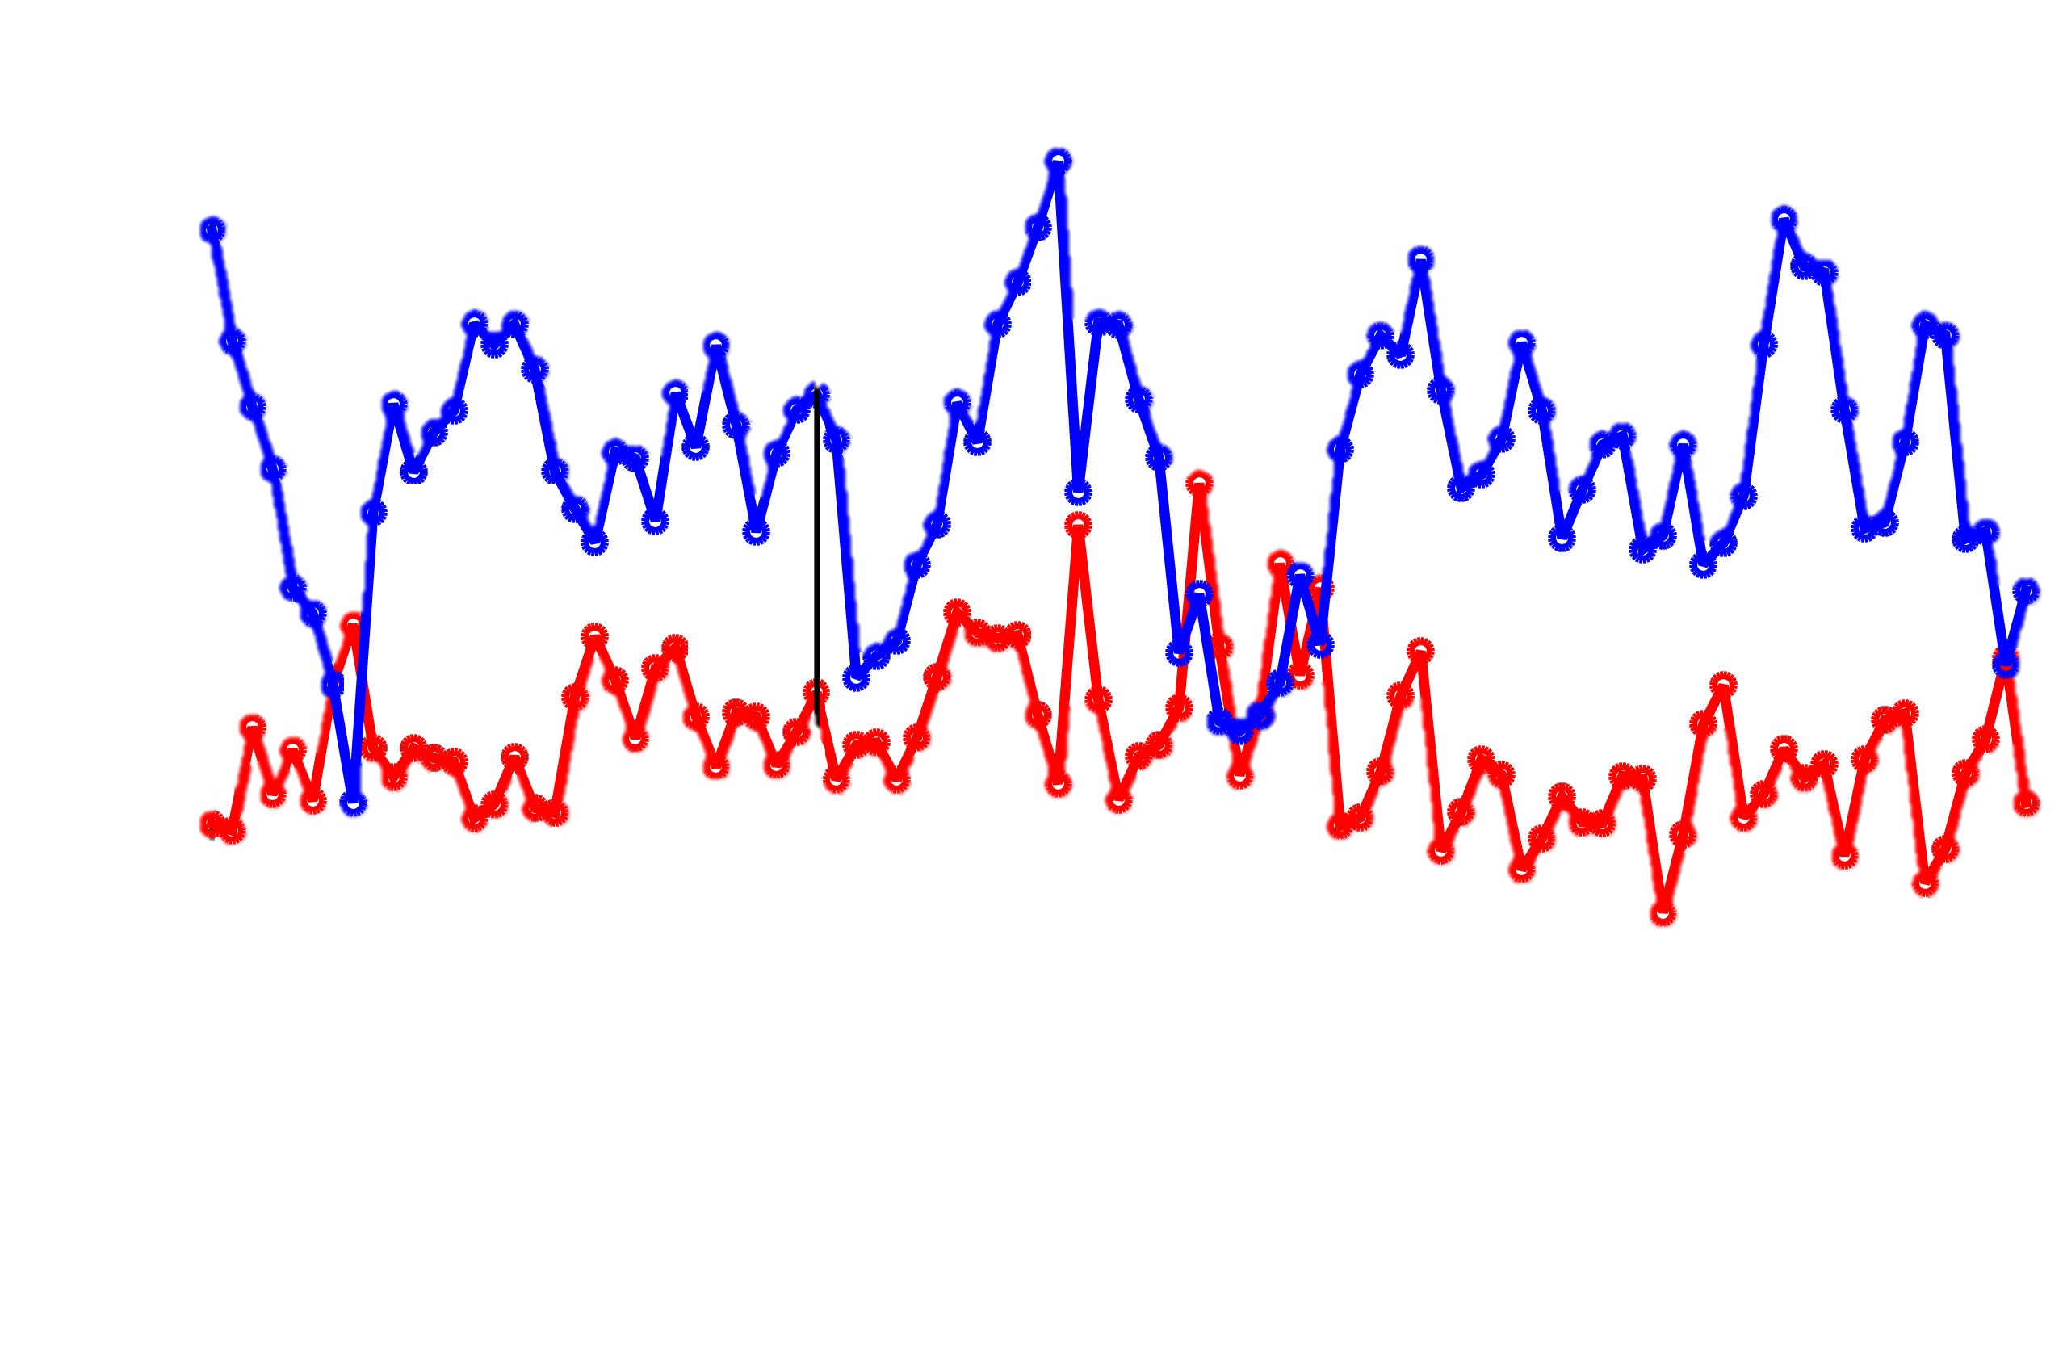
Results – SSW
Trondheim 63°N
7 SSW-ES events.
Super-posed epoch.
SSWs mainly S2 driven.
Could explain how SSW signal propagates southward through the ionosphere.
SSW
(Hibbins, personal contact 2016)

Slide 14
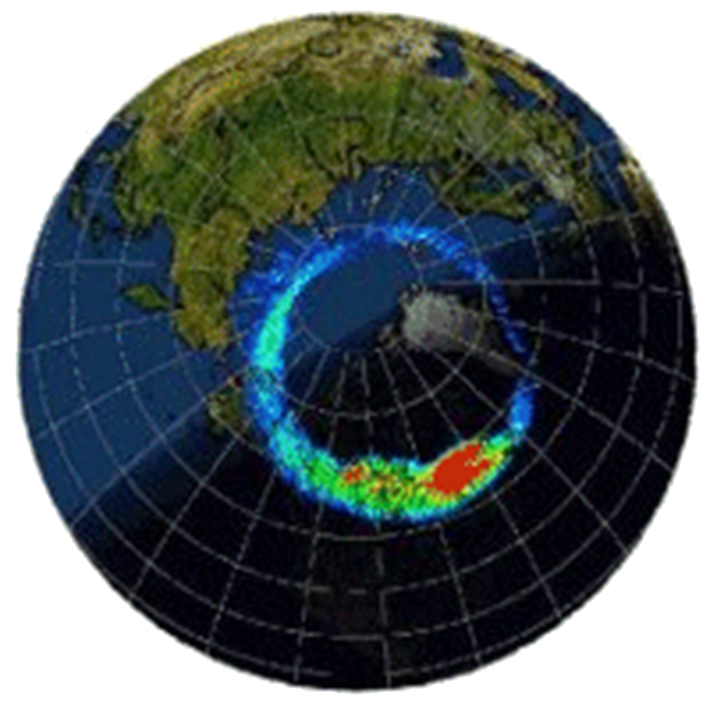
Auroral heating creating S1
Asymmetric heating around 60°N coupling with tides?
Proposed by Baumgartner (2006).
Correlating S1 amplitude and AE index.
60°N
Notes:
Asymmetric heating by the auroral oval creating a S1 structure which coupling with the S2 (proposed by Baum) can generate a S1 tidal wave.

Slide 15
Results – AE and S1 correlation
Correlation between S1 tidal amplitude and auroral electrojet (AE) index.
Weak but significant correlation, but only during solar minimum.
Clear 27-day cycle.
Notes:
Subtract of the climatology amplitudes to get anomaly amplitudes (de-seasonalized).
Persisting coronal holes could make

Slide 16
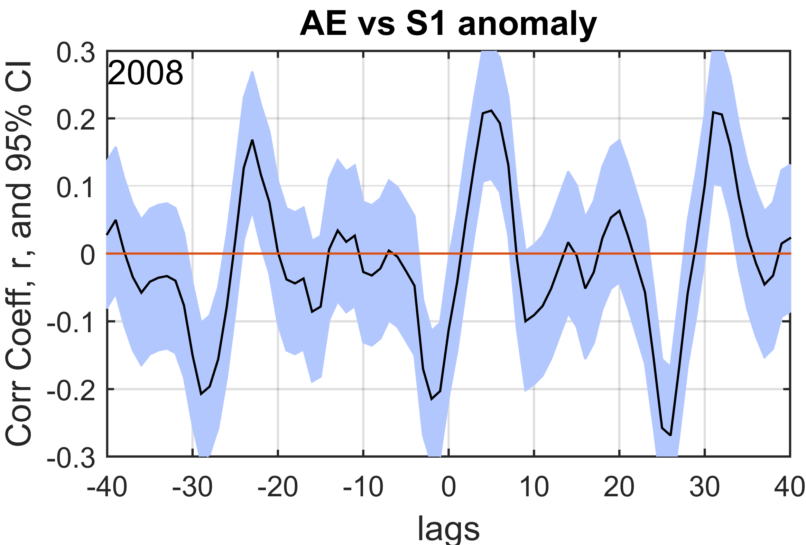
Results – AE and S1 correlation
Correlation between S1 tidal amplitude and auroral electrojet (AE) index.
Weak but significant correlation, but only during solar minimum.
Clear 27-day cycle.
27 days
Notes:
Subtract of the climatology amplitudes to get anomaly amplitudes (de-seasonalized).
Persisting coronal holes could make this 27 day cycle (Carrington Rotation).
Results does not say that S1 only generated during solar minimum, but that the conditions during solar minimum is so that it can be seen in the correlation.

Slide 17
Conclusion
Chain of SuperDARN radars able to separate S1 and S2 components of the semidiurnal tide.
S2 maximizes around fall equinox and winter months. S1 maximizes during fall.
Sometimes up to 50% of the tide is S1.
Enhancement in the S2 ~10 days after the SSW wind reversal.
Weak significant correlation (0.2-0.3) between S1 and AE index, but only during solar minimum.

