Slide 1
Atmospheric Circulation
Patrick Espy, NTNU

Slide 2
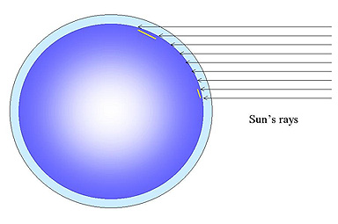
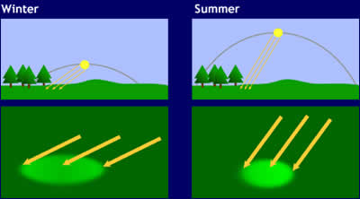
Surface and LOWER Atmospheric Heating Horizontal Structure in Latitude and Season
Sun’s energy spread over a larger area at Poles vs Equator
Sun’s energy spread over a larger area Winter vs Summer
Gives us the latitude (& seasonal) differences in heating

Slide 3
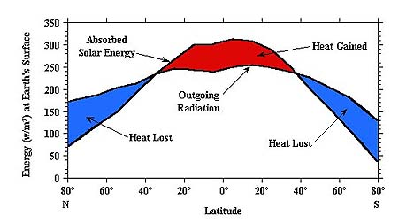
Gives a Net Latitude Imbalance of Absorbed vs. Radiated Energy
Solar Heating
falls due to Low sun and
High albedo

Slide 4
Gives a Net Latitude Imbalance of Absorbed vs. Radiated Energy
Radiative cooling P_{R} = σT⁴
Solar Heating
falls due to Low sun and
High albedo

Slide 5
Gives a Net Latitude Imbalance of Absorbed vs. Radiated Energy
Radiative cooling P_{R} = σT⁴
Solar Heating
falls due to Low sun and
High albedo

Slide 6
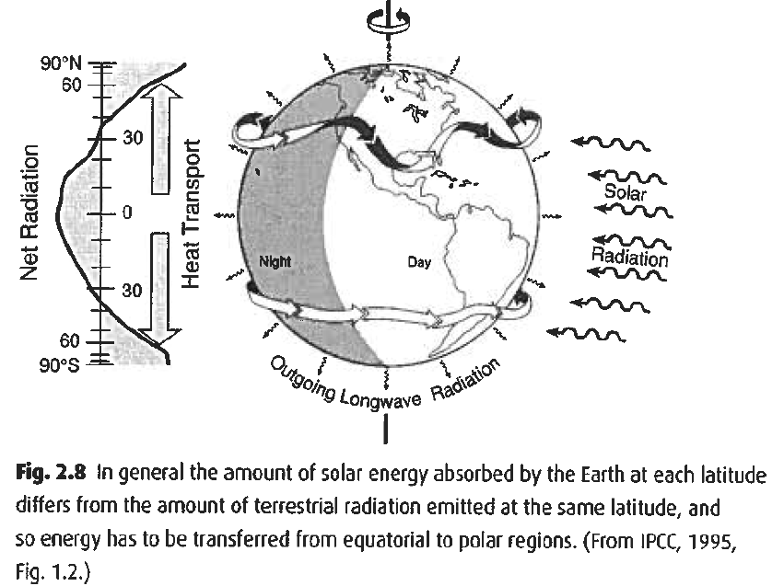
Means the Atmosphere Tries to Transport the Energy Polewards
Must transport energy to the poles
Air from equator rotating faster → cyclonic patterns
Means that Energy is pumped into the climate system at low latitudes and escapes at high latitudes
Find ~6x10¹⁵ W crossing 35º latitude ⇒ 179 MW/(m of longitude)

Slide 7
How Does the Air Move Horizontally
Newton’s Law (F = m⋅a) for a volume dV of density ρ :
Where F_{total} = F_{gravity}+F_{pressure}+F_{Coriolis}+F_{friction}
But atmosphere rapidly becomes hydrostatic in the vertical direction ⇒ vertical accelerations short-lived
Can consider only the horizontal directions of motion (So F_{gravity} is not a factor)

Slide 8
Look at the Forces- Friction
Air moving over terrain or against other air
  Terrain only effective in the first few hundred metres of the atmosphere
  Air-air friction negligible above ~ 1 km
Can be parameterized in terms of a roughness parameter
Outside of the Boundary Layer (z > 1 km) can usually drop the F_{friction} term

Slide 9
Look at the Forces- Pressure Force
High pressure next to low pressure = force
F_{pressure} = - ∇p⋅dV
    ∝ Size of the -pressure gradient
    ∝ Size of the parcel

Slide 10

How do we get pressure gradients
Temperature gradients lead to
Pressure gradients
P₃= 0
P₂< P₁
P₁< P_{o}
P_{o}

Slide 11
How do we get pressure gradients
Temperature gradients lead to
Pressure gradients
P₃= 0
P₂< P₁
P₁< P_{o}
P_{o}
P_{o}

Slide 12
How do we get pressure gradients
Temperature gradients lead to
Pressure gradients
∇p
∇p
∇p
P_{o}
P_{o}

Slide 13
How do we get pressure gradients
Temperature gradients lead to
Pressure gradients that force a wind
(from hot to cold)
P₂
P₃=0
P₂
P₁
P₁
P_{o}

Slide 14
Look at the Forces- Coriolis
Newton’s Law only valid in inertial (non-rotating) frame
News flash, the Earth rotates
Want to be able to use Newton’s Law in rotating frame
Introduce Coriolis force.

Slide 15
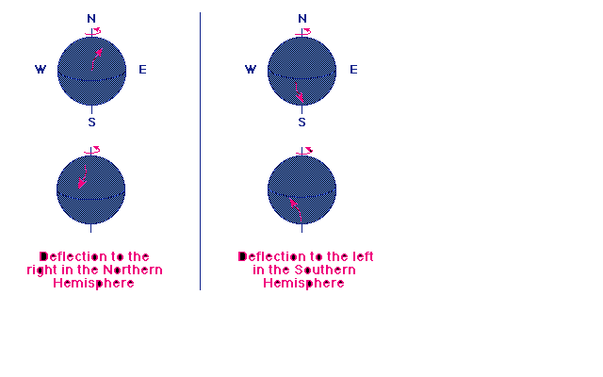
Look at the Forces- Coriolis
If not rotating, moves in a straight line as seen be fixed observer
In the rotating frame, see a curved path
F_{c} ⊗
Ω
u

Slide 16
Look at the Forces- Coriolis
F_{Coriolis} = (u x 2 Ω)⋅ρ⋅dV
    Ω = Earth’s angular velocity
    ϕ = Latitude
In the horizontal direction, F_{Coriolis}=2⋅Ω⋅sin(ϕ)⋅u⋅ρ⋅dV
= ƒ⋅u⋅ρ⋅dV
  Where ƒ is the Coriolis parameter and ϕ is the latitude
Air moving along latitude circles (meridional or N↔S)
experiences a force in the longitude (zonal or E↔W)
direction
F_{c} ⊗
Ω
u

Slide 17

Coriolis force

Slide 18
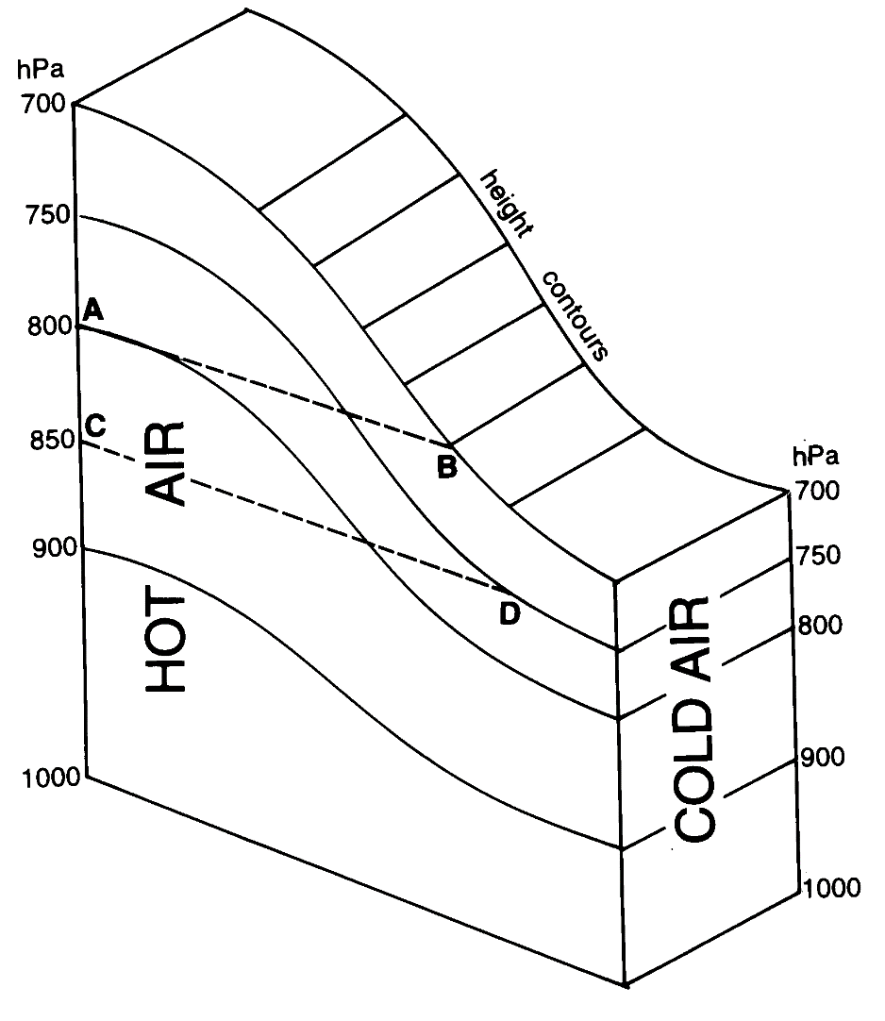
Main Dynamics Principles
Coriolis Effect
Motion to the pole
Deflects to E
Motion from the pole
Deflects to W
Pole
Equator

Slide 19
Main Dynamics Principles
Coriolis Effect
Motion to the pole
Deflects to E
Equator
Motion from the pole
Deflects to W
Pole

Slide 20
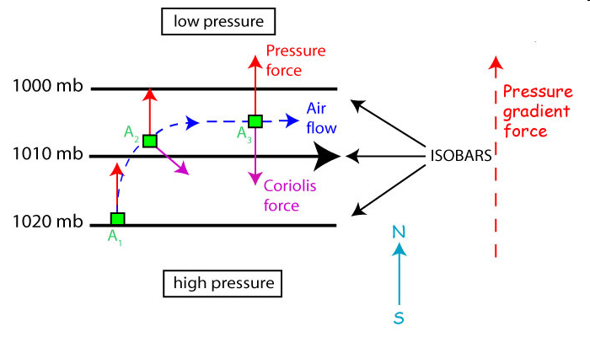
Geostrophic flow
In equilibrium, du/dt → 0
F_{pressure} + F_{Coriolis} = 0 in the horizontal
    2006. Steven C. Wofsy, lecture notes.
Flow parallel to lines of constant pressure
Where f = 2⋅Ω⋅sin(ϕ)

Slide 21
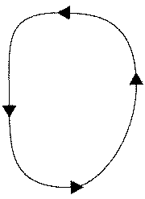
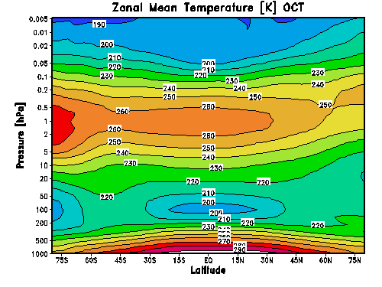
Very lowest layers-Troposphere
Air is dense
Water vapour is high
Sunlight absorption creates strong vertical gradients in temperature
This causes uplift
Air expands, cools and tries to descend
But is pushed to higher latitudes

Slide 22
Very lowest layers-Troposphere
Air is dense
Water vapour is high
Dense, cold descending air drags nearby air down with it
This air moves to higher latitudes at surface
Re-warms at surface and ascends again

Slide 23
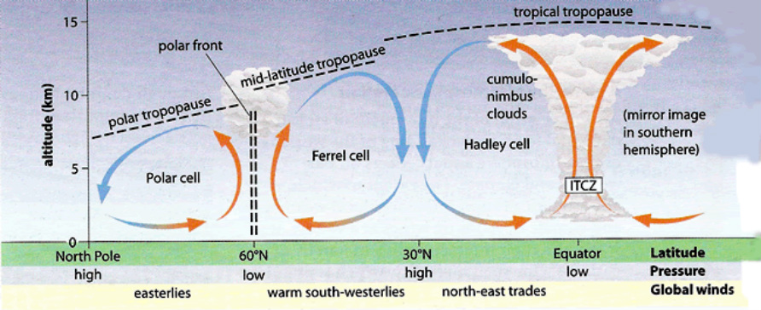
Very lowest layers-Troposphere
Air is dense
Water vapour is high
Get a third cell develop near poles

Slide 24
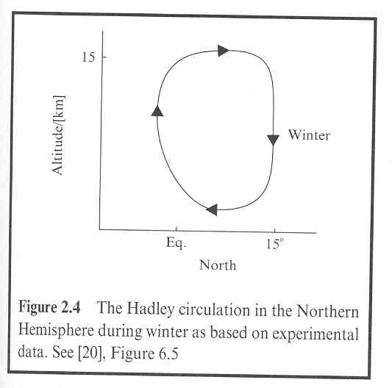
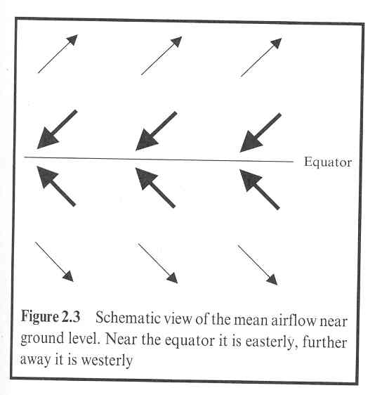
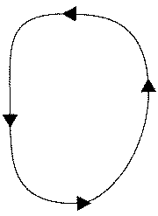
Hadley circulation and the surface trade winds
Winds Aloft in opposite direction
+15°
West
East
Surface Winds
-15°
Hot air at the equator is rising, and being replaced by colder air from the north/south.
When the air approaches the equator, the increasing rotational speed of the earth (closer to the equator) causes the air to move westward (easterly/from the east) relative to the surface of the earth. Motion away from equator turns eastward

Slide 25
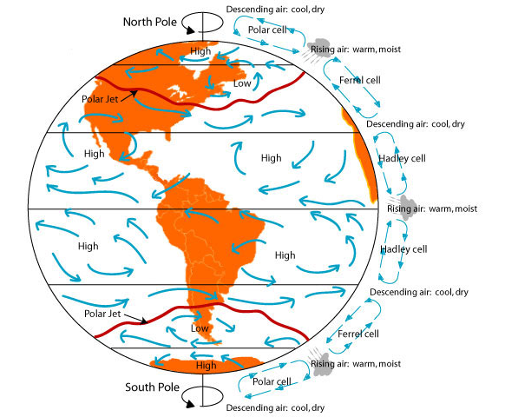
Heating not uniform in latitude
Horizontal temperature, pressure gradients⇒wind
Temperature (C)
Creates temperature gradients
Resulting in pressure gradients
Causes winds
Coriolis forces meridional winds easterly and westerly
(westward & eastward)
Easterly and westerly winds
Ozone
heating
Surface and H2O
heating

Slide 26
Heating not uniform in latitude
Horizontal temperature, pressure gradients⇒wind
Temperature (C)
Creates temperature gradients
Resulting in pressure gradients
Causes winds
Coriolis forces meridional winds easterly and westerly
(westward & eastward)
Fp
Fc
U
Easterly and westerly winds

Slide 27
Heating not uniform in latitude
Horizontal temperature, pressure gradients⇒wind
Temperature (C)
What happens in the mesosphere?
Coldest in summer
Winds reverse
Why
Easterly and westerly winds

Slide 28
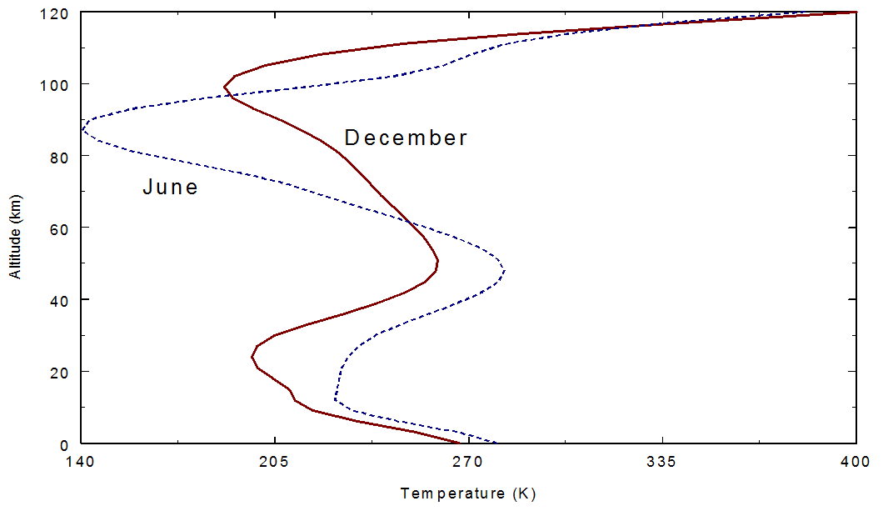
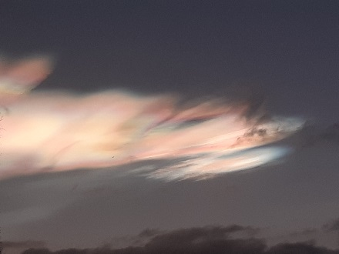
Atmospheric Temperature Structure
Northern Hemisphere
Seasonal variation: Stratosphere & Troposphere look logical
Notes:
PSC taken Trondheim 9 Jan
Water ice, Radii 6μm

Slide 29
Atmospheric Temperature Structure
Northern Hemisphere
Seasonal variation: Stratosphere & Troposphere look logical
What’s up with the mesosphere?
Dynamics
Notes:
Leave it here and go to summary

Slide 30
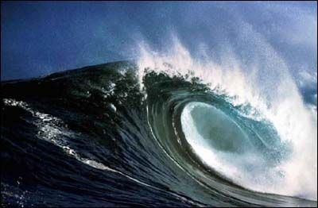
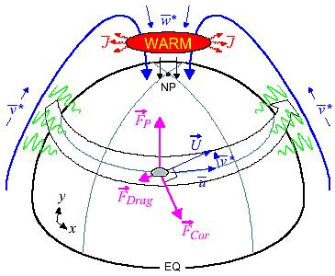
Higher Still (Mesosphere), Friction from Breaking Waves
Waves generated at low altitudes
Propagate upward in the atmosphere
Amplitude grows as density decreases
Break and deposit momentum
Creates friction at high altitudes
Friction is anti-parallel to u
This kicks the winds:
  To the pole in winter
  From the pole in summer

Slide 31
Why the cold summer mesosphere?
Seasonal variation: Stratosphere & Troposphere look logical
What’s up with the mesosphere? Dynamics
Notes:
Leave it here and go to summary

Slide 32
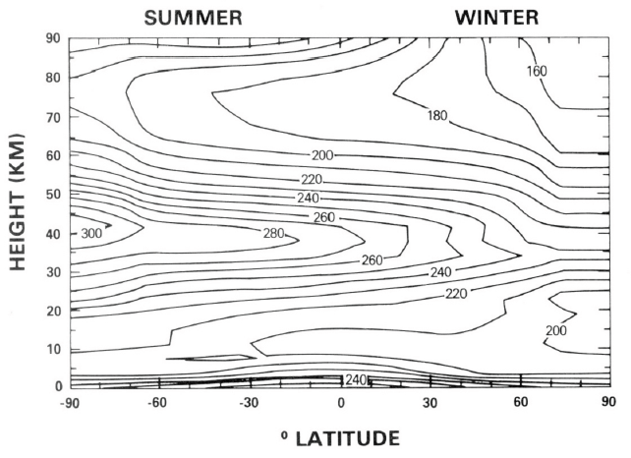
Pure Radiative Equilibrium

Slide 33
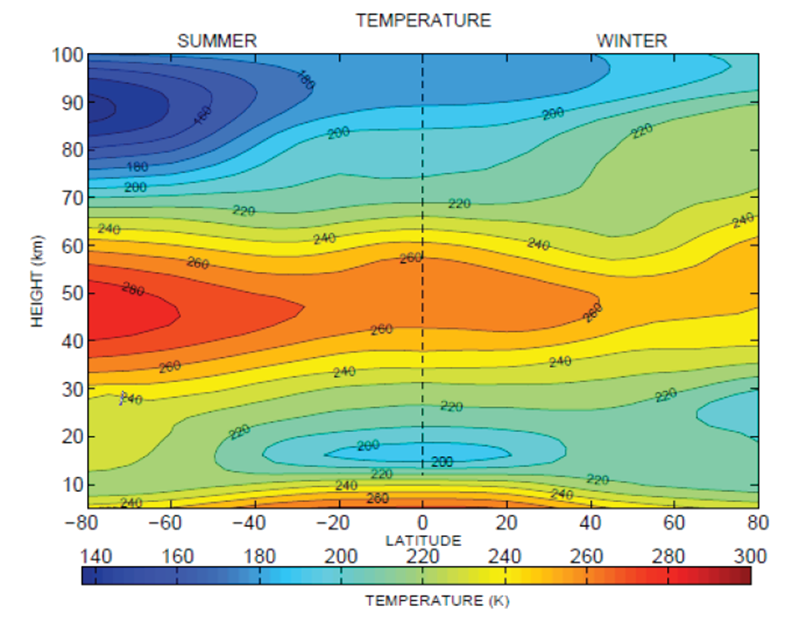
Dynamic Equilibrium
Pure Radiative Equilibrium

Slide 34
Atmospheric Temperature Structure
Dynamics makes the summer mesopause the coldest place on Earth
Cold enough so the part per million of water vapour forms clouds

Slide 35
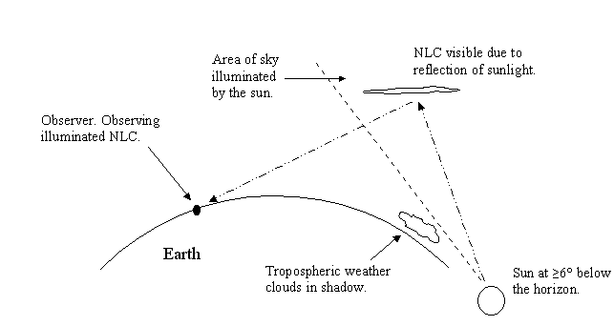
Consequences: NOCTILUCENT CLOUDS?

Slide 36
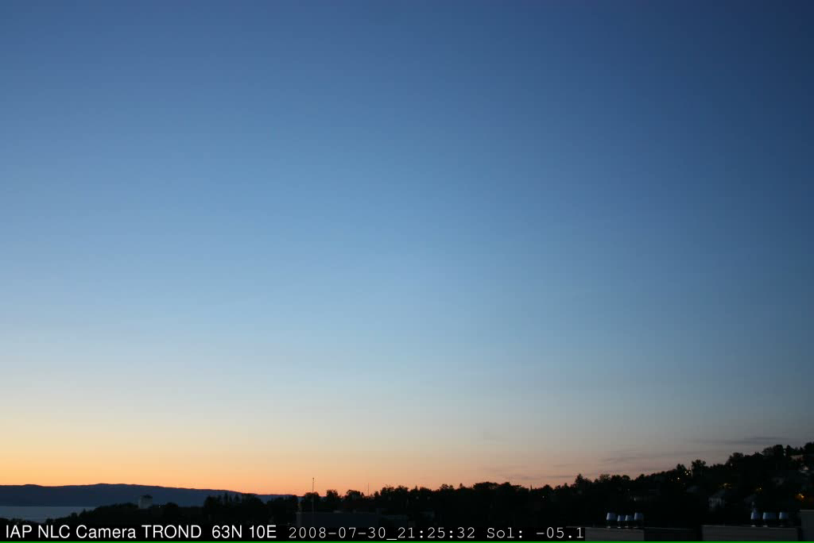
See the Waves in High Altitude Clouds

Slide 37
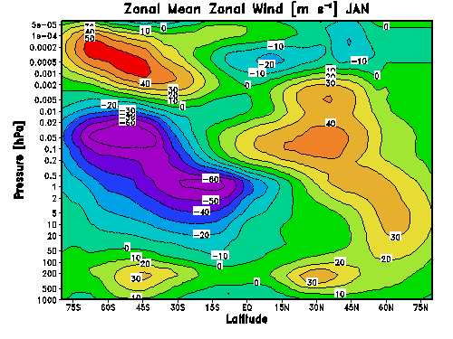
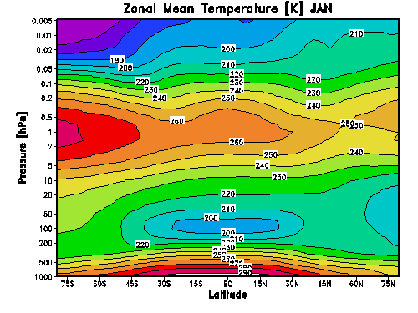
Seasonal cycle in Temperature and Wind
Summer
Winter
Summer
Winter

Slide 38
Summary Troposphere
Differential absorption of solar energy with latitude
  Lower Troposphere—radiative equilibrium—H₂O heating & return flow
    Wind rises at equator, cools, and as it moves to poles sinks
    Forces air at surface to flow to the equator
    Coriolis Bends the Surface Winds
    Trade winds near the equator (W_{w})
    Note, surface friction high—makes winds variable!
  Upper Troposphere—radiative equilibrium—H₂O heating
    Radiative driven latitudinal temperature gradients (minor species)
    Wind Flow Equator to Poles
    Coriolis Bends the Upper Troposphere Winds
    Zonal Wind Jet-Streams (E_{w})

Slide 39
Summary Stratosphere
Differential absorption of solar energy with latitude
  Below Stratopause—radiative equilibrium—O₃ heating
    Radiative driven latitudinal temperature gradients (minor species)
    Wind Flow Latitudinal (Meridional – Np ↔ Sp)
    Coriolis Bends the Winds
    Zonal Wind Jets (E↔W)

Slide 40
Summary Stratosphere-Mesosphere
Differential absorption of solar energy with latitude
  Below Stratopause—radiative equilibrium—O₃ heating
    Radiative driven latitudinal temperature gradients (minor species)
    Wind Flow Latitudinal (Meridional – Np ↔ Sp)
    Coriolis Bends the Winds
    Zonal Wind Jets (E↔W)
  Above Stratopause—dynamic equilibrium—Wave driven
    Zonal wind jets slowed by wave breaking momentum
    Creates flow from summer (expansion-cooling) to winter pole (converges-heats)
  Pole-to-pole flow in mesosphere transports species
    Does it cause feedbacks to dynamics since these are the minor species that started the whole circulation in the first place??

