Slide 1
The Arctic Stratosphere Polar Vortex Breakdown and Its Impact
Objectives
Disturbances
Review the Sudden Stratospheric Warming (SSW) phenomena and its importance
Highlight large-scale upper atmospheric dynamics related to SSW and their significance
SSW
Credits: Clark Christensen, BYU

Slide 2
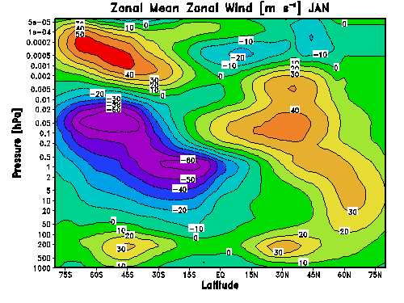
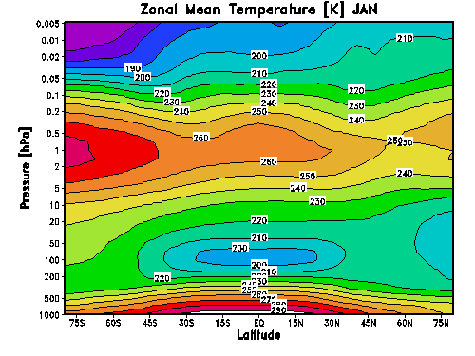
Seasonal cycle in Temperature and Wind

Slide 3
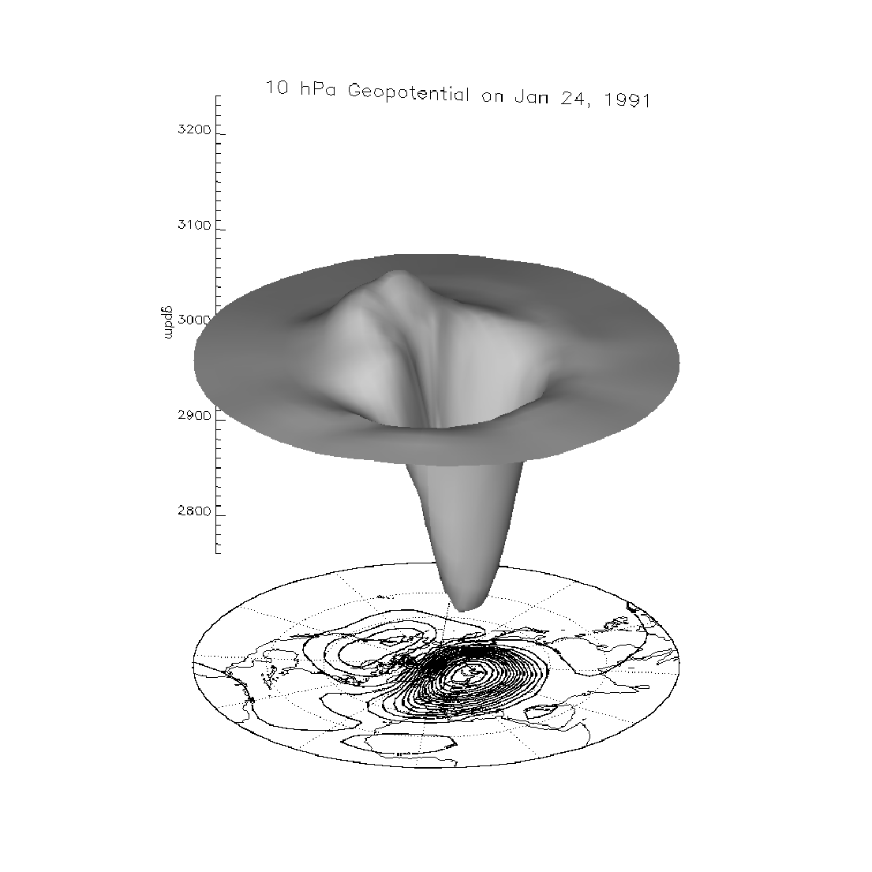
The wintertime stratospheric polar vortex (polar night jet)
In winter, the negative meridional temperature gradient between equator and pole leads to a strong westerly jet in the stratosphere ~60°N („Polar Night Jet“) which forms a mixing barrier between polar and mid-latitudes.
Geopotential height at 10 hPa (24th Jan. 1991)
3200
Polar vortex
gph (dm)
Westerlies
“PNJ”
2800
In the polar vortex:
Isolated air masses
Very cold temperature
If temperature < 195 K ⬄ Polar stratospheric clouds (PSCs) are formed (in the range 15-25 km)

Slide 4
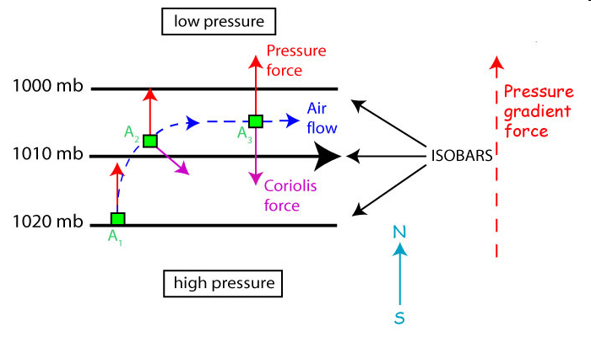
Geostrophic flow
In equilibrium, du/dt → 0
F_{pressure} + F_{Coriolis} = 0 in the horizontal
    2006. Steven C. Wofsy, lecture notes.
Flow parallel to lines of constant pressure
Where f = 2⋅Ω⋅sin(ϕ)

Slide 5
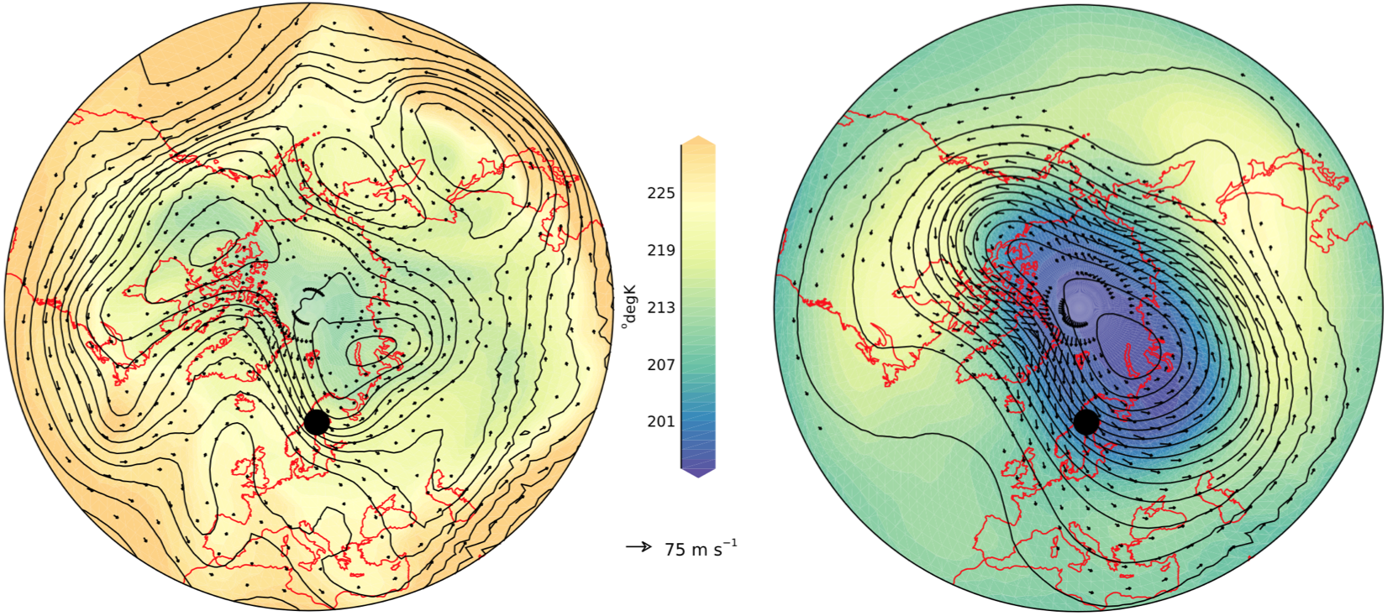
Circumpolar flow dominates the wintertime circulation: Jet Stream & Polar Vortex.
Troposphere (7 km)
Stratosphere (25 km)
1 Jan 2009 (before SSW onset)
1 Jan 2009 (before SSW onset)
NTNU
Data: NASA MERRA Re-analyses

Slide 6
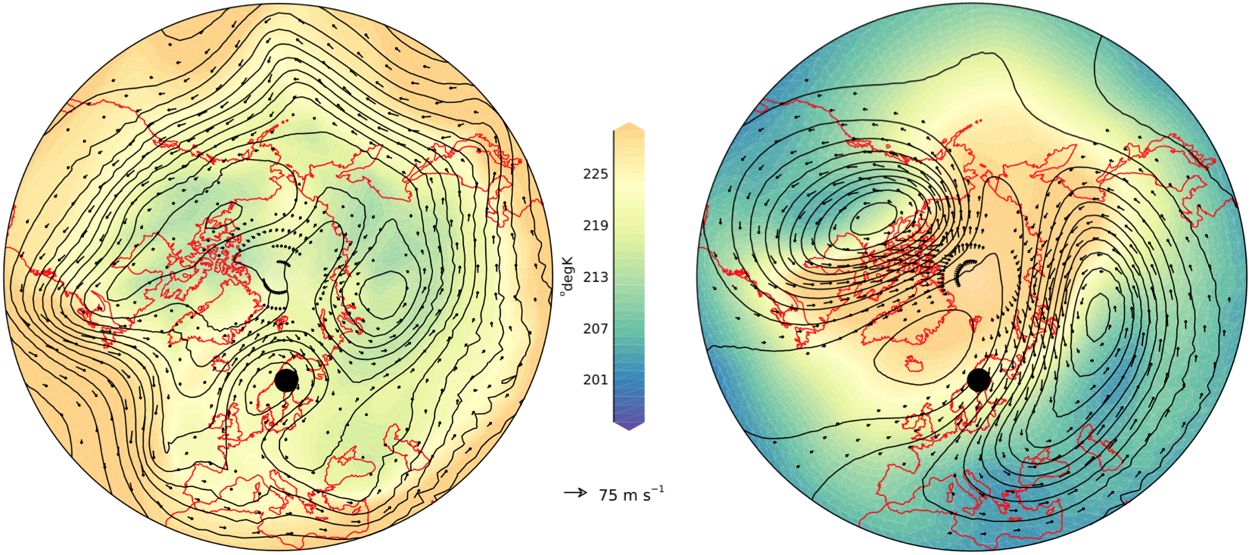
Circumpolar flow dominates the wintertime circulation: Jet Stream & Polar Vortex.
Troposphere (7 km)
Stratosphere (25 km)
1 Feb 2009 (after SSW onset)
1 Feb 2009 (after SSW onset)
NTNU
Data: NASA MERRA Re-analyses

Slide 7
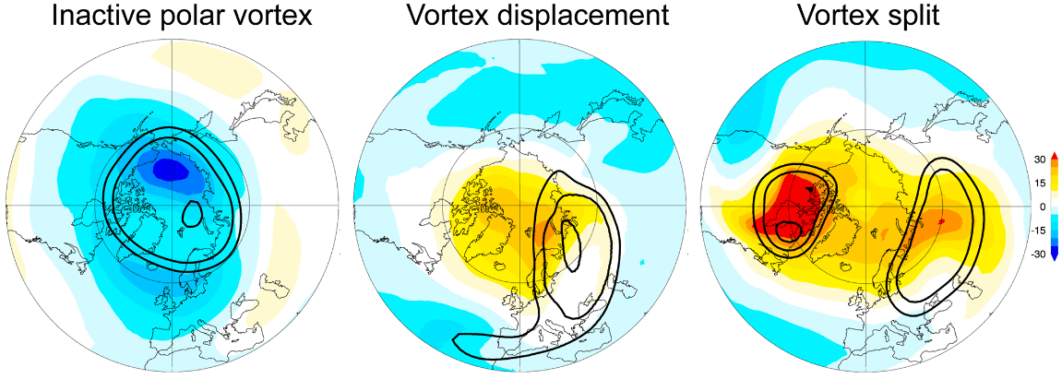
SSWs
the most dramatic phenomenon in the wintertime polar stratosphere (Scherhag, 1952)
→Increase in temperature in the polar stratosphere in wintertime
→ Abrupt weakening and occasionally even the breakup of the polar vortex
WMO Criterion for Major SSWs identification: Simultaneous reversal of:
  the zonal-mean zonal wind at 60N and 10 hPa
  the zonal-mean temperature difference between 60N and 90N at 10 hPa

Slide 8
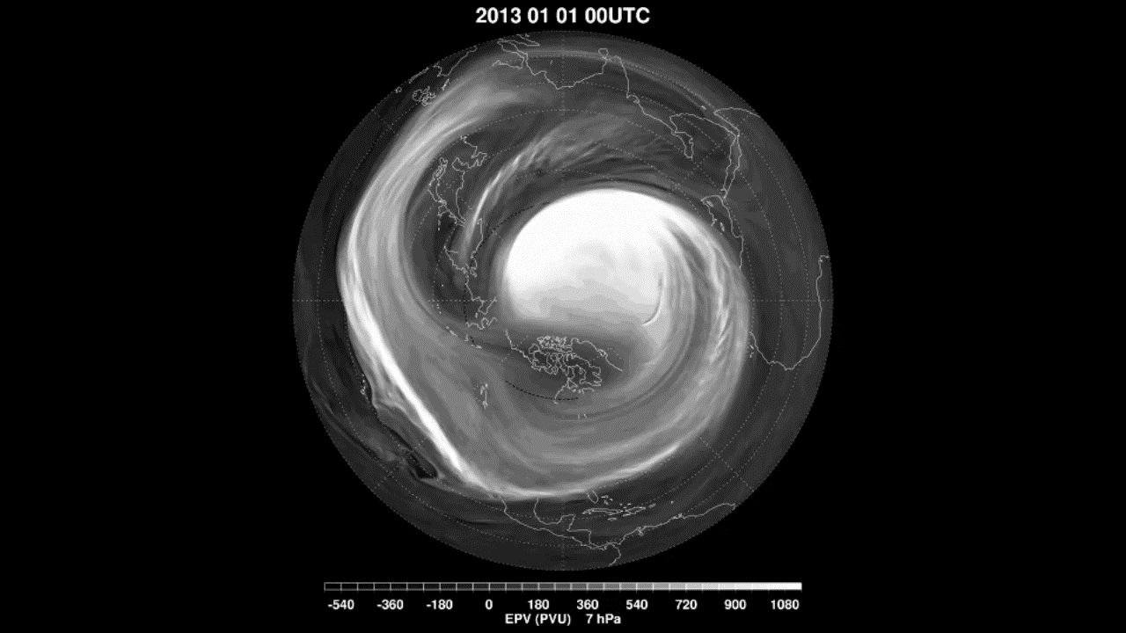
Stratospheric warming in January 2013
potential vorticity («dynamical» tracer)
(white is polar air, dark is tropical air)
7 hPa, near 32 km

Slide 9
Remarks
    Non-linear phenomenon
    Simulation shows fluid-like mixing and turbulence (like milk in a coffee cup)
    Fluid vortices, sometimes shed and pulled apart, sometimes merging
    Filament and ribbons of fluid are mixed across all latitudes : rapid mixing of tropical and polar air

Slide 10
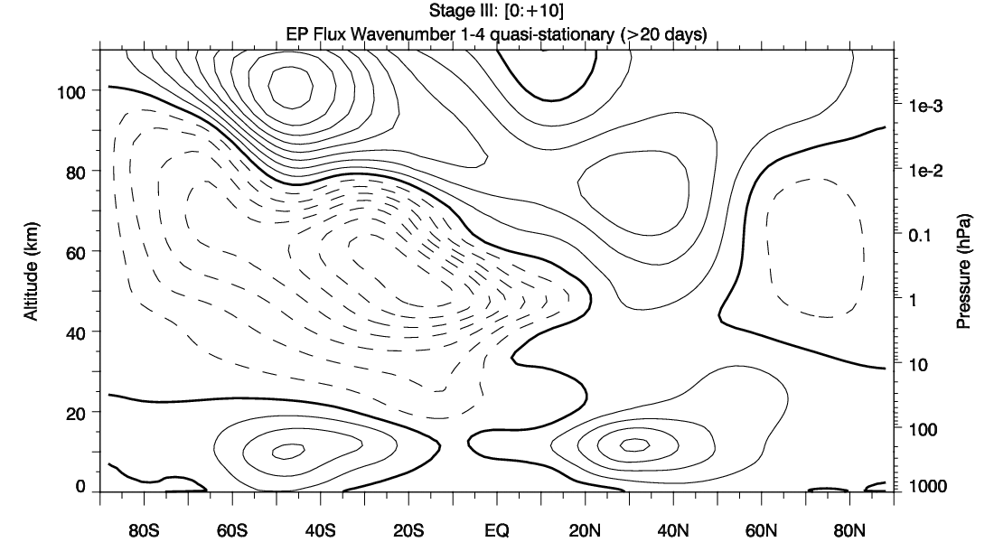
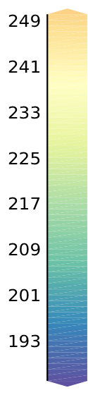
Longitudinally Averaged Wind [u] & Temperature [T]
SSW ONSET means REVERSAL : Summer-like circulation (westward) in the middle of winter
1 Jan 2009 (before SSW onset)
1 Feb 2009 (after SSW onset)
EASTWARD
JET
40
40
WESTWARD
JET
30
30
Warm
Cold
Altitude (km)
Altitude (km)
20
20
10
10
0
0
EQ
20°N
40°N
60°N
80°N
EQ
20°N
40°N
60°N
80°N
Data: NASA MERRA Re-analyses
[u] westward
[u] eastward
[u] = 0
Notes:
.

Slide 11
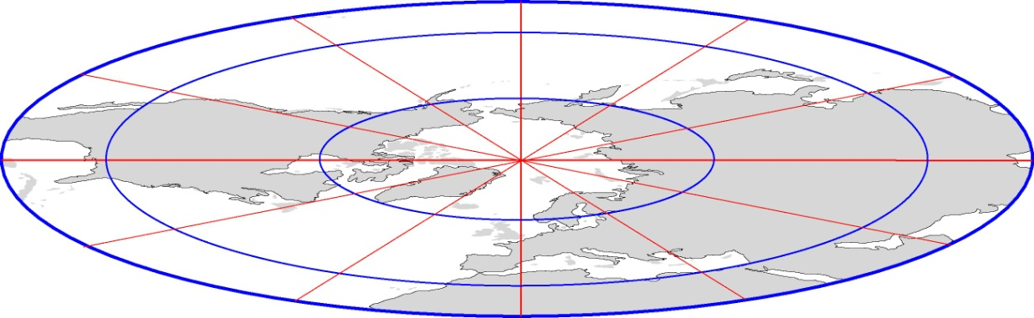
Planetary waves (PWs) propagate from the troposphere to the upper stratosphere, distorting the circumpolar flow ( polar vortex)
Mesosphere
Ultra-long waves
  Longitudinal wavenumbers 1-2
  Zero phase speed (cr=0)
50 km
Ultra-long waves
Stratosphere
Quasi-stationary waves are Forced :
  Topography
  Thermal contrast between land and ocean
  More prominent in the northern hemisphere
Polar Vortex
12 km
Troposphere

Slide 12
Surface impacts (e.g. on weather)

Slide 13
North Atlantic Oscillation (NAO)
The NAO is the dominant mode of winter climate variability in the North Atlantic region ranging from central North America to Europe and much into Northern Asia.
The NAO is a large scale seesaw in atmospheric mass between the subtropical high and the polar low.
The corresponding index varies from year to year, but also exhibits a tendency to remain in one phase for intervals lasting several years
The positive NAO index phase shows a stronger than usual subtropical high pressure center and a deeper than normal Icelandic low.
The negative NAO index phase shows a weak subtropical high and a weak Icelandic low.

Slide 14
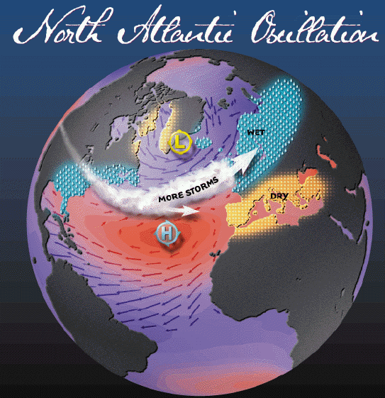
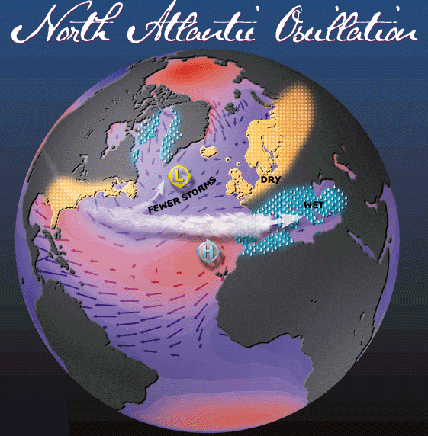
NAO +
NAO -
NAO +
  Stronger subtropical high pressure
  Deeper Icelandic low.
  Intense northerly storm track.
NAO -
  Weaker subtropical high pressure
  Shallow Icelandic low.
  Less intense, southerly storm track.

Slide 15
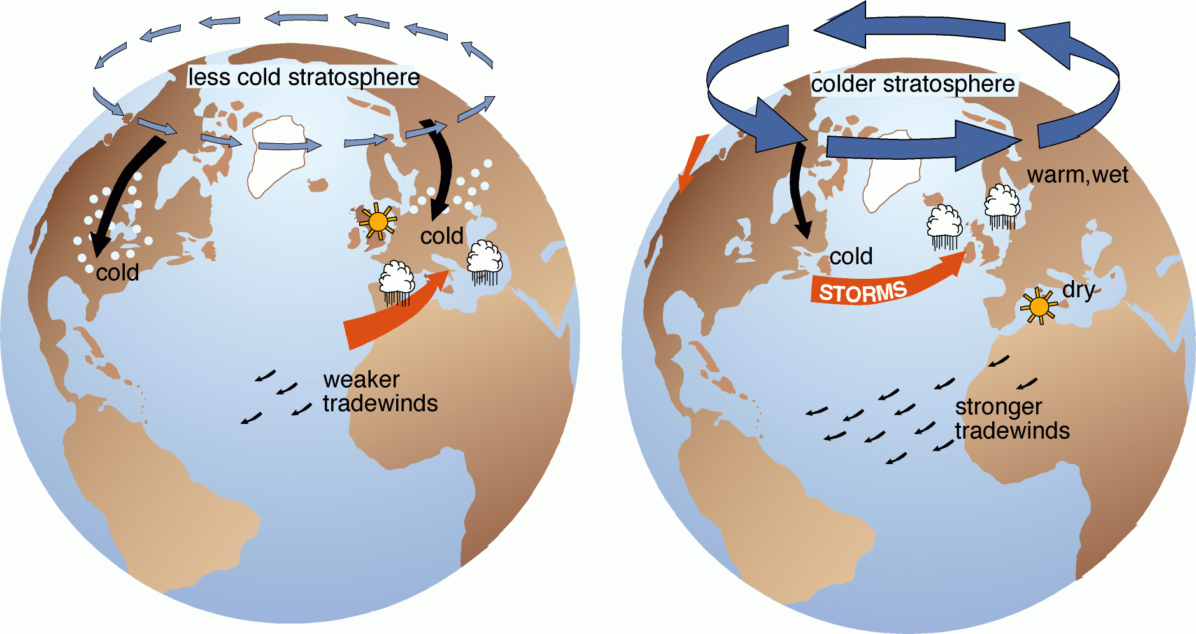
The Northern Hemisphere Annular Mode (NAM) dominates the wintertime variance.
Negative NAM phase
Positive NAM phase
Courtesy of D. W. Thompson @ Colorado State University
Notes:
The NAM is the leading mode of climate variability accounting for nearly 1/3 of the wintertime departure from climatology. The NAM “see-saw” fluctuation has no preferred period, so very difficult to pinpoint a cause.
The fluctuation in jet and waves affects the climate near the surface and in the stratosphere
We have found that we can realistically simulate the NAM using a realistic computer with the ocean in its climatological state. Thus, the NAM appears to be independent from anomalous ocean changes (particularly, the anomalous warming of the eastern equatorial Pacific ocean associated with El Nino).
We tend to think of the NAM as purely dynamical and natural modes result of complex interaction between with waves and jets.
The NAM acts like a “master switch” that can alter the climate north of 20N. When the switch is on HIGH, warm and wet conditions over N. Europe associated with more intense storm. Drought condition over Mediterranean areas. Mild temperatures over the Eastern US. The stratosphere is also much colder with stronger vortex.
When the switch is on LOW, usually wetter over Southern Europe. Clearer but much colder over Northern Europe. The eastern US is also cooler. The stratosphere is unusually warm with weaker vortex.
Of note, is that the NAM shows great extension into the stratosphere with cold and stronger vortex during the HIGH NAM.

Slide 16
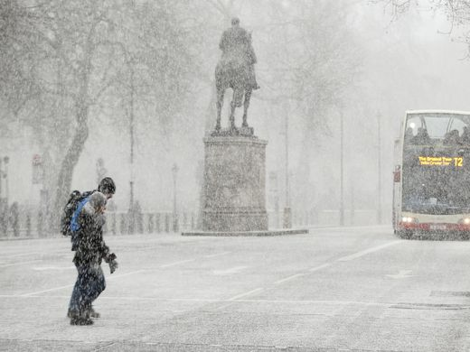
A case study of an extreme cold in Europe in late February 2018

Slide 17
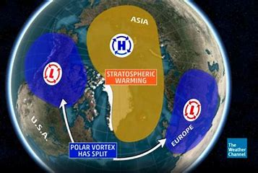
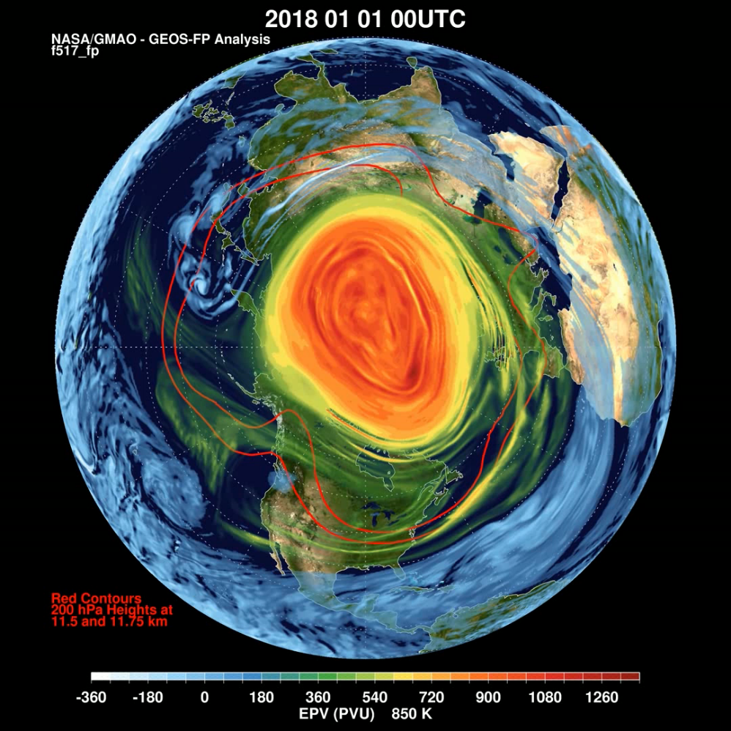
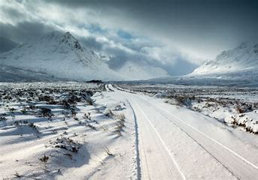
Stratospheric sudden warming FEB 2018
Polar vortex split and Cold air outbreaks over Europe, North America, Eurasia

Slide 18


Slide 19
A major sudden stratospheric warming (SSW) event around 10 Feb 2018
W
Time
(days)
Figure 2. Latitude-time cross sections of (a) zonal-mean temperature (units: K) and (b) zonal-mean zonal wind (units: m s⁻¹) at 10 hPa during the winter of 2017/18.
W
  Rapid warming at the pole (30 degrees in a few days !)
  zonal wind decelerates and reverses rapidly

Slide 20
Stratospheric sudden warming FEB 2018
  Evidence for a lagged negative wind anomaly in troposphere
  zonal wind anomaly occurs nearly at once, within entire stratosphere (10-200 hPa)

Slide 21
Time series of the surface temperature anomalies averaged over the European region (40-70°N, 0-60°E).

Slide 22
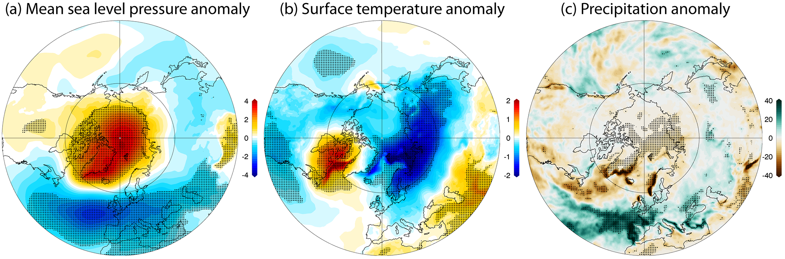
Surface impacts of stratospheric warmings : average picture
Mean over a two-month period after onset
Butler et al., 2017

Slide 23
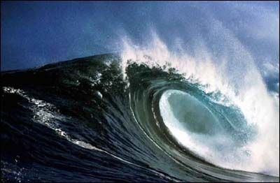
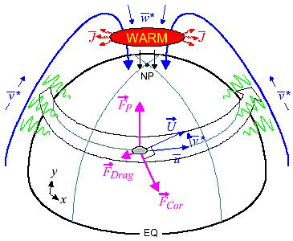
Higher Still (Mesosphere), Friction from Breaking Waves
Waves generated at low altitudes
Propagate upward in the atmosphere
Amplitude grows as density decreases
Break and deposit momentum
Creates friction at high altitudes
Friction is anti-parallel to u
This kicks the winds:
  To the pole in winter
  From the pole in summer

Slide 24
Thermal wind balance
Jet
Altitude
Warm
Cold
Equator
[u] eastward
North Pole
06
Notes:
Before we proceed further, let’s make sure that we are clear on the terminology of that we are using.
We have latitude being from south to north pole. We have longitude begin from east to west.
We have altitude being away from the surface.
We can look at an altitude versus latitude cross-section.
We have the troposphere, stratosphere, and the mesosphere.
During the Northern Hemisphere wintertime, there is a vortex that extends from the upper troposphere to the lower mesosphere.
The vortex is circumpolar wind. The core of the vortex is cold and dark.
As this movie shows, the vortex is wobbly and its boundary is typically wavy.

Slide 25
Thermal wind balance
J
Westward
Altitude
Warm
Cold
Equator
[u] eastward
North Pole
Wave Forcing
06
Notes:
Before we proceed further, let’s make sure that we are clear on the terminology of that we are using.
We have latitude being from south to north pole. We have longitude begin from east to west.
We have altitude being away from the surface.
We can look at an altitude versus latitude cross-section.
We have the troposphere, stratosphere, and the mesosphere.
During the Northern Hemisphere wintertime, there is a vortex that extends from the upper troposphere to the lower mesosphere.
The vortex is circumpolar wind. The core of the vortex is cold and dark.
As this movie shows, the vortex is wobbly and its boundary is typically wavy.

Slide 26
Thermal wind balance
Vertical Wind Shear Reduced
J
Westward
Altitude
Warm
Cold
Equator
[u] eastward
North Pole
Wave Forcing
06
Notes:
Before we proceed further, let’s make sure that we are clear on the terminology of that we are using.
We have latitude being from south to north pole. We have longitude begin from east to west.
We have altitude being away from the surface.
We can look at an altitude versus latitude cross-section.
We have the troposphere, stratosphere, and the mesosphere.
During the Northern Hemisphere wintertime, there is a vortex that extends from the upper troposphere to the lower mesosphere.
The vortex is circumpolar wind. The core of the vortex is cold and dark.
As this movie shows, the vortex is wobbly and its boundary is typically wavy.

Slide 27
Thermal wind balance
Vertical Wind Shear Reduced
J
Westward
Altitude
Adiabatic
Cooling
Adiabatic
Warming
Warm
Cold
Equator
[u] eastward
North Pole
Wave Forcing
Circulation
06
Notes:
Before we proceed further, let’s make sure that we are clear on the terminology of that we are using.
We have latitude being from south to north pole. We have longitude begin from east to west.
We have altitude being away from the surface.
We can look at an altitude versus latitude cross-section.
We have the troposphere, stratosphere, and the mesosphere.
During the Northern Hemisphere wintertime, there is a vortex that extends from the upper troposphere to the lower mesosphere.
The vortex is circumpolar wind. The core of the vortex is cold and dark.
As this movie shows, the vortex is wobbly and its boundary is typically wavy.

Slide 28
Thermal wind balance
Vertical Wind Shear Reduced
J
Westward
Altitude
Adiabatic
Cooling
Adiabatic
Warming
Warm
Cold
Temperature Gradient Reduced
Equator
[u] eastward
North Pole
Wave Forcing
Circulation
06
Notes:
Before we proceed further, let’s make sure that we are clear on the terminology of that we are using.
We have latitude being from south to north pole. We have longitude begin from east to west.
We have altitude being away from the surface.
We can look at an altitude versus latitude cross-section.
We have the troposphere, stratosphere, and the mesosphere.
During the Northern Hemisphere wintertime, there is a vortex that extends from the upper troposphere to the lower mesosphere.
The vortex is circumpolar wind. The core of the vortex is cold and dark.
As this movie shows, the vortex is wobbly and its boundary is typically wavy.

Slide 29
Ozone transport (Brewer-Dobson circulation)
NH winter
Wave breaking
Stratosphere
Tropopause
Troposphere
PW
Ozone concentration (DU/km)
IPCC/TEAP, 2005
TTL: Tropical Tropopause Layer PW: Planetary waves

Slide 30
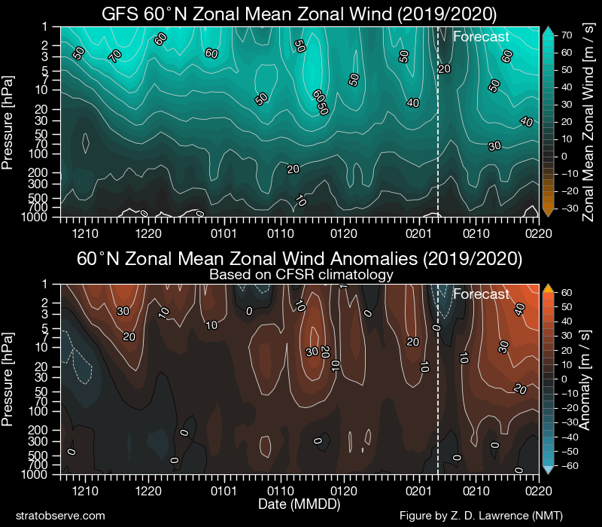
Stratosphere today

Slide 31
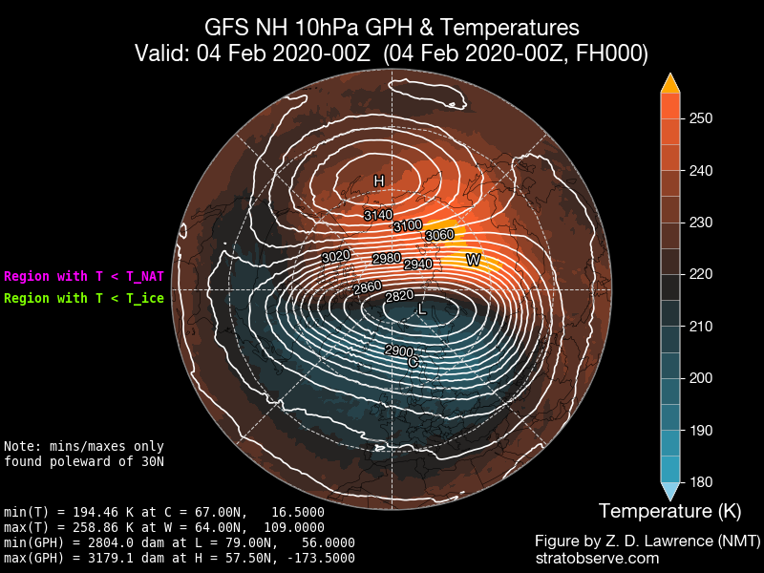

Slide 32
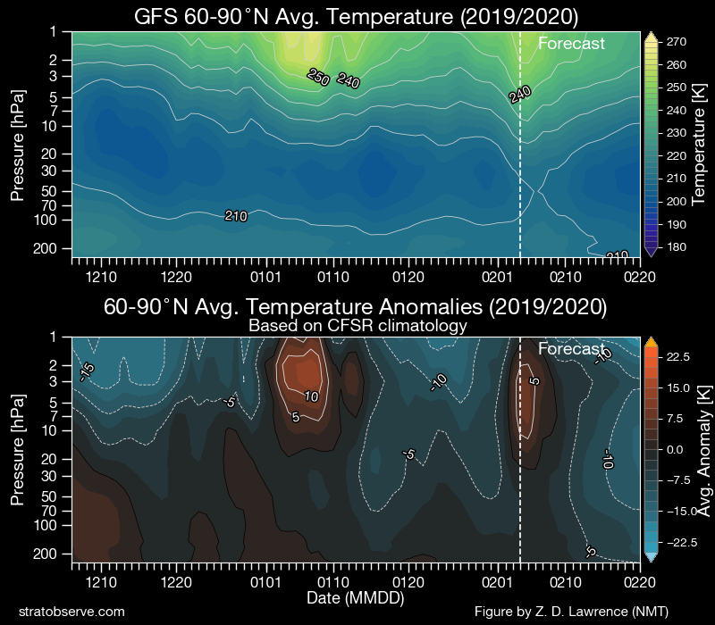

Slide 33
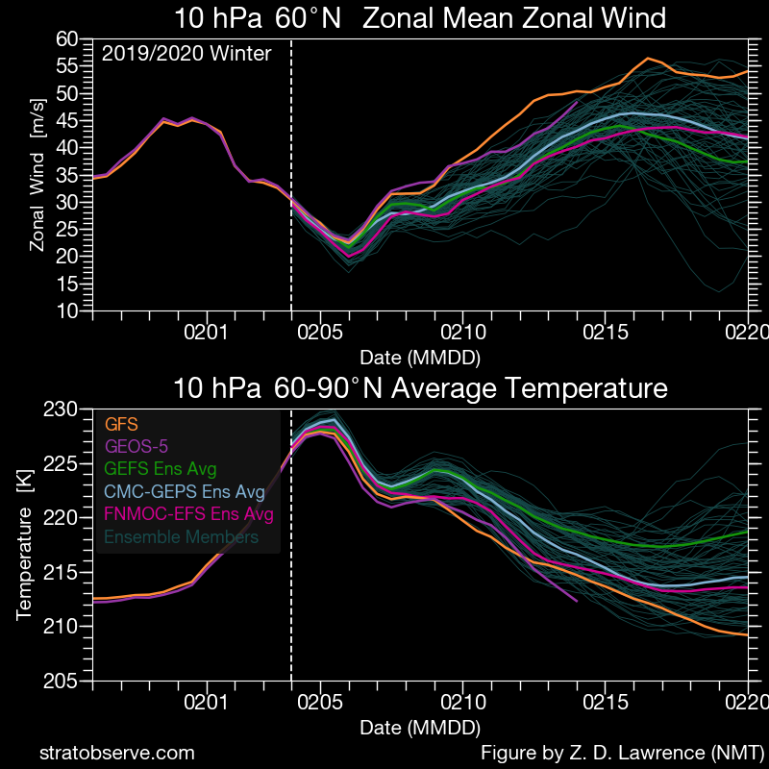

Slide 34
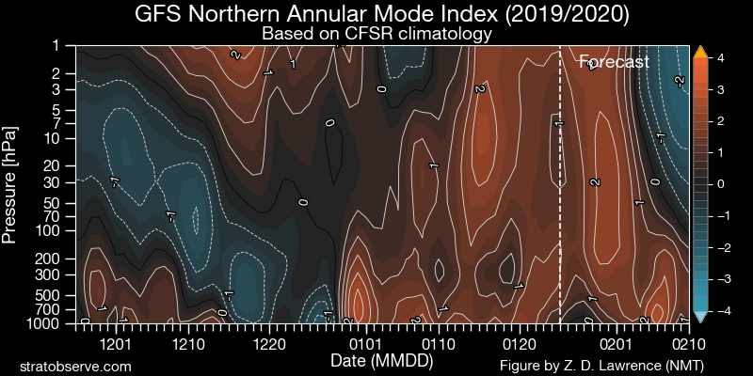

Slide 35
RESERVE SLIDES

Slide 36
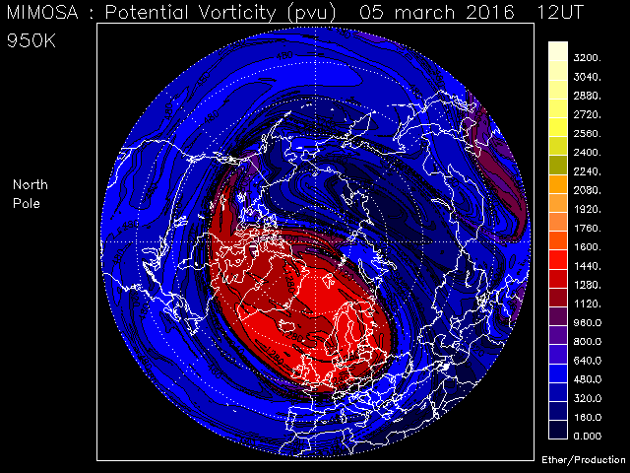
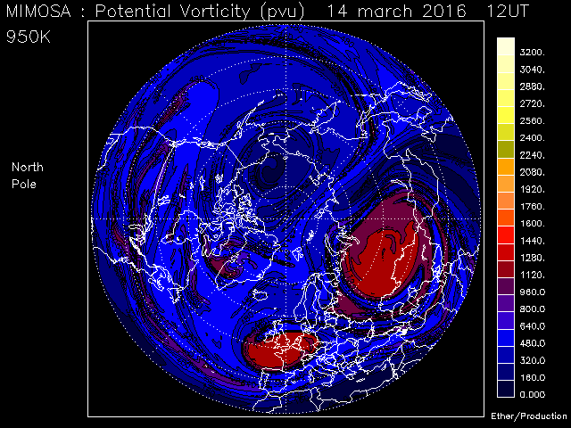
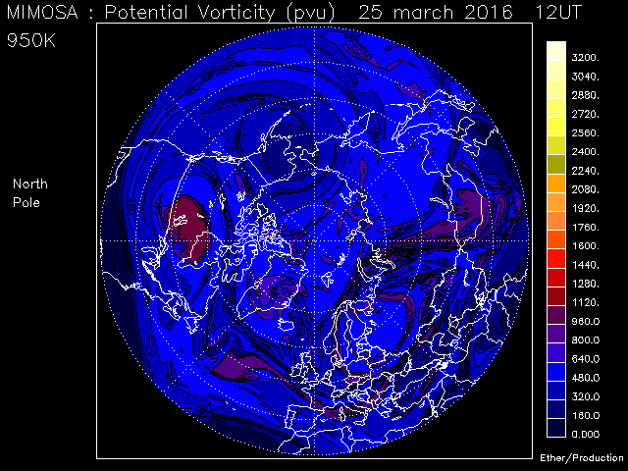
Stratospheric final warming: vortex breakdown and remnants
March 5
March 14
Polar Vortex breakdown
in March 2016
(near 35km)
Plots: Courtesy of Remi Thiéblemont, CNRS
POTENTIAL VORTICITY on the 950K isentropic surface
high vorticity : polar vortex
lower vorticity : low-latitude intrusions
( MIMOSA model, a high-resolution two-dimensional isentropic transport model driven by ECMWF re-analyses )
March 25
Thiéblemont, R., Orsolini Y.J., Hauchecorne, A., Drouin M.-A., Huret N. (2013), A climatology of frozen-in anticyclones in the spring arctic stratosphere over the period 1960–2011, J. Geophys. Res., 118, doi:10.1002/jgrd.50156.

Slide 37
Stratospheric final warming: vortex breakdown and remnants
30km
Year 2011
Thiéblemont, R., Orsolini Y.J., Hauchecorne,A., Drouin M.-A., Huret N. (2013), A climatology of frozen-in anticyclones in the spring arctic stratosphere over the period 1960–2011, J. Geophys. Res., 118, doi:10.1002/jgrd.50156.

Slide 38
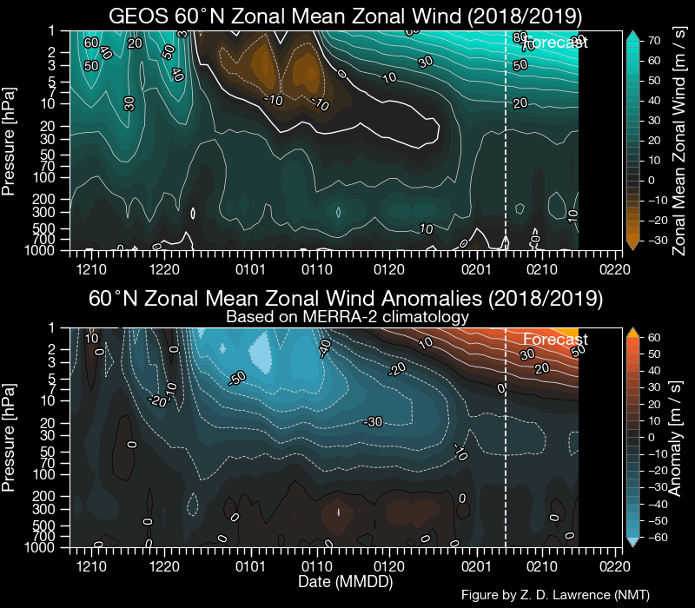
Stratospheric sudden warming DEC 2018
(vortex split event)

Slide 39
An Extended View of the Sudden Stratospheric Warming (SSW)
Var Limpasuvan, Coastal Carolina University, Conway-Myrtle Beach, South Carolina
1 Jan 2009 (before SSW onset)
Objectives
Review the major SSW phenomenon.
Highlight related middle atmospheric dynamics and their significance after SSW onset.
Data: NASA MERRA Re-analyses @ 25 km
Notes:
In a nutshell, a major SSW is about the strong disturbed state of the winter polar vortex in the Northern Hemisphere.
In the winter, the lack of insolation in the polar stratosphere region sets up a strong north-south temperature gradient as shown here for 1 Jan 2009 at 25 km. The temperature is provided in the filled color with blue being very cold.
This thermal configuration then sets up a strong circumpolar flow that wraps around the North Pole. The wind is shown as vectors and the contour is the geopotential height.
The wind speed can exceed 100 m/s or equivalent to a Category 5 hurricane.
So, the polar vortex acts to contain the cold air over the polar cap.

Slide 40
The vortex split following the 11 February 2018 event
A vortex splitting event
The negative phase of the NAO
Figure 9. (Top) Geopotential height (shading; units: km) and potential vorticity (contours; intervals: 2×10⁻⁴ K kg⁻¹ m² s⁻¹) at 10 hPa on 9 Feb, 11 Feb and 13 Feb. (Bottom) SLP anomalies (units: hPa) averaged over 11-17 Feb, 18-24 Feb, and 25-28 Feb 2018.

