Slide 1
Our Friend the Gravity Wave
P.J. Espy

Slide 2
OUTLINE
Gravity Waves
A physical rather than mathematical approach
The Small-Scale Structure: Large-Scale Effects
Observations of Gravity Waves
Gravity-Wave Sources

Slide 3
Why “Gravity” or “Buoyancy” Wave
Ocean Surface Wave Analogy
Discontinuous density gradient between water and air
Restoring forces: gravity (downward), buoyancy (upward).
g
b
From: W.K. Hocking, UWO
Atmospheric Case
Continuous density gradient—internal wave
Restoring forces: gravity (downward) buoyancy (upward).
From: W.K. Hocking, UWO
A parcel of dense air is moved into a region of less dense air
Gravity pulls parcels heavier than their surroundings downward
Can overshoot
Buoyancy pushes parcels lighter than their surroundings upward
To propagate away from source, need to get the initial pressure disturbance to create disturbances in adjacent columns

Slide 4
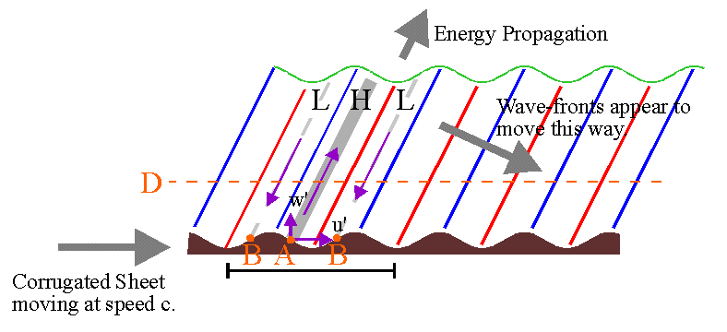
Gravity or Buoyancy waves in an atmosphere
A corrugated sheet pushed to the right against the air will be the same air blowing to the left over the sheet
At "A", the corrugations move upward and to the right with increasing time, forcing the air in this region up and forward. This will "push" the air along the line of the purple arrow shown.
Conversely, at the "B’s", the corrugations will appear to be "falling away“ to the left, letting the air fall away to the left
The air at H will rise, expand and cool while the air at L will sink, compress and heat.
From Wayne Hocking

Slide 5
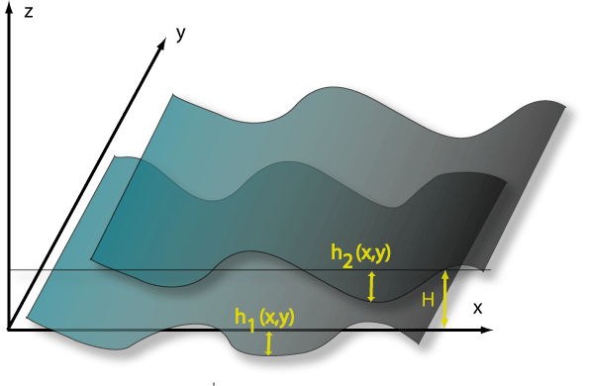
C_{g} upward
Phase fronts
F
Each “sheet” of air becomes the corrugated sheet perturbing the air above

Slide 6
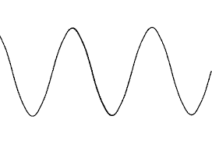
C_{g} upward
Z
Z
Amplitude
X=0, t=0
X

Slide 7
C_{g} upward
Z
Z
Amplitude
X=0, t=0
X

Slide 8
C_{g} upward
Z
Z
Amplitude
X=0, t=0
X

Slide 9
C_{g} upward
Z
Z
Downward Phase velocity
Amplitude
X=0, t=1
X

Slide 10
How to Propagate the Pressure Perturbation
No pressure change in any column (weight of air above is the same)
Move parcel vertically AND horizontally
Pressure on parcel decreases as weight of column above decreases
p_{o}
p_{o}
p_{o}
p_{o}
p_{o}
p_{o}
p_{o}
Just move parcel vertically
Pressure here increases as weight of column above increases
True for every displaced parcel, So initial pressure disturbance propagates to adjacent columns causing them to oscillate

Slide 11
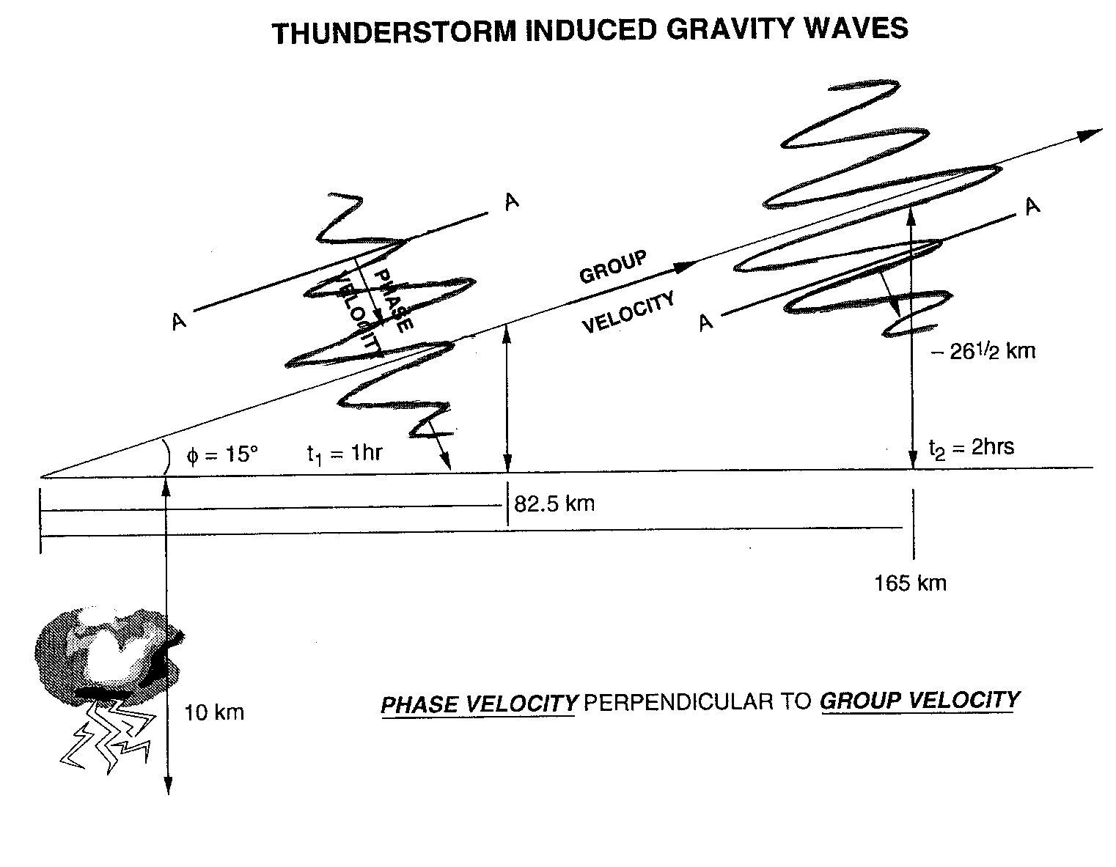
SMALL-SCALE STRUCTURE: GRAVITY WAVES
Column motions parallel to group velocity—longitudinal wave
Aligned along gravity and buoyancy directions—Shorter Periods →Tb
H C H
~Perpendicular to gravity and buoyancy directions—Longer Period
AMPLITUDE WILL INCREASE WITH HEIGHT
BREAKING WILL DRAG OR ACCELERATE ATMOSPHERE

Slide 12
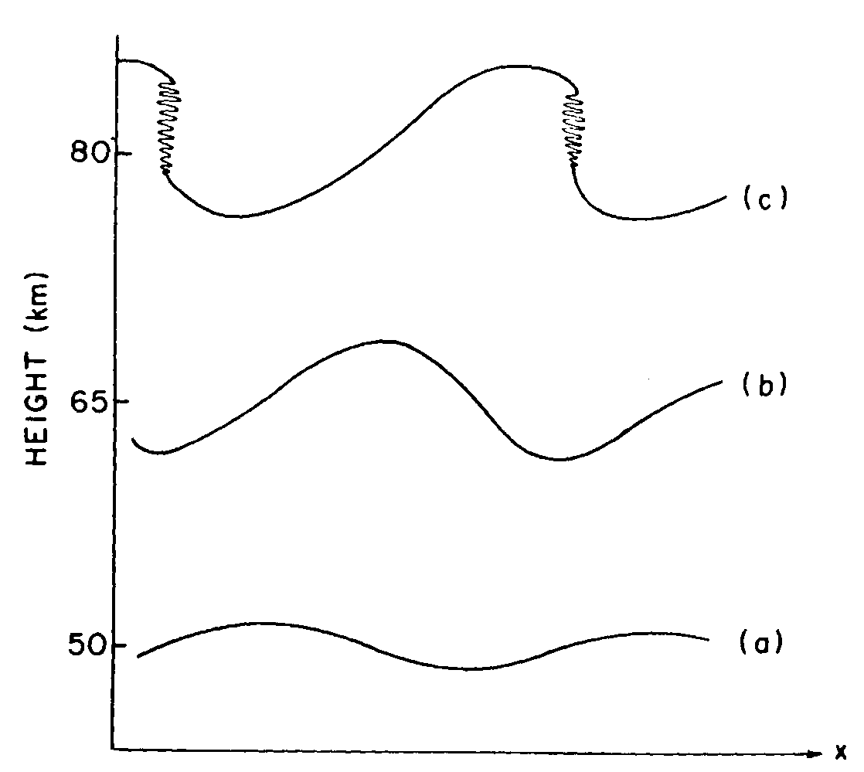
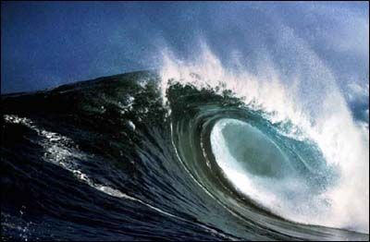
Gravity Wave Breaking
Grows in amplitude with height to conserve energy
Becomes non-linear & unstable: sheds energy and momentum (whitecaps)
Overturns and deposits its energy and momentum locally

Slide 13
Intrinsic vs Observed
Observed wave properties represent Source-Observer conditions
The horn tone that a pedestrian hears determined only by car-pedestrian relative velocity (wind doesn’t change sound’s pitch)
Intrinsic properties represent wave characteristics in the frame of moving medium
Wind towards car, bug on leaf blowing in the wind hears higher note that is determined by wind speed
Intrinsic properties
Determine if wave will propagate in medium
Are related to observed properties through the dispersion equation

Slide 14
Propagation In Background Winds
Z
@ t = t₀
X
C_{g}
C_{x-phase}
U = 0
λ_{z}
λ_{x}
C_{g}
C_{x-phase}
U = 0
λ_{z}
C_{in} = C_{obs} = ω_{obs} / k
λ_{x}
Z
@ t = t₀
X
C_{x-phase}
No wind, all is well

Slide 15
Propagation In Background Winds
Z
@ t > t₀
C_{x-phase}
X
C_{g}
U ≠ 0
λ_{z}
λ_{x}
C_{in} = ω_{in} / k =C_{obs}-U
C_{g}
C_{x-phase}
U = 0
λ_{z}
C_{in} = C_{obs} = ω_{obs} / k
λ_{x}
Z
@ t > t₀
X
C_{x-phase}
Horizontal Wavelength Unchanged, Reach Critical Layer at U=C
Notes:
In the frame of reference of an observer moving with the wind, the corrugated sheet of air just below the boundary is moving to the right more slowly by an amount (Cx-phase –U) since the observer is moving in the same direction as the corrugated sheet. Thus this sheet does not push the air above it as far up or as far to the right (in the diagram) by an amount Cx-U. So, both Cv ‘and Cx ‘to an observer moving in the medium are smaller than Cv and Cx in the region below the wind.
But the ground based observer still sees this newly perturbed layer moving to the right at speed U (as it is carried in the wind), and therefore the perturbation is still moving at speed Cx to the right. However, it has not propagated as far up (since the Doppler shift “correction” is only in the horizontal), and Cv’ is still smaller. Thus, when I connect the phase front, it has moved over an amount Cx*t = Cx*t and up an amount Cv’*t < Cv*t. Therefore the phase front has “tipped” into the wind.
Now, LambdaX’ = LambdaX, but LambdaZ’ < LamgdaZ

Slide 16
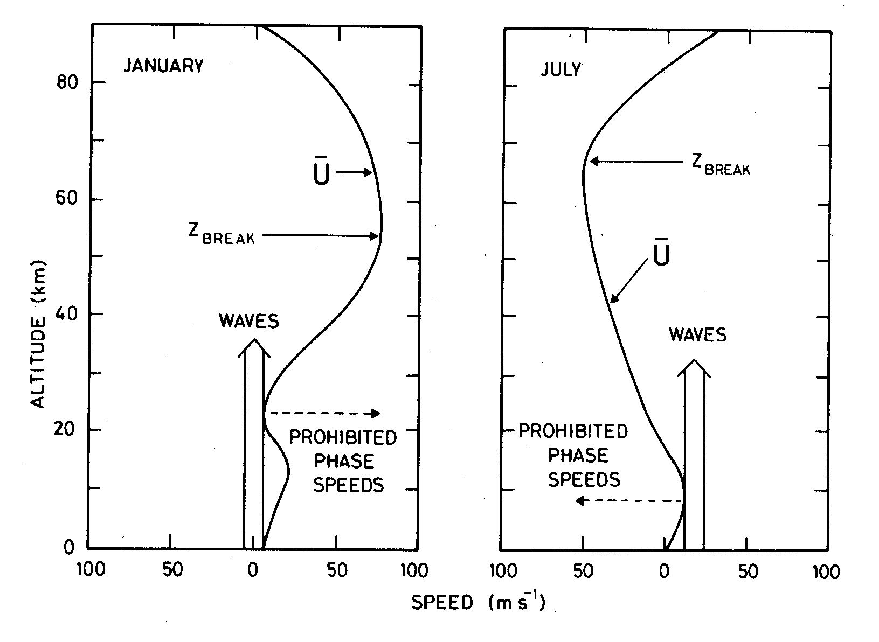
Seasonal Trend in Wave Direction
After Brasseur and Solomon, Aeronomy of the Middle Atmosphere, 1986
Wave Momentum reverses winds: Dynamic Control
N.H.
Winds in Radiative Control
Waves survive and grow to breaking amplitude
Winds in Radiative Control
Hit critical levels: Waves don’t grow to breaking amplitude
Westward
Eastward
Westward
Eastward

Slide 17
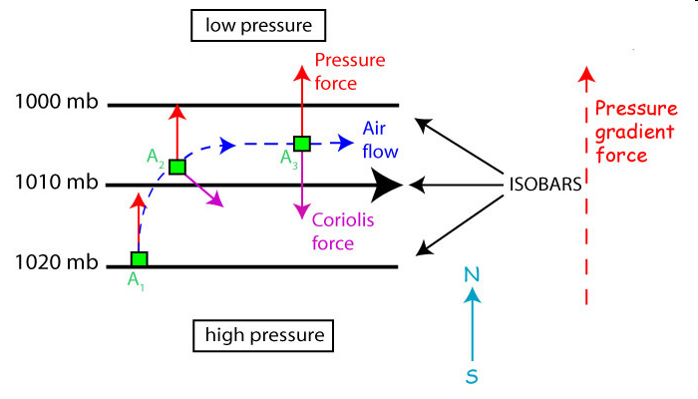
Geostrophic flow
In equilibrium, du/dt → 0
F_{pressure} + F_{Coriolis} = 0 in the horizontal
2006. Steven C. Wofsy, lecture notes.
Flow parallel to lines of constant pressure
Where f = 2⋅Ω⋅sin(ϕ)

Slide 18
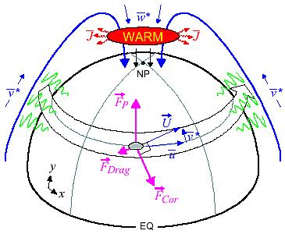
New force-Gravity Wave Drag F_{pressure} + F_{Coriolis} + F_{Drag}= 0 large scale circulation and temperature effects
Warm Mesosphere for Winter Circulation
Cold Mesosphere for Summer Circulation
T. Duck, Dalhousie University

Slide 19
GRAVITY-WAVE MOMENTUM FLUX
Circulation and thermal balance between 60 and 100 km forced by “sub-grid-scale” gravity waves
Bulk of the energy and momentum carried by waves with period < 1 h
GCM’s require spatial and temporal variations of gravity-wave parameterization (particularly in the Antarctic)

Slide 20
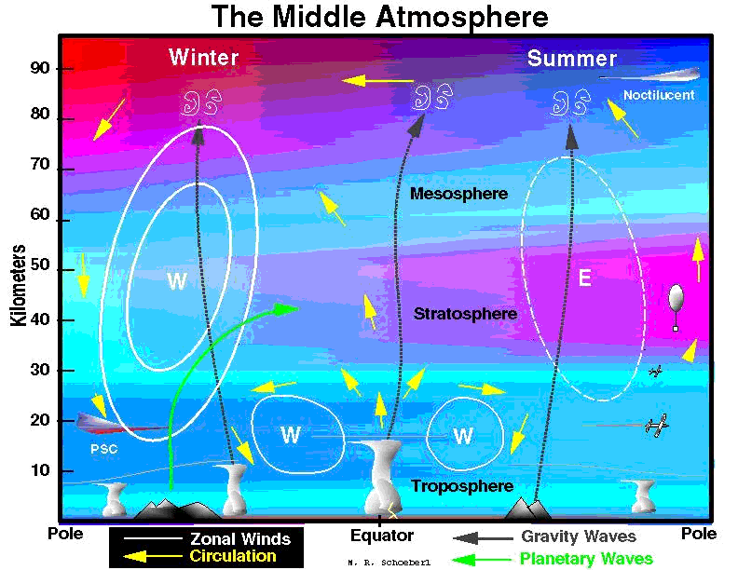
Carried to Stratosphere in Pole-to-Pole & Vertical Circulation
Wave Energy reaching here drives Pole-to-Pole circulation
O
NO_{x}
Waves: Primary way the atmosphere exchanges energy vertically

Slide 21
SEASONAL VERTICAL FLOWS ISAMS CO showing seasonal winter descent & summer ascent

Slide 22
End of part 1, GW and effects
Gravity waves are longitudinal waves (air motion parallel to energy propagation direction) with phase velocity perpendicular to group velocity
Structure means that at a location, one sees a phase front move downward in time for upward energy propagation
Major source of energy and momentum in middle atmosphere
Drives the global, pole-to-pole circulation and drives the middle atmosphere far from radiative equilibrium

