Slide 1
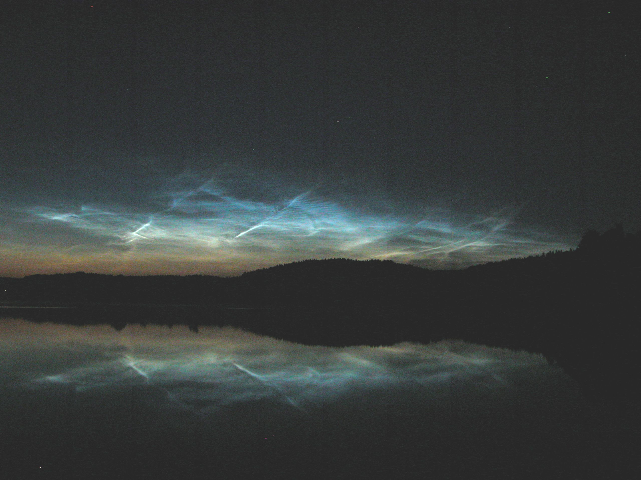
NOCTILUCENT CLOUDS
P.J. Espy
The British Antarctic Survey
Photo:
S. Kirkwood

Slide 2
OUTLINE
Noctilucent (Night-Shining) Clouds
What are they?
When, where and how do they form?
What can they tell us about the atmosphere?
What are the outstanding problems?

Slide 3
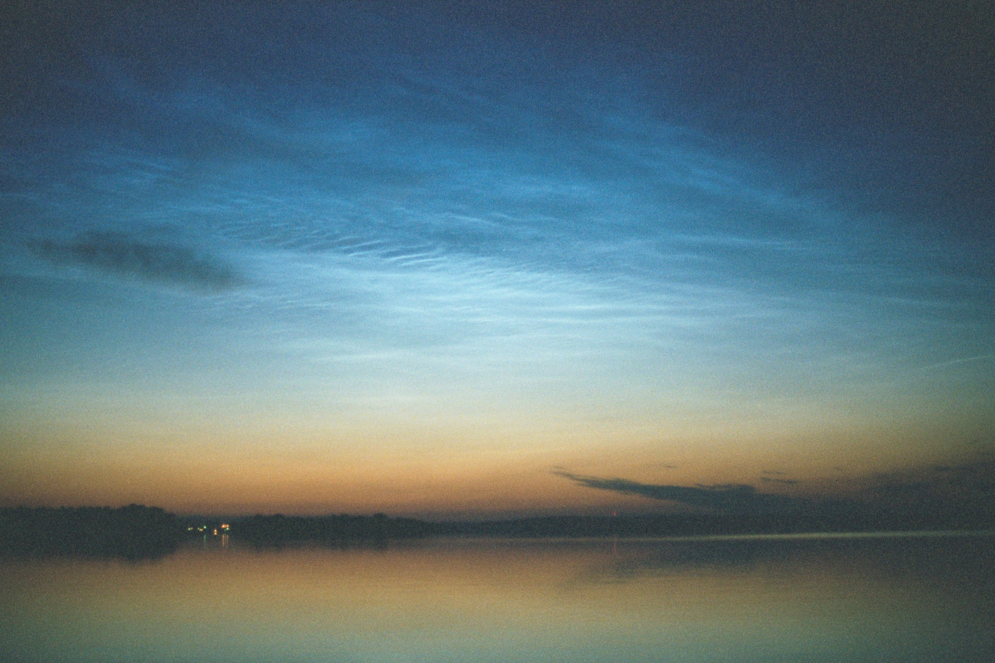
WHAT ARE THEY?
Water-Ice Clouds!!!!
Very Small Ice Crystals
  Largest ~ 0.07 Microns in Diameter!!!
High Altitude
Photo:
P. Espy

Slide 4
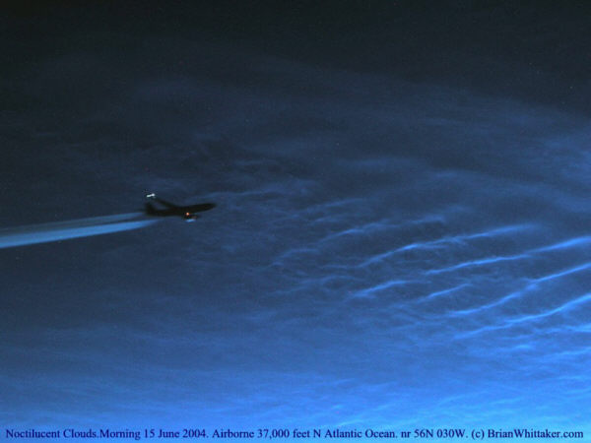
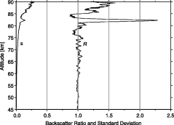
HOW HIGH ARE THEY?
Pretty High!
Very High!!!
Altitude
of Jesse,
1887

Slide 5
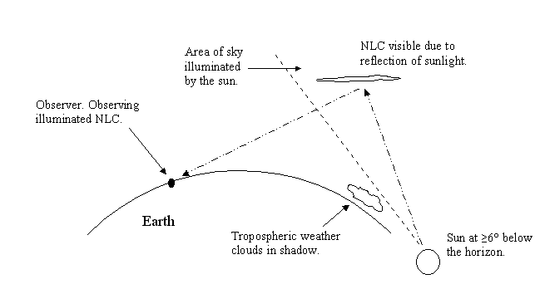
WHY NOCTILUCENT?
When observed from Satellites or Lidar the are sometimes called Polar Mesospheric Clouds (PMC)

Slide 6
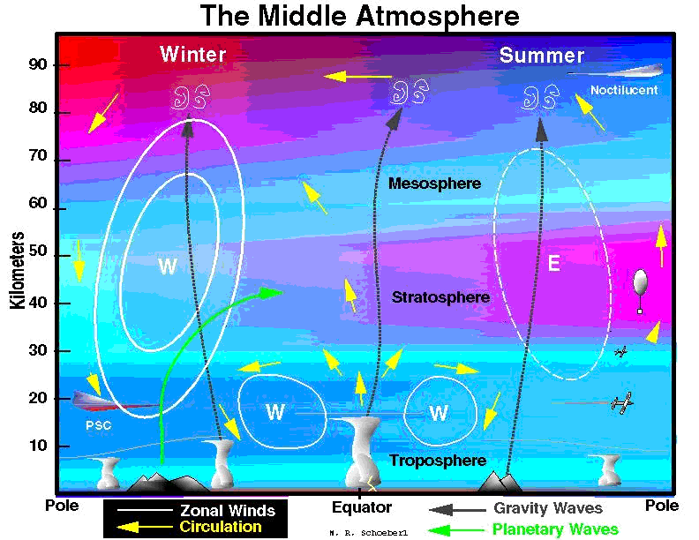

Slide 7
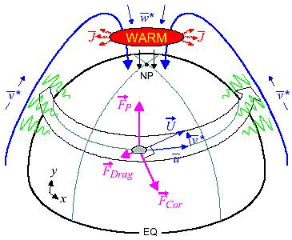
LARGE SCALE CIRCULATION AND TEMPERATURE EFFECTS
Warm Mesosphere for Winter Circulation
Cold Mesosphere for Summer Circulation

Slide 8
SUMMER UPLIFT CREATES COLD MESOPAUSE TEMPERATURES

Slide 9
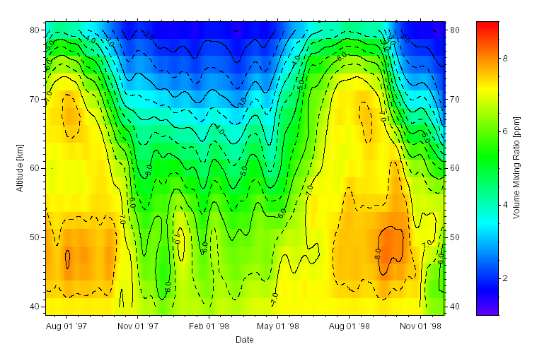
HAVE THE TEMPERATURES,
WHAT ABOUT THE WATER?
Water Vapour at 69N Showing Uplift
P. Hartogh

Slide 10
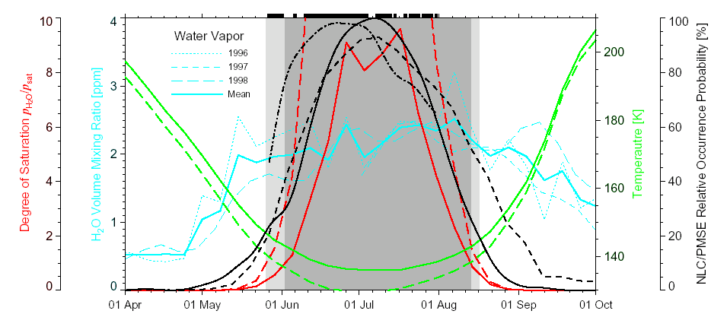
WATER VAPOUR IS SATURATED BETWEEN 81-90 KM
85 km
88 km
P. Hartogh
Saturated Water Vapour Yields Cloud Formation

Slide 11
Particle size and number density distribution
91
Nucleation
89
87
Condensation
Sedimentation
85
83
Sublimation
81
Adapted from Berger and von Zahn, 2002

Slide 12
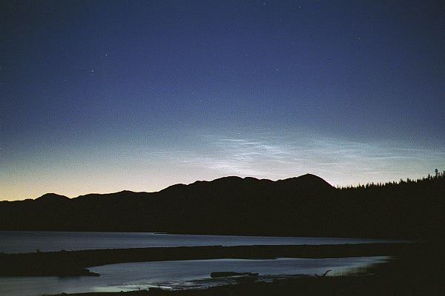
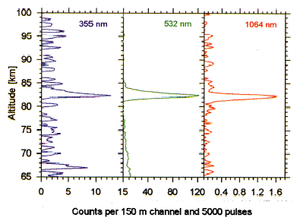
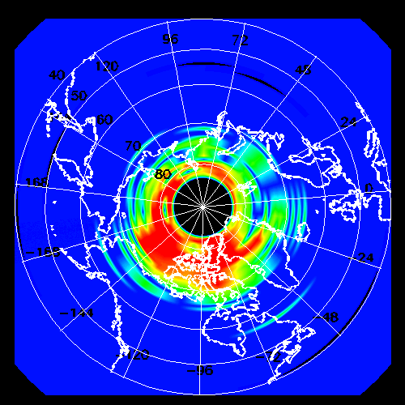
HOW TO OBSERVE THEM
Ground Based Visual
Ground Based Lidar
Satellite

Slide 13
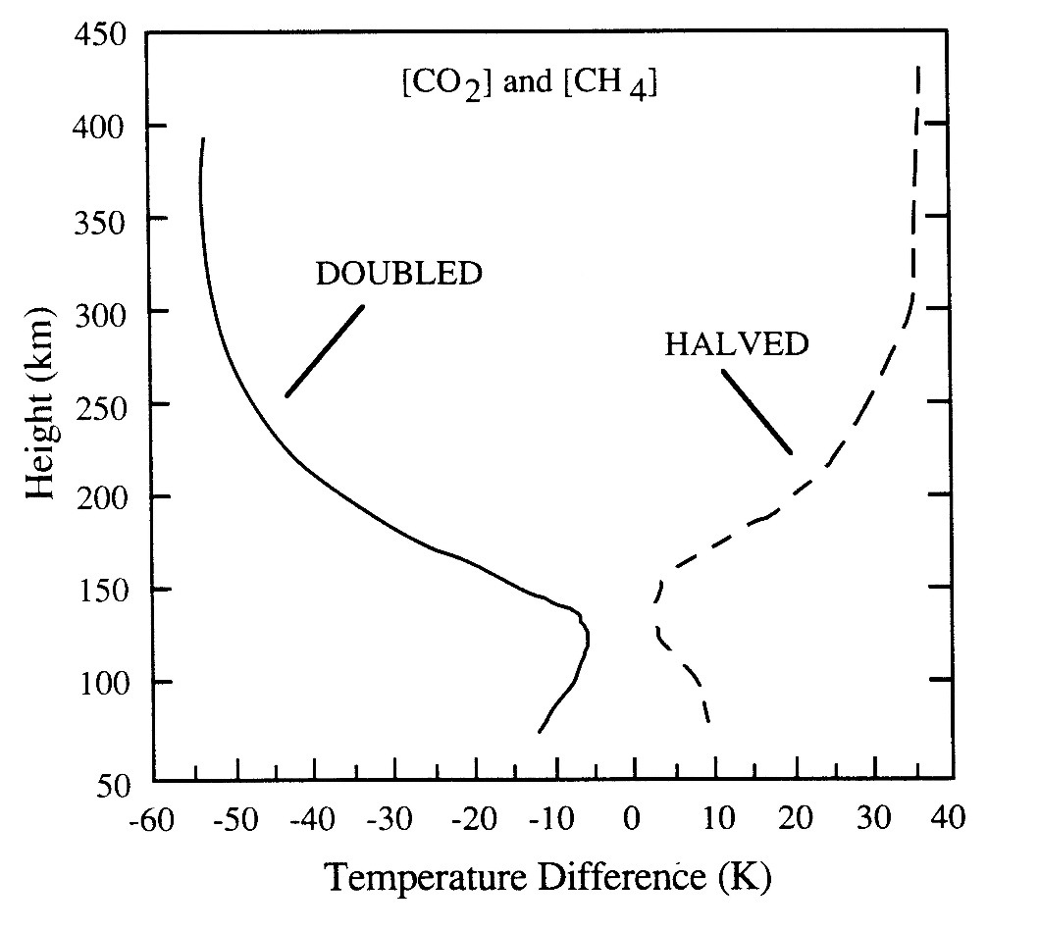
WHAT CAN THEY TELL US?
Predicted changes in upper atmospheric temperature with increased greenhouse gasses (Roble and Dickinson, 1989).

Slide 14
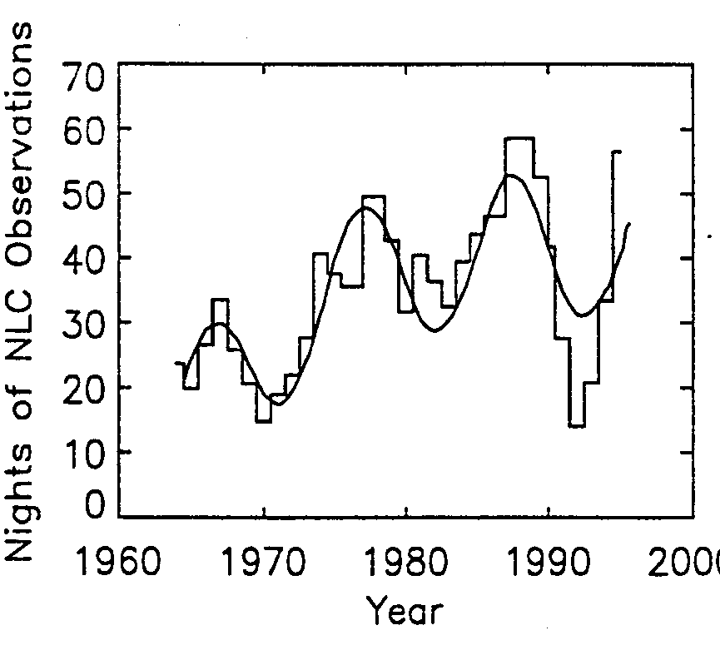
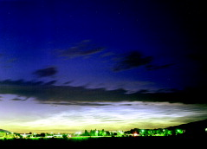
NLC MAY SHOW CHANGES IN FREQUENCY OR EXTENT
The variation in the number of nights that noctilucent clouds were seen in a particular year, for the period 1964 to 1995 (Gadsden 1998)
Noctilucent Cloud observed over Logan, Utah (42°N) in 1999.
From Wickwar et al, 2002

Slide 15
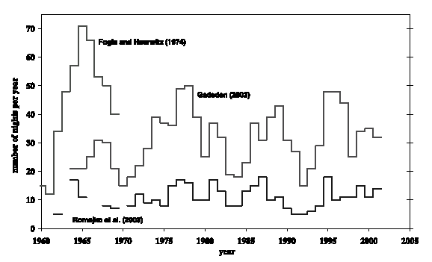
GROUND-BASED OBSERVATIONS ARE “OBSERVER DEPENDENT”

Slide 16
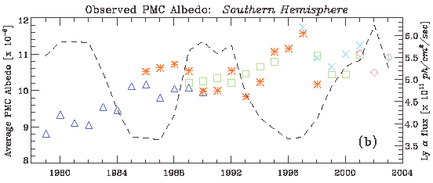
SATELLITE RECORD NOW LONG ENOUGH TO SHOW CHANGE
Average albedo for all PMCs detected by SBUV and SBUV/2 instruments during each season (30 days before summer solstice to 70 days after solstice).
Symbols: Δ= Nimbus-7 SBUV, * = NOAA-9 SBUV/2, = NOAA-11 SBUV/2,
× = NOAA-14SBUV/2, ◊= NOAA-16 SBUV/2, + = NOAA-17 SBUV/2.

Slide 17
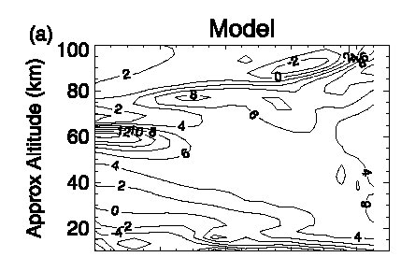
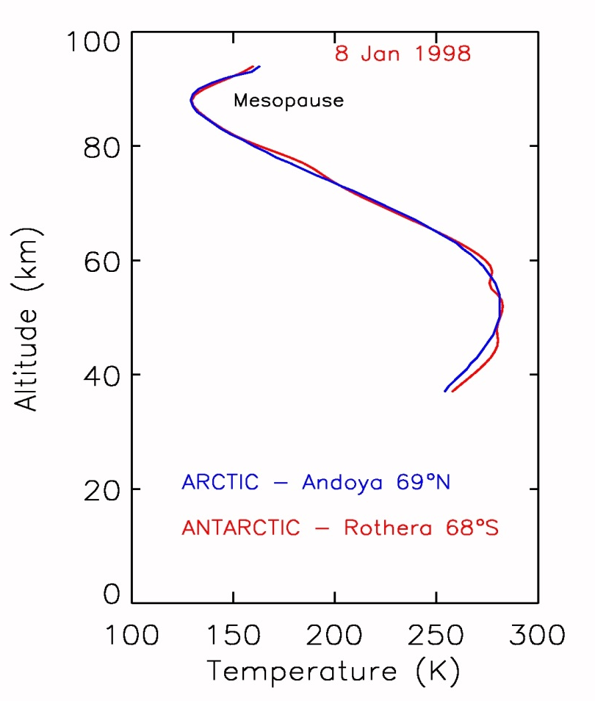

INTER-HEMISPHERIC DYNAMICS
NH – SH Model temperatures Summer
Some disagreement between models and “snapshot” measurements

Slide 18
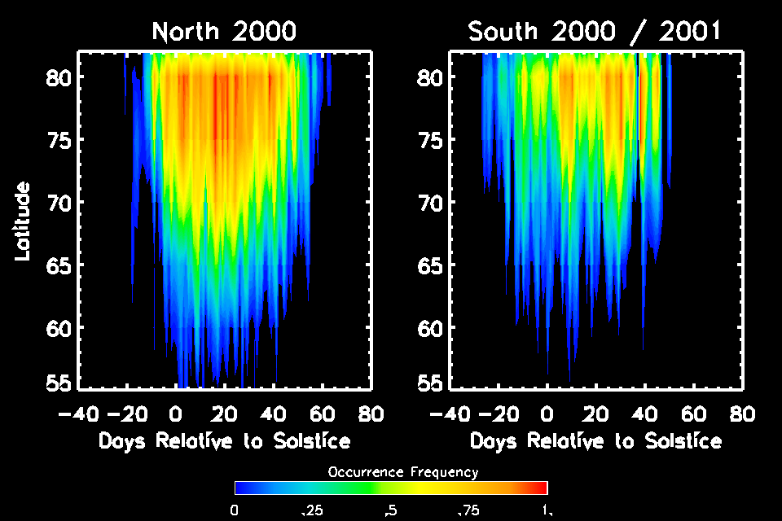
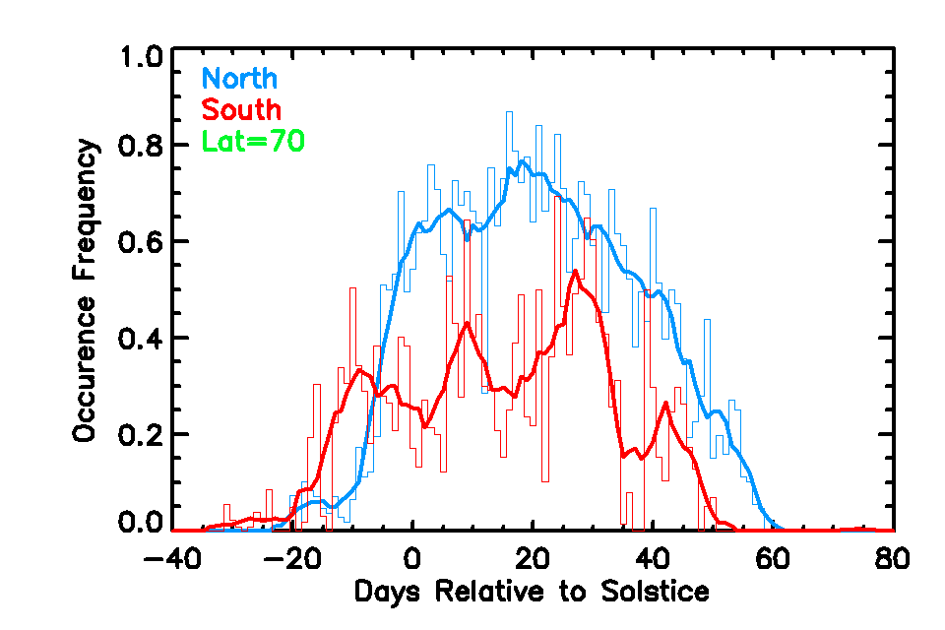
SATELLITE PMC SHOW DIFFERENCES

Slide 19
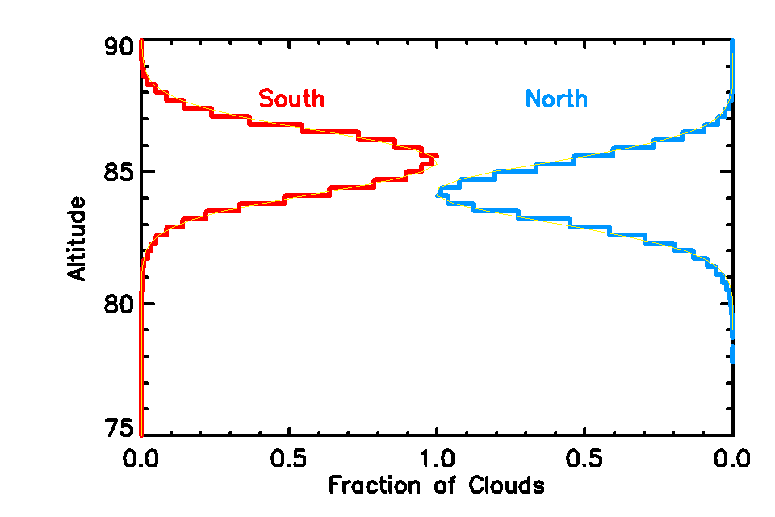
AND HEIGHT

Slide 20
CAN AFFECT CHEMISTRY
Uptake Fe on ice particles (coefficient ~ 0.1) competes with meteoric input

Slide 21
WHERE DO WE GO FROM HERE?
DON’T KNOW:
  Nucleation sites (Meteoritic smoke?)
  Nucleation mechanisms (homogeneous or heterogeneous)
  Particle size distribution
  Charging mechanisms or their effects on nucleation/growth
  Effects of atmospheric waves and tides on particles
  Full extent of their chemical interaction

Slide 22
Can they be used as the “miner’s canary” for global change?
“On some nights at high latitudes, the sky itself offers another ghostly image that signals the loss of ecological balance now in progress”
Al Gore

Slide 23
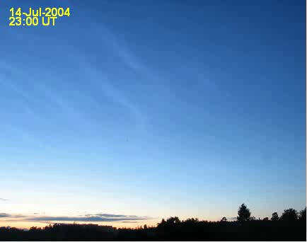
GRAVITY WAVES AND TIDES IN NLC
Courtesy
J. Stegman, Srockholm Universtiy

