Slide 1
How is circulation created?
Temperature gradients ⇒ Pressure gradients
Wave momentum deposited in atmosphere
  Gravity wave processes
  Planetary wave processes
    Critical level
    Wave breaking

Slide 2
Temperature gradients ⇒ Pressure gradients
Consequence of
Hydrostatic Equation

Slide 3
Temperature gradients ⇒ Pressure gradients
250 hPa
12 km
10 km
250 hPa
350 hPa
500 hPa
500 hPa
Consequence of
Hydrostatic Equation
0 km
1000 hPa
1000 hPa
0 km
T_{c} < T_{H}

Slide 4
Temperature gradients ⇒ Pressure gradients
250 hPa
12 km
10 km
250 hPa
350 hPa
500 hPa
500 hPa
Consequence of
Hydrostatic Equation
0 km
1000 hPa
1000 hPa
0 km
T_{c} < T_{H}
250 hPa
15 km
10 km
250 hPa
500 hPa
Horizonal Temperature gradients
Pressure gradients at each altitude
Winds at each altitude
500 hPa
0 km
1000 hPa
1000 hPa
0 km
T_{c} < < T_{H}

Slide 5
Temperature gradients ⇒ Pressure gradients
F_{tot} = F_{pressure} + F_{gravity} + F_{viscosity}
So Newton’s Law ⇒ a_{I}=F_{tot}/m becomes:
In the Inertial Frame:
Which in the Rotating Frame is:
Horizontal motions only
Above boundary layer

Slide 6
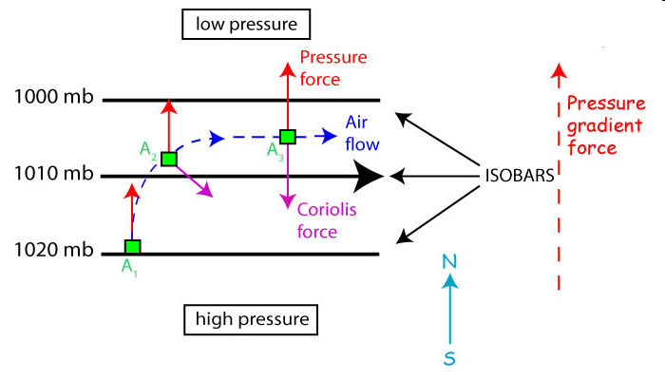
Temperature gradients ⇒ Pressure gradients
In the horizontal, with no friction,
Equilibrium, when F_{p} is equal & opposite F_{Coriolis}

Slide 7
How is circulation created?
Solar heating gradients ⇒ Temperature gradients
those Temperature gradients ⇒ Pressure gradients
those Pressure gradients ⇒ Winds
Works for the troposphere and stratosphere
  Radiatively driven latitude temperature gradients that
  drive pressure gradients that
  drive meridonal (north-south) winds that
  Corriolis turns zonal (eastward or westward)
Does not work in the mesosphere!

Slide 8
How is circulation created?
Temperature gradients ⇒ Pressure gradients
    Troposphere and stratosphere
Mesosphere:
  Wave momentum deposited in atmosphere
    Gravity wave processes
    Planetary wave processes
      Critical level
      Wave breaking

Slide 9
Gravity Wave
What is a gravity wave?
What happens at a critical level?
What causes it to break?

Slide 10
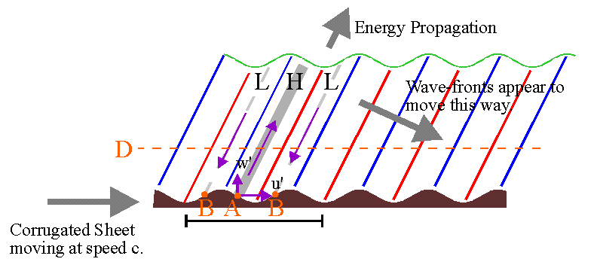
Gravity or Buoyancy waves in an atmosphere
A corrugated sheet pushed to the right against the air will be the same air blowing to the left over the sheet
At "A", the corrugations move upward and to the right with increasing time, forcing the air in this region up and forward. This will "push" the air along the line of the purple arrow shown.
Conversely, at the "B’s", the corrugations will appear to be "falling away“ to the left, letting the air fall away to the left
The air at H will rise, expand and cool while the air at L will sink, compress and heat.
From Wayne Hocking

Slide 11


How to Propagate the Pressure Perturbation
No pressure change in any column
(weight of air above is the same)
Move parcel vertically AND horizontally
Pressure on parcel decreases as weight of column above decreases
p_{o}
p_{o}
p_{o}
p_{o}
p_{o}
p_{o}
p_{o}
Just move parcel vertically
Pressure here increases as weight of column above increases
True for every displaced parcel,
So initial pressure disturbance propagates to adjacent columns

Slide 12
Gravity Wave
What is a gravity wave?
What happens at a critical level?
What causes it to break?

Slide 13
Intrinsic vs Observed
Observed wave properties represent
Source-Observer conditions
  The horn pitch that a pedestrian hears determined only by car-pedestrian relative velocity (wind doesn’t change sound’s pitch)
Intrinsic properties represent wave characteristics in frame of moving medium
  Wind towards car, the bug on leaf blowing in the wind hears higher pitch determined by wind speed when transported towards car
Intrinsic properties
  Determine if wave will propagate in medium
  Are related through the dispersion equation

Slide 14
Propagation In Background Winds
Z
@ t = t₀
X
C_{g}
U = 0
Wave crests or troughs
λ_{z}
λ_{x}
C_{g}
U = 0
λ_{z}
C_{in} = C_{obs} = ω_{obs} / k
λ_{x}
Z
@ t = t₀
X
No wind, all is well

Slide 15
Propagation In Background Winds
Z
@ t > t₀
X
C_{g}
U ≠ 0
λ_{z}
λ_{x}
C_{in} = ω_{in} / k =C_{obs}-U
C_{g}
U = 0
λ_{z}
C_{in} = C_{obs} = ω_{obs} / k
λ_{x}
Z
@ t > t₀
X
Horizontal Wavelength Unchanged, Reach Critical Layer at U=C

Slide 16
At the Critical Level
When U → C, the vertical wavelength →0
The upward energy propagation ceases
Wave energy and momentum deposited in a narrow layer in a non-linear process

Slide 17
What if U→ -C
When U → -C, the vertical wavelength → ∞
The wave becomes a vertical oscillation
Wave become evanescent and does not propagate away from the region.

Slide 18
Gravity Wave
What is a gravity wave?
What happens at a critical level?
What causes it to break?

Slide 19
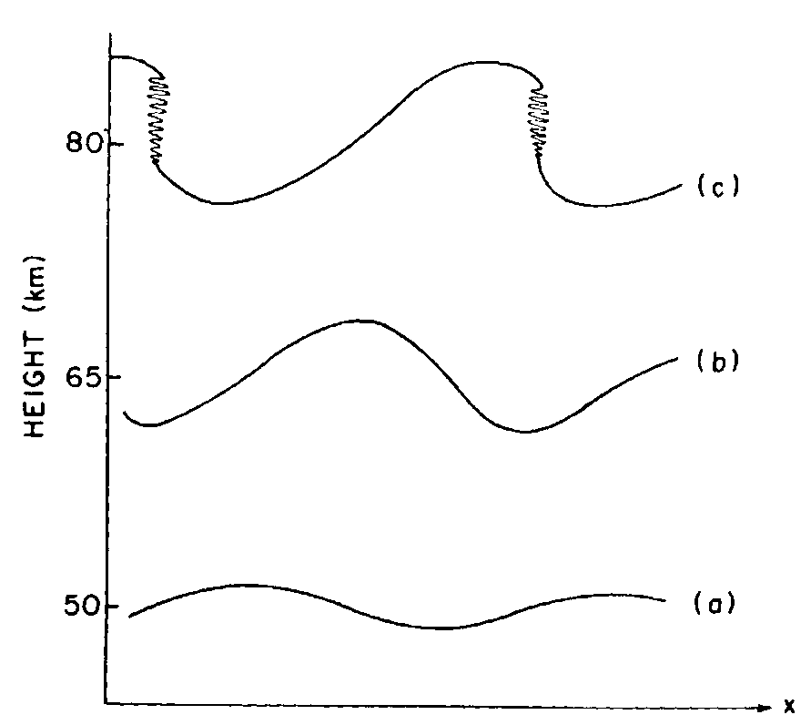
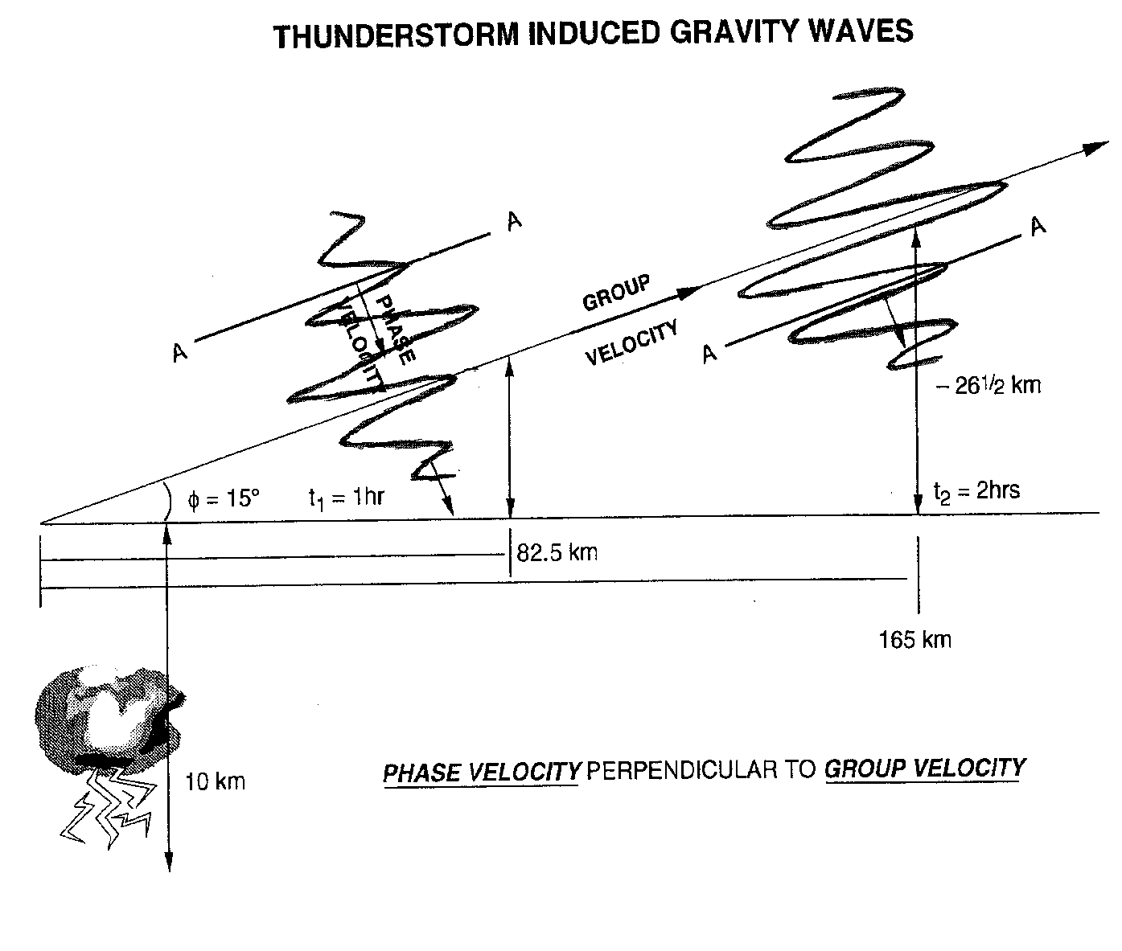

SMALL-SCALE STRUCTURE:
GRAVITY WAVES
The larger the amplitude, the steeper the gradient in temperature
When dT/dZ > Γ_{dalr}
wave becomes unstable
H
C
H
AMPLITUDE WILL INCREASE WITH HEIGHT
BREAKING WILL DRAG OR ACCELERATE ATMOSPHERE

Slide 20
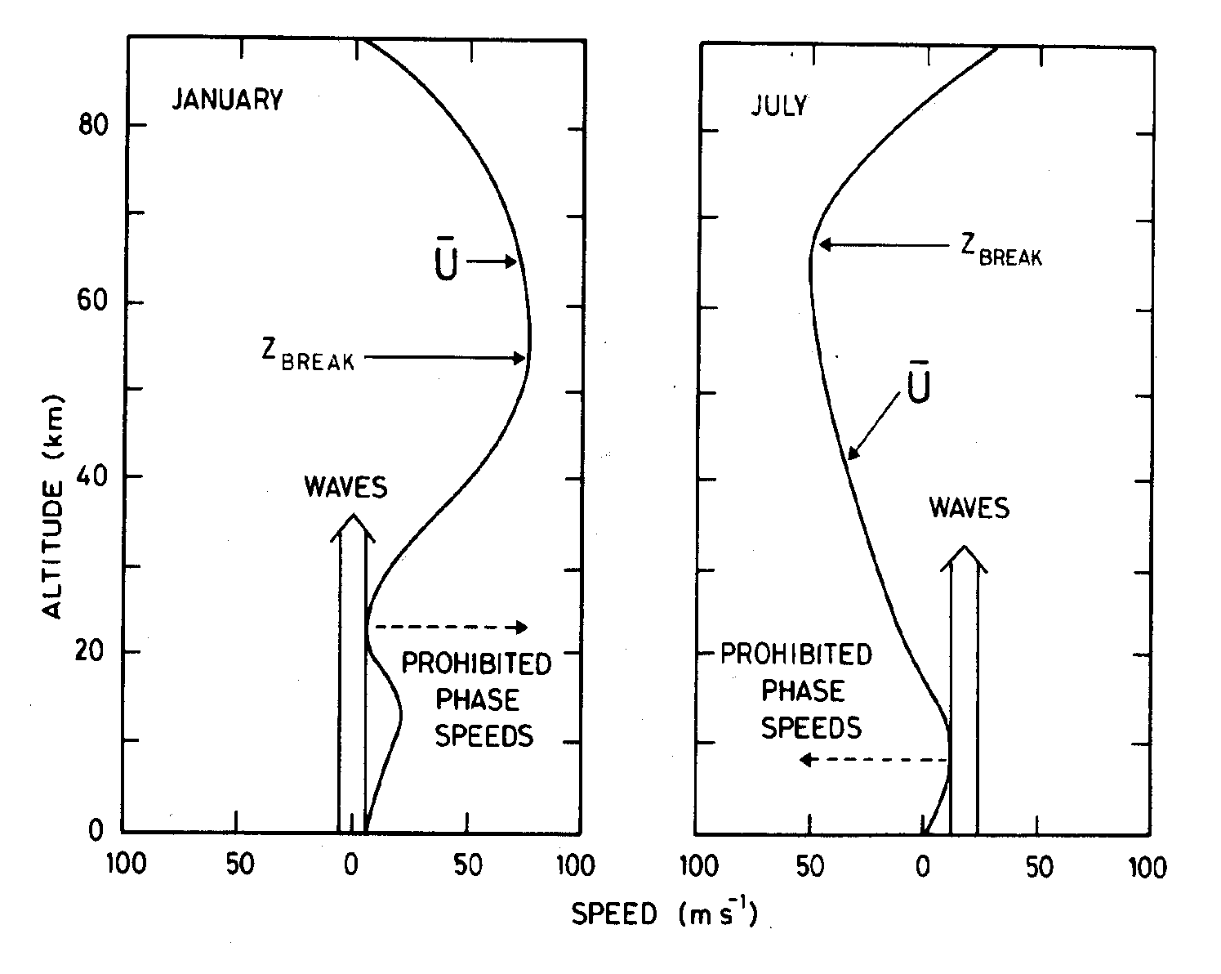
Seasonal Trend in Wave Direction
After Brasseur and Solomon, Aeronomy of the Middle Atmosphere, 1986
Wave Momentum reverses winds: Dynamic Control
N.H.
Winds in Radiative Control
Waves survive and
grow to breaking amplitude
Winds in Radiative Control
Hit critical levels:
Waves don’t grow to breaking amplitude
Westward
Eastward
Westward
Eastward

Slide 21
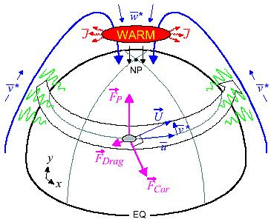
LARGE SCALE CIRCULATION AND TEMPERATURE EFFECTS
Warm Mesosphere for Winter Circulation
Cold Mesosphere for Summer Circulation
T. Duck, Dalhousie University

Slide 22
Mesosphere Lower Thermosphere (MLT) process summary
Gravity waves filtered in the radiative winds of stratosphere
Winter westward and Summer eastward net wave momentum in MLT
Net wave momentum deposition reverses radiative flow in MLT
New flow creates a winter to summer MLT circulation
This results in:
  Convergence at winter pole Divergence at summer pole
  Downward motion Upward motion
  Adiabatic heating Adiabatic cooling
Drives a cold summer and warm winter mesopause

Slide 23
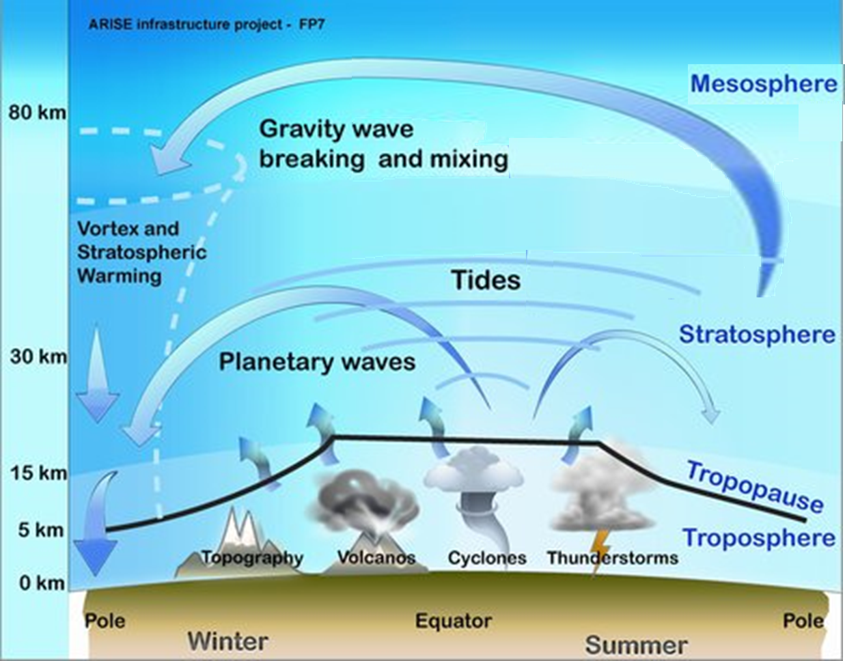
Gravity Planetary wave breaking
Breaking
  If the wave amplitude becomes too large, the wave can become unstable, depositing its eastward or westward momentum (depending on season)
Gives rise to
Pole-to-Pole Circulation
in the Mesosphere
Divergent adiabatic uplift/cooling summer
Convergent adiabatic downwelling/heating in winter

Slide 24
Planetary Wave
What is a planetary wave?
  Why does it only move westward
What happens at a critical level?
What causes it to break?

Slide 25
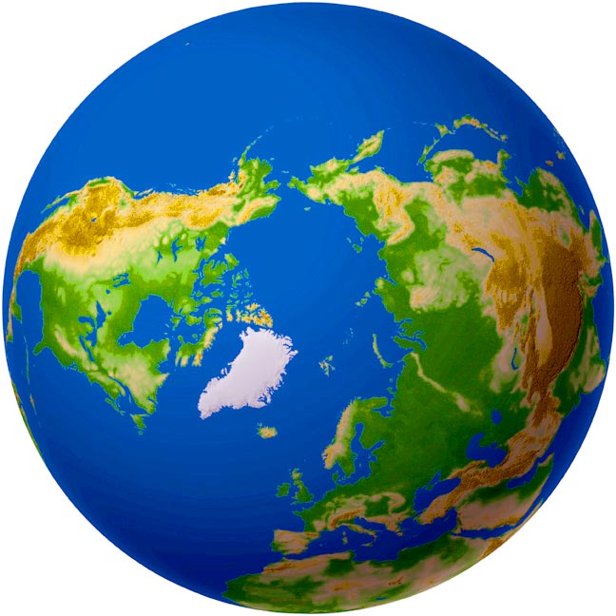


Water barrel at the North Pole
Barrel of water at the North Pole with paddle
Inertial observer view

Slide 26
Inertial observer view

Slide 27
Inertial observer view

Slide 28
Inertial observer view

Slide 29
Inertial observer sees paddle rotate 360°
Observer at the barrel does not see paddle rotate

Slide 30
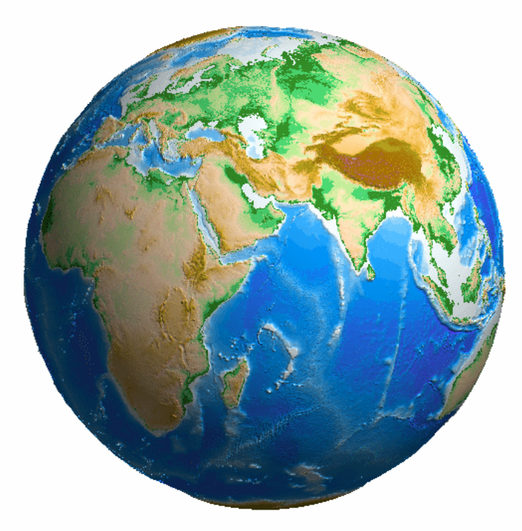
Barrel of water at the equator with paddle
Inertial observer view

Slide 31

Inertial observer view

Slide 32

Inertial observer does not see paddle rotate
Neither does the observer at the barrel

Slide 33
What happens if I instantly transport the north pole barrel to the equator
While the barrel will not rotate, the water in the barrel, and the paddle, will continue to rotate at 360° per day.
The paddle in the equatorial barrel will continue to be still
The inertial and equatorial observer will see Polar paddle rotate and the Equatorial paddle be still
Polar Barrel
Equatorial Barrel

Slide 34
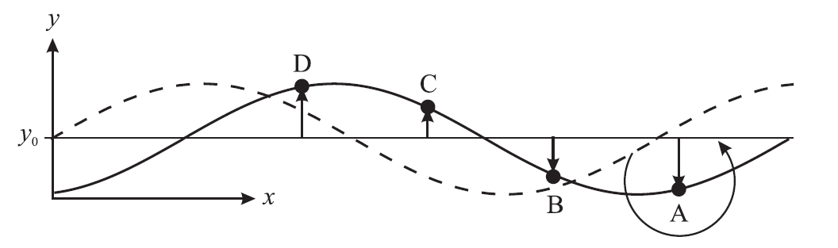
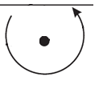
Westward propagation
Any displacement to lower latitudes causes the parcel to spin anti-clockwise with respect to the air (and observer) at that location.
Drags air to the west to lower latitudes (where it spins up), air to the east towards higher latitudes (where it spins down)
Any displacement to higher latitudes causes the parcel to spin clockwise with respect to the air (and observer) at that location.
Drags air to the west to higher latitudes (where it spins up), air to the east towards lower latitudes (where it spins down)
Result: Initial disturbance moves toward the west

Slide 35
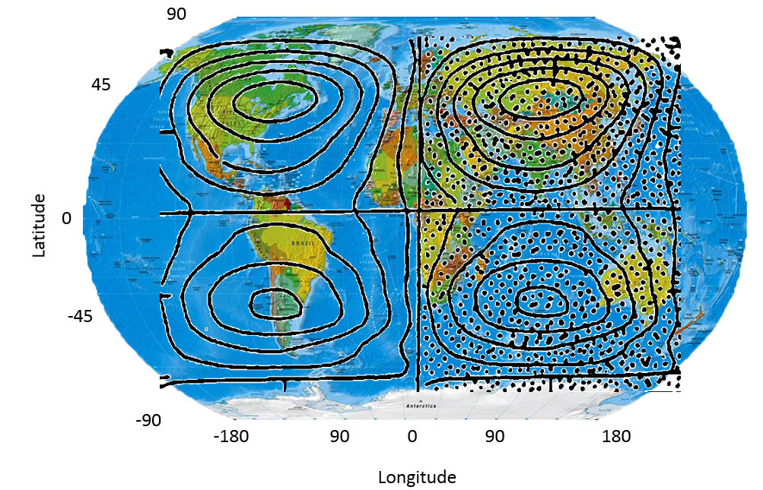
Travelling planetary waves
Planetary Wavenumber-1, 5-day wave
Planetary Waves
  Variations of temperature and wind on global scales
  Different waves travel at different speeds/periods (5-day, 9-day, etc)
  Superposition of all wavenumber n waves is a wavenumber n wave
  Changes in [O]/[N₂] ratio at base of ionosphere

Slide 36
Critical levels and reflections
Critical Level
  Like gravity waves, if the wind speed is in the direction of the wave (westward) and equal to the wave speed, wave will cease to propagate (and give up its energy and momentum to the mean flow)
Reflection level
  Like gravity waves, if the wind speed is against the wave (eastward) but too strong, the wave will cease to propagate and reflect
Breaking
  If the wave amplitude becomes too large, the wave can become unstable, depositing momentum and dissipating energy

Slide 37
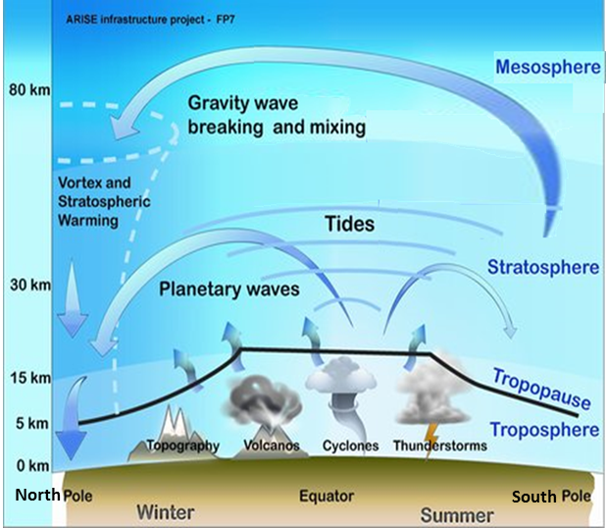
Planetary wave breaking
Breaking
  If the wave amplitude becomes too large, the wave can become unstable, depositing its westward momentum and dissipating its energy
Gives rise to
Brewer-Dobson Circulation
in the Stratosphere
(but does not overcome
radiative forcing)

Slide 38
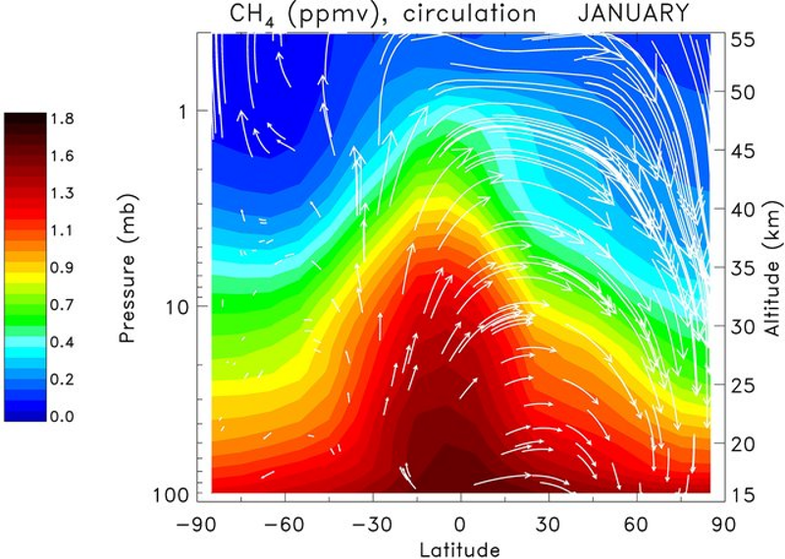
Mesosphere vs Stratosphere Circulation
Mapping the flow using tracers
Carbon monoxide mapping mesospheric flow
Methane mapping stratospheric flow

