Slide 1
Role of tides in the downward transport of NOx
Patrick J. Espy, Mathias Strupstad, Kristina Skarvang, Stefan Bender
Norwegian University of Science and Technology (NTNU), Trondheim, Norway Birkeland Centre for Space Science, Bergen, Norway

Slide 2
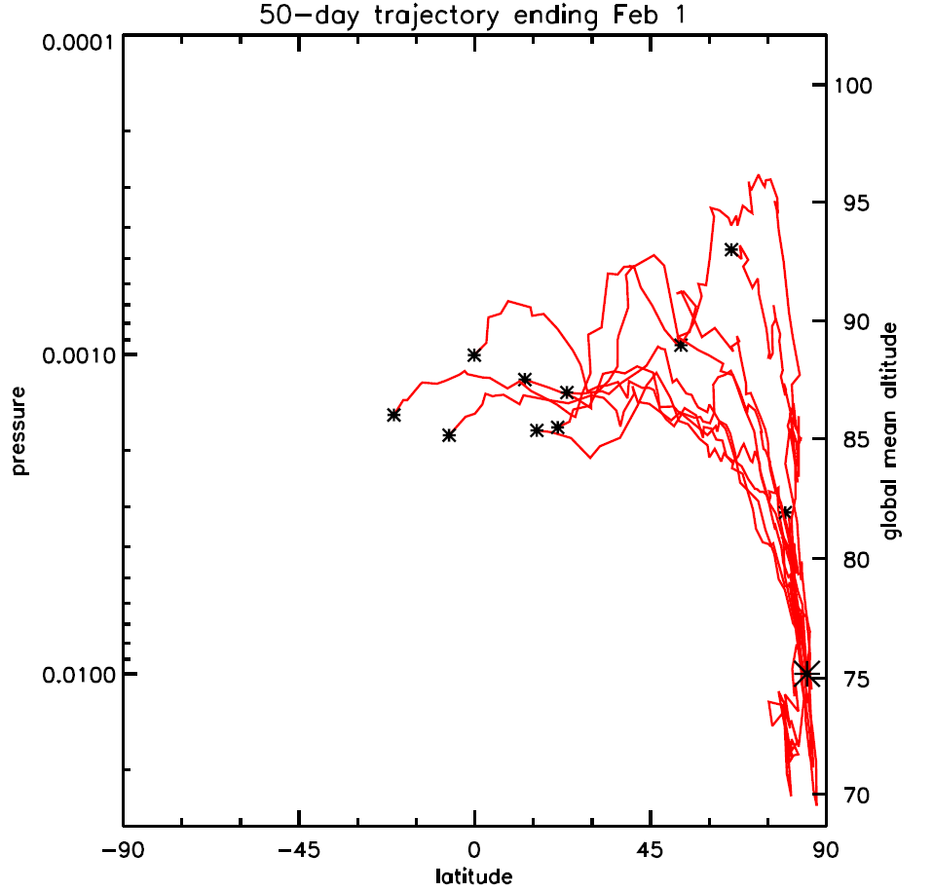
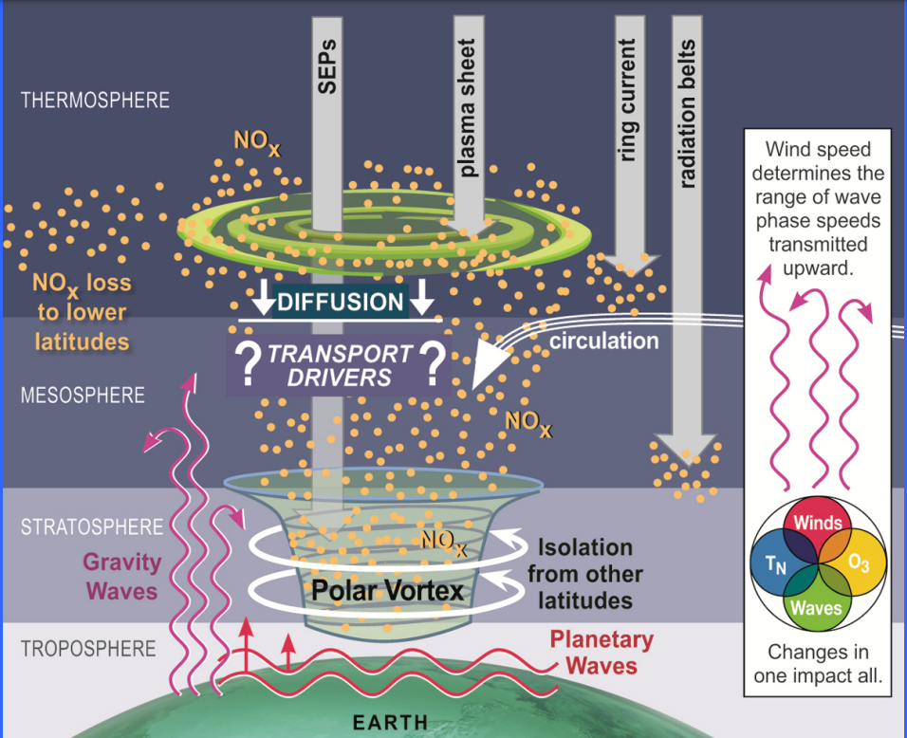
Role of tides in the downward transport of NOx
Picture of pole-ward & downward transport
Trajectory modelling of where the air at 75 km comes from
From: Randall and Harvey
From: Smith et al. doi:10.1029/2011JD016083

Slide 3
Role of tides in the downward transport of NOx
Looking at the altitude of auroral and ring-current deposition
How effective is the “indirect effect” for transporting thermospheric NO_{x} at
105 km downward to the stratosphere?

Slide 4
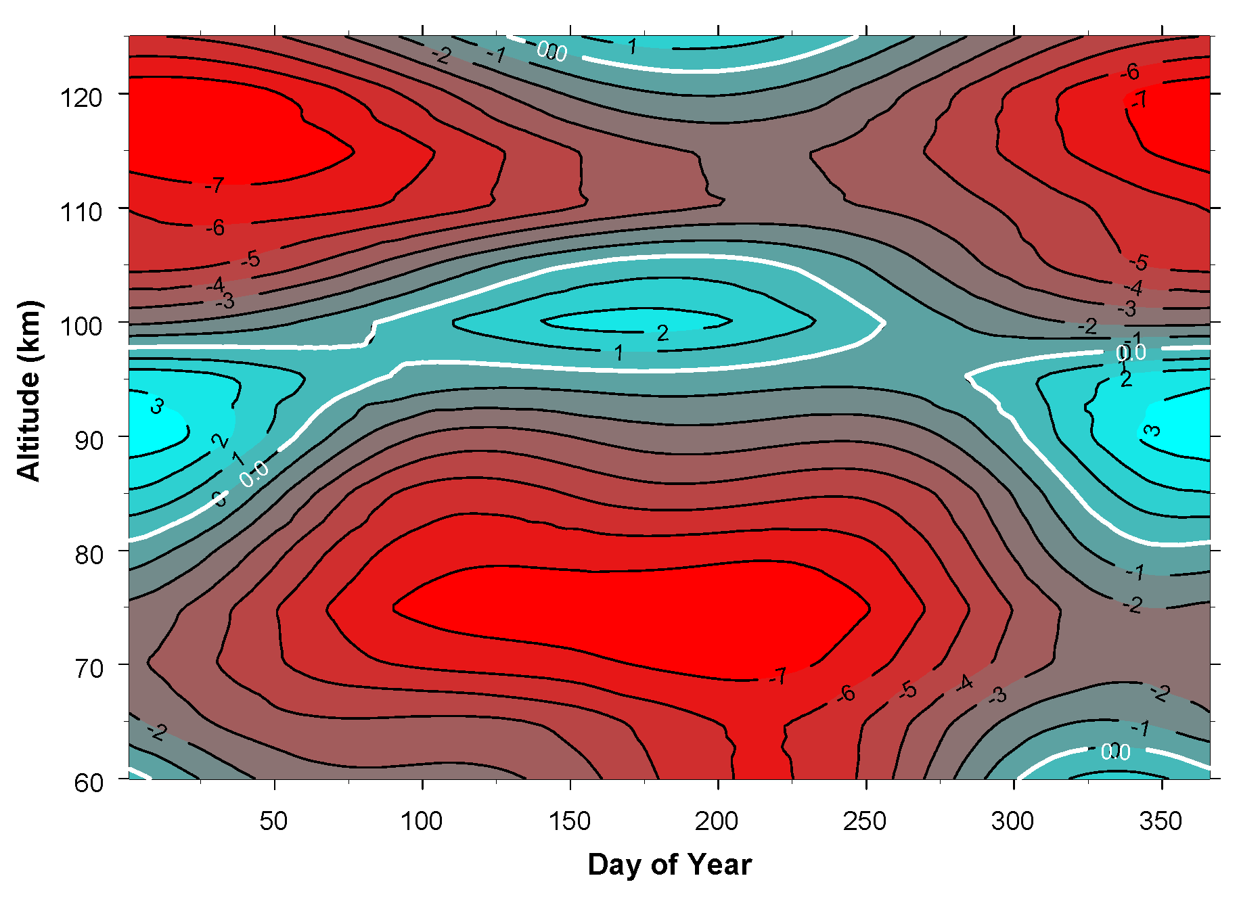
Role of tides in the downward transport of NOx
Observational evidence of wintertime upward transport at 95-105 km indicates a change in circulation
Southern Hemisphere H₂O mixing ratio
Visible at Rothera in HWM, daily-mean meridional wind
Red = poleward flow, Blue =equatorward flow
From: Lossow et al. doi:10.1029/2008JD011462

Slide 5
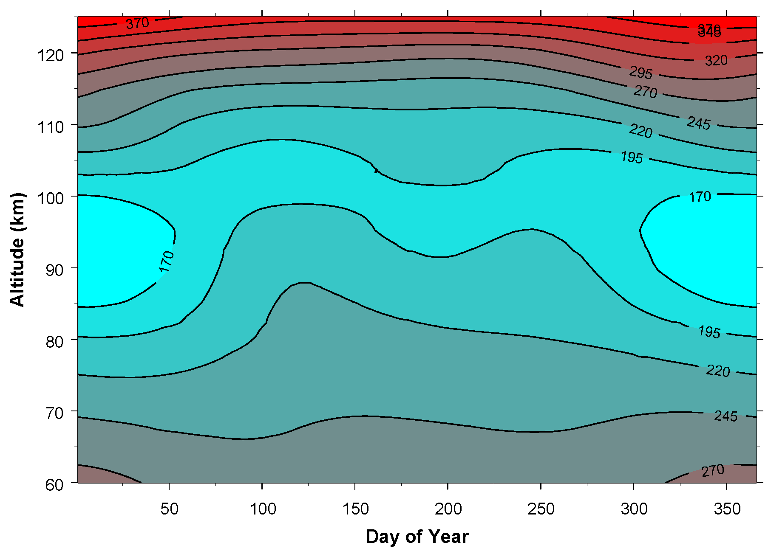
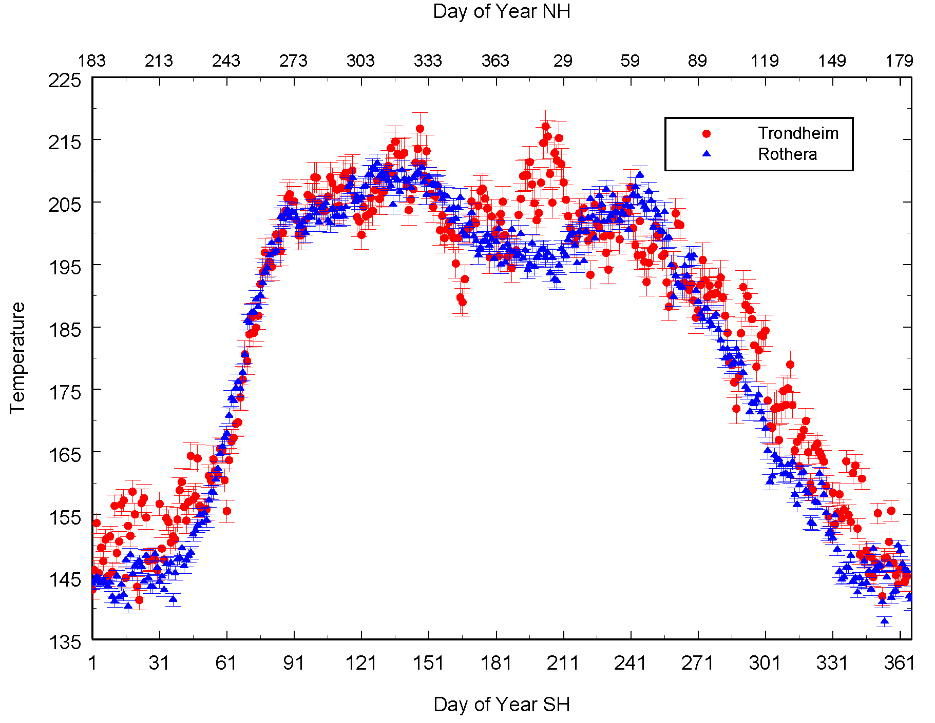
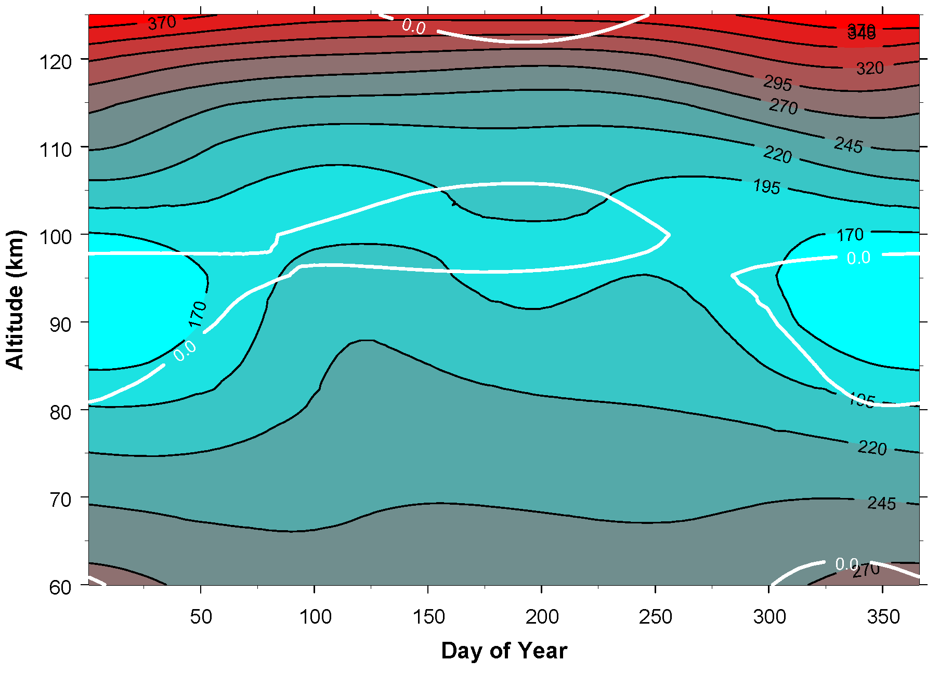
Role of tides in the downward transport of NOx
Observational evidence of wintertime upward transport at 95-105 km indicates a change in circulation
Daily mean MSIS Temperature at Rothera
Overlay of zero-wind contour
Mid-winter cooling observed in both hemispheres
in meteor radar temperatures (90±5 km)

Slide 6
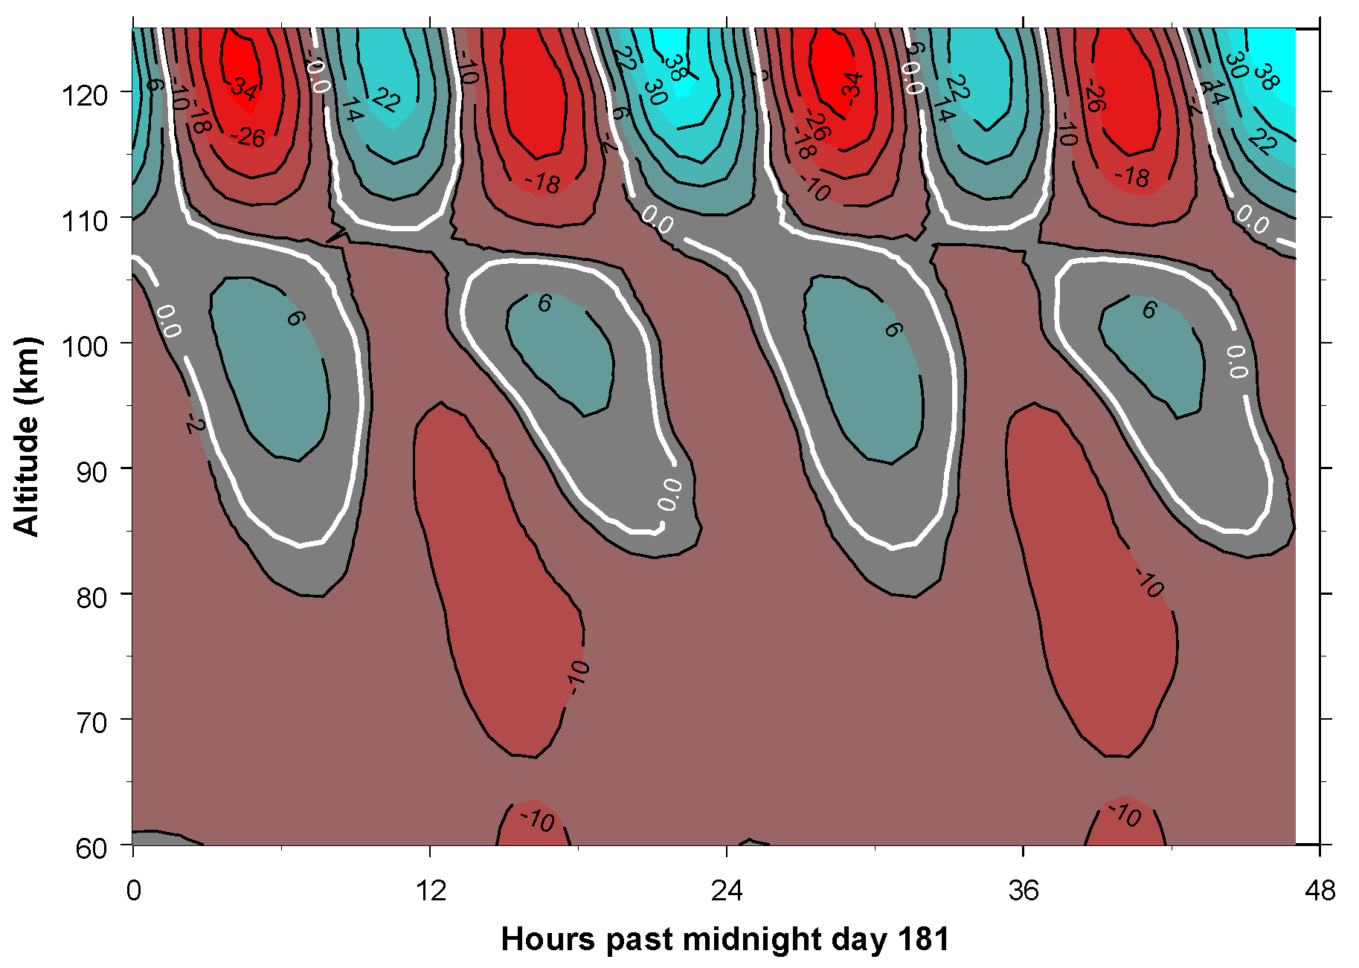
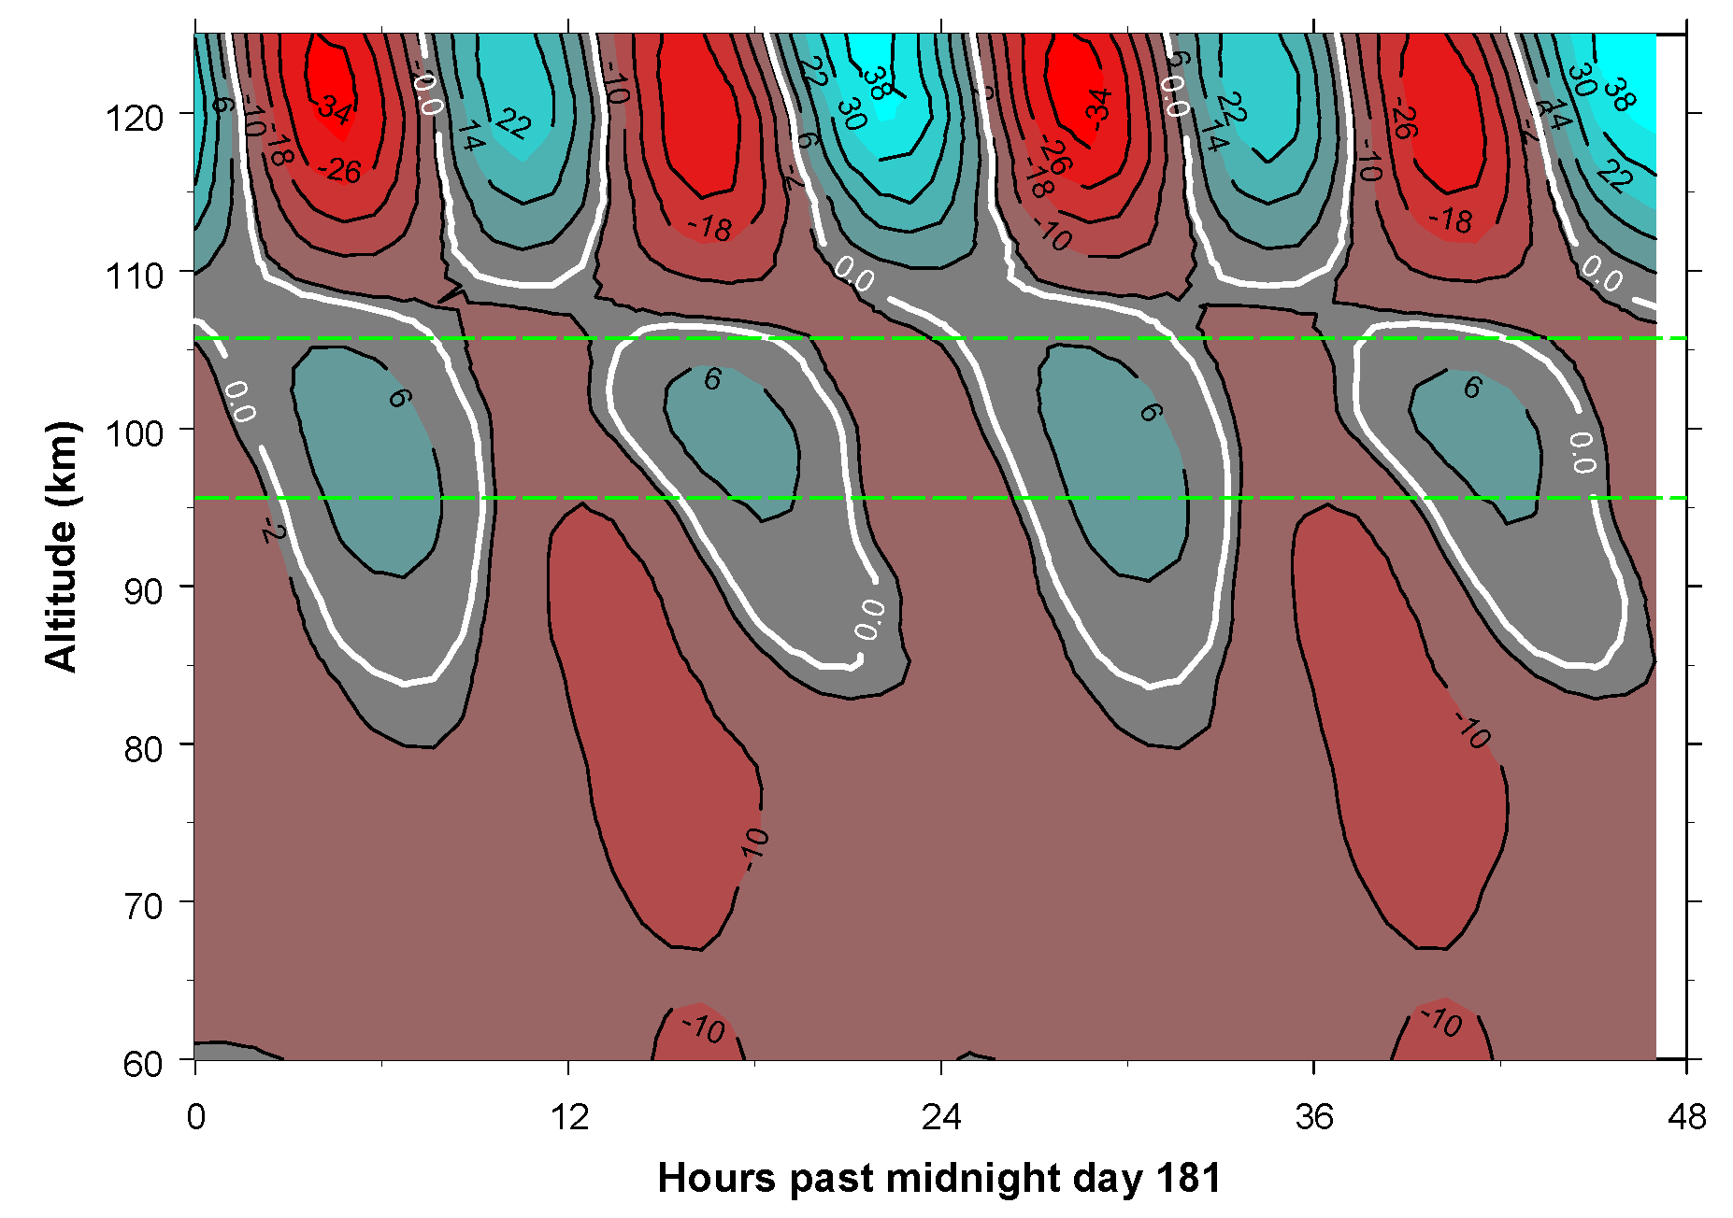
Role of tides in the downward transport of NOx
Hourly data shows tidal modulation of the equatorward, divergent flow
gives poleward and downward “channels”
Visible in HWM, daily-mean meridional wind
Red = poleward flow, Blue =equatorward flow
Visible in HWM, hourly mean meridional wind
Red = poleward flow, Blue =equatorward flow

Slide 7
Role of tides in the downward transport of NOx
Questions to be examined?
Does EPP affect the tides themselves?
Do the tides affect the downward transport of thermospheric NO_{x}

Slide 8
Question 1-Does EPP affect mean winds and tides
Use the Rothera, Antarctica (68S 68W) hourly meteor radar winds
Form a climatology over the years from Feb 2009-Aug 2019
Over a 4-day window shifted hourly:
  Fit the mean wind and 8-, 12-, 24-hour tidal components plus 2-day wave
  Create an hourly climatology of each fitted component
  Calculate the hourly anomaly of each fitted component
Superposed Epoch Analysis over centred on 40 Dst events
  Before/After = average 2-6 days before and after event, respectively

Slide 9
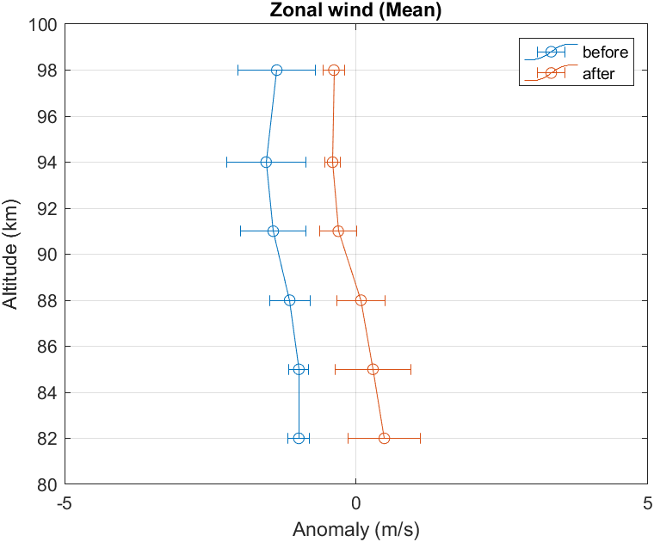
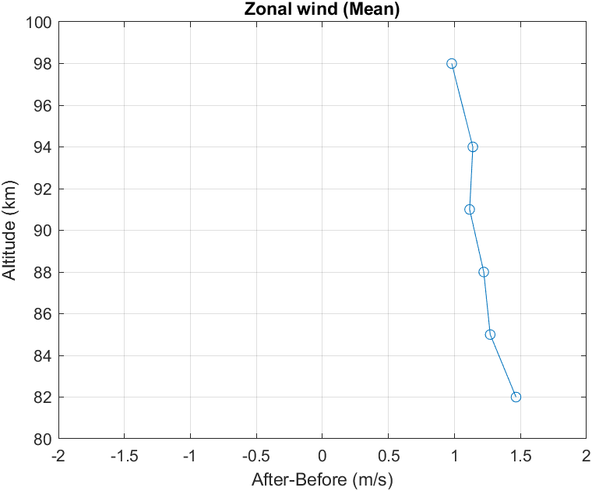
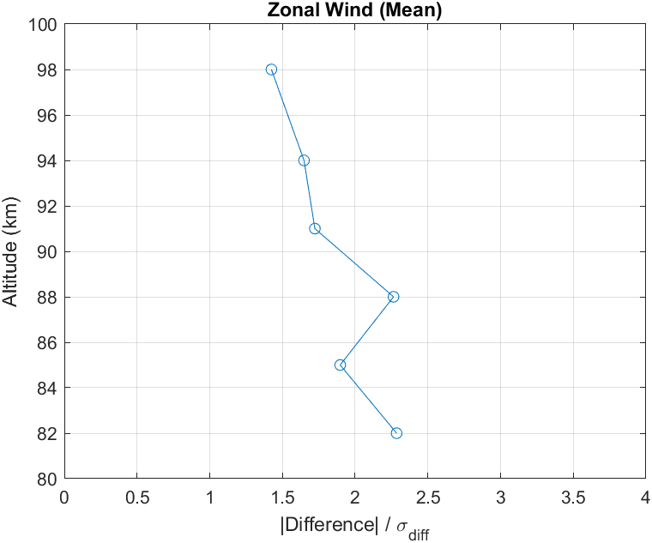
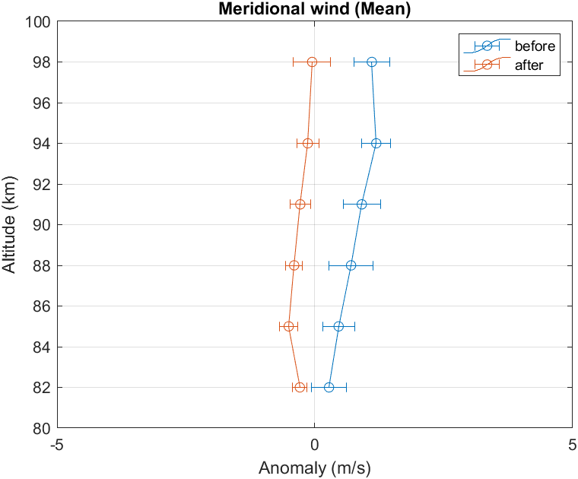
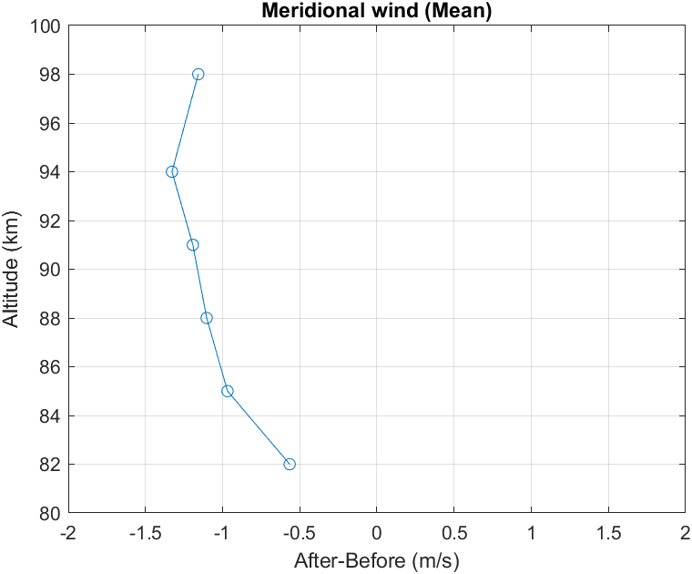
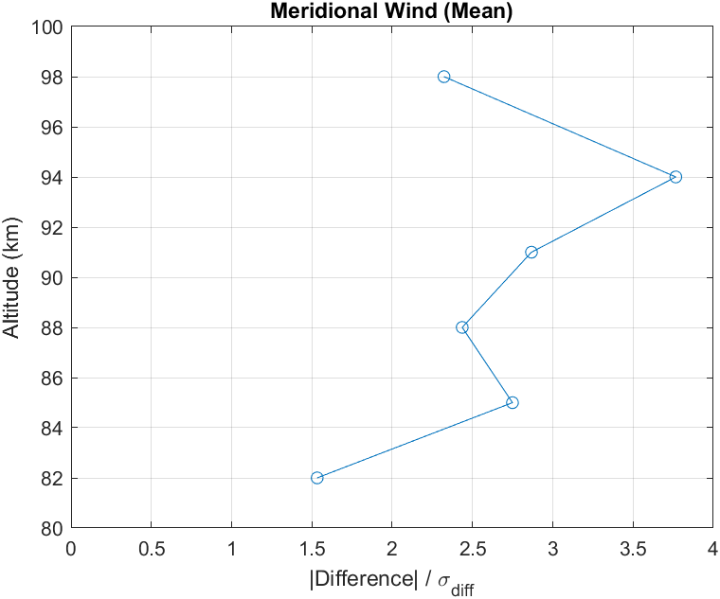
Before and after Dst event difference, Mean wind anomaly

Slide 10
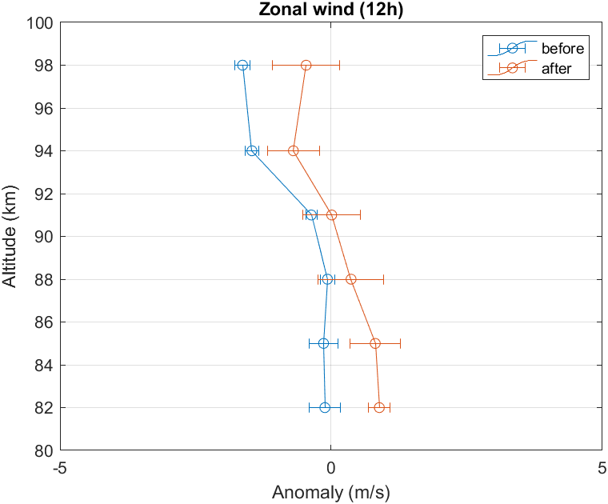
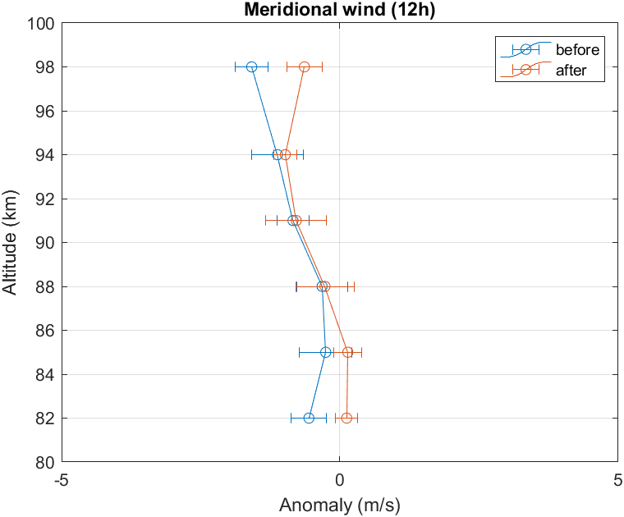
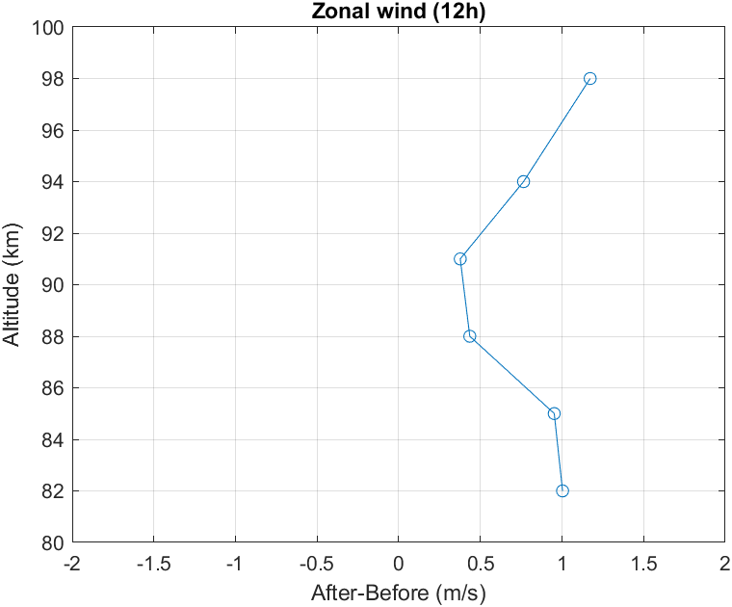
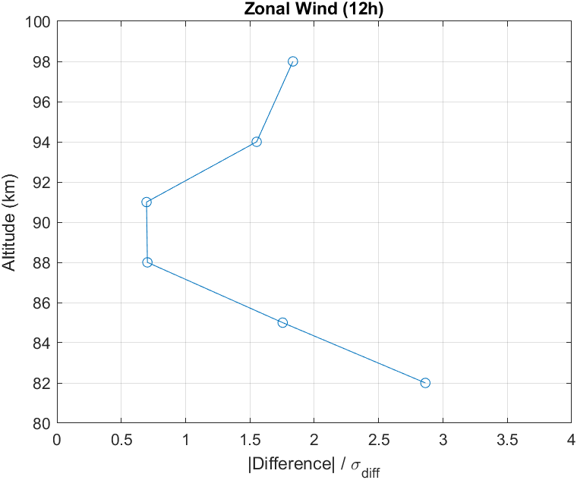
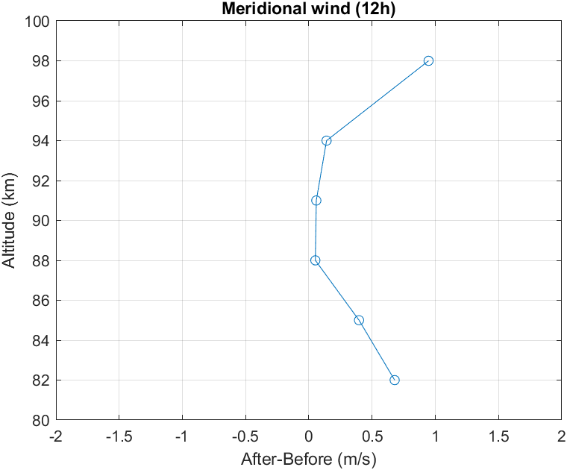
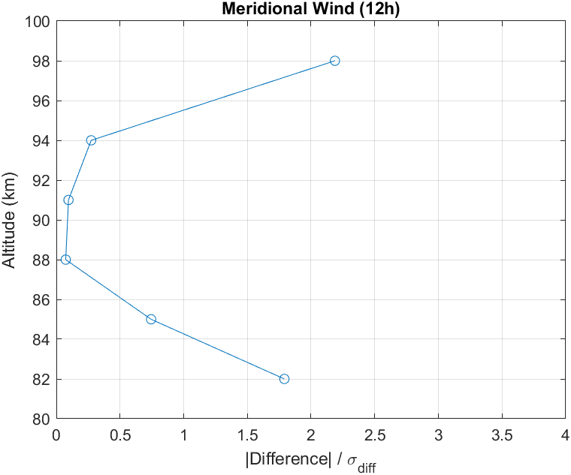
Before and after Dst event difference, 12-hour tide anomaly

Slide 11
Perhaps the small change in the tide is not surprising
Model fit to SW2 tide determined from SuperDARN meteor radar (van Caspel et al, 10.1029/2021JD036007)
SW2 at 95 km due to tropospheric forcing only
SW2 at 95 km due to stratospheric forcing only
SW2 at 95 km due to in-situ MLT forcing only
On the order of 1m/s

Slide 12
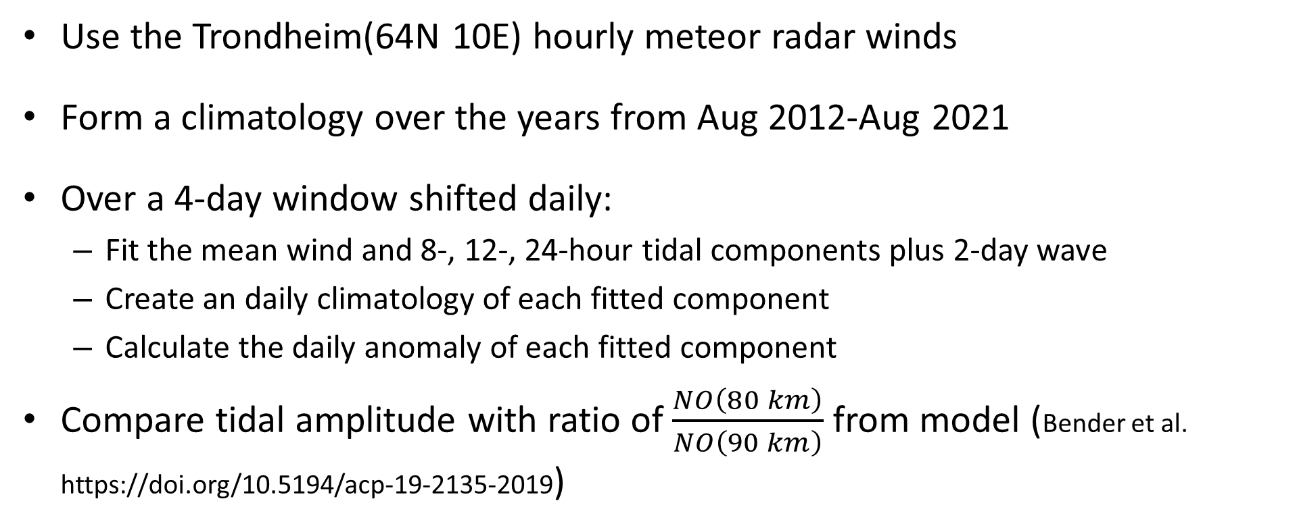
Question 2- Do the tides affect the downward transport of thermospheric NO_{x}
Use the Trondheim(64N 10E) hourly meteor radar winds
Form a climatology over the years from Aug 2012-Aug 2021
Over a 4-day window shifted daily:
  Fit the mean wind and 8-, 12-, 24-hour tidal components plus 2-day wave
  Create an daily climatology of each fitted component
  Calculate the daily anomaly of each fitted component
Compare tidal amplitude with ratio of $\frac{NO\left(80 km\right)}{NO\left(90 km\right)}$ from model (Bender et al. https://doi.org/10.5194/acp-19-2135-2019)

Slide 13
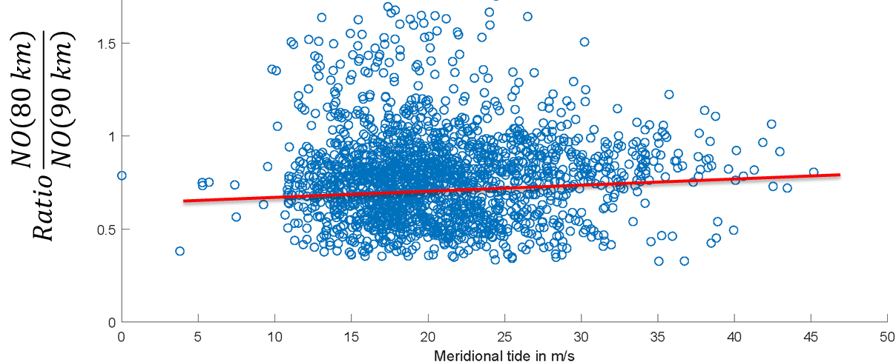
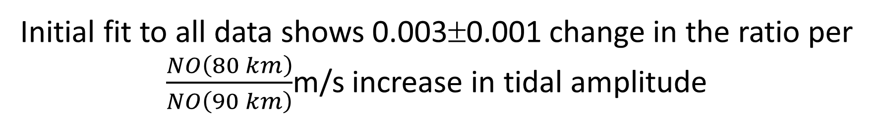
Initial fit to all data shows 0.003±0.001 change in the ratio per $\frac{NO\left(80 km\right)}{NO\left(90 km\right)}$m/s increase in tidal amplitude

Slide 14
Summary and conclusions
Epp events create significant (at 2σ)
  Increase mean zonal wind of 1.25 to 1.5 m/s
  Decrease (more poleward) mean meridional wind of 1-1.25 m/s
  At 82 km, a 0.7 to 1 m/s increase in the 12-hour tide only
Preliminary result that NO increases at low altitude (80 km) relative to NO at 90 km by 0.003±0.001 per m/s of tidal amplitude increase

Slide 16
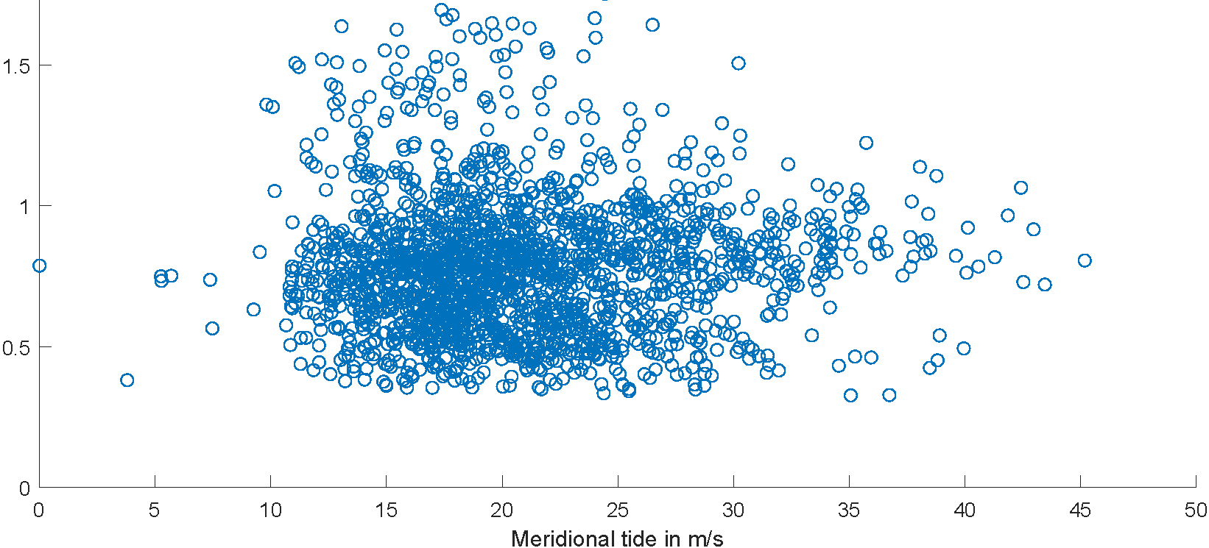
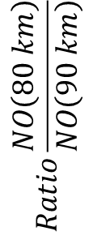
Summary
$$Ratio\frac{NO\left(80 km\right)}{NO\left(90 km\right)}$$

