Slide 1
Long wavelength heating/cooling

Slide 2
Last time: Long Wavelength approximations
No longer have a single beam (μ=μ_{s}) but light is travelling in all directions
Assumptions
The infrared (λ> 3-4μ) light is blackbody radiation ⇒ isotropic (not a function of angle, μ)

Slide 3
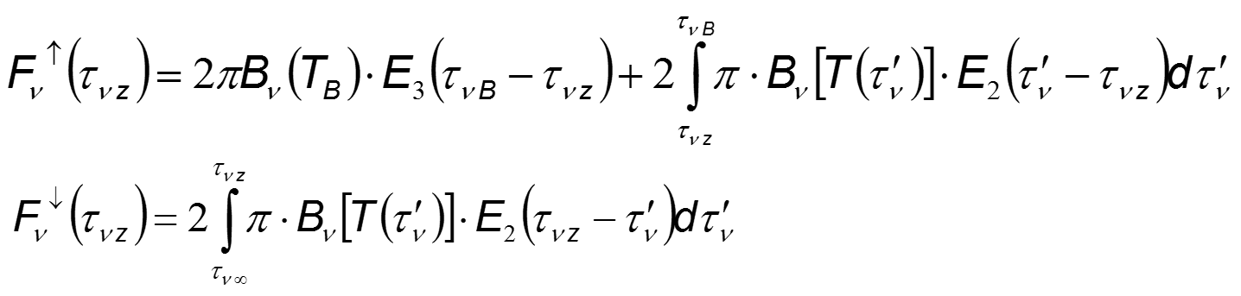
Can re-write as:
Exponentials
Exponential integrals
Average transmission coefficients
↓

Slide 4
Integration difficulties
↑
Not too bad: One average Δτ_{ν} over μ for each wavelength, ν
↑
Bad: Each intermediate layer dτ’ has a different , average Δτ_{ν} over μ for each wavelength, ν, both top and below the layer.
↓

Slide 5
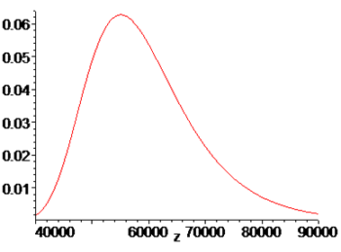

But, only beams with Δτ≈1 actually interact with the layer no matter what the angle or wavelength!
Surface Light Attenuated
Interaction Between Layers
Shown for the vertical path ONLY!

Slide 6
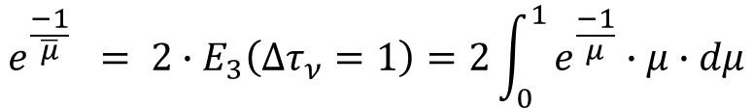
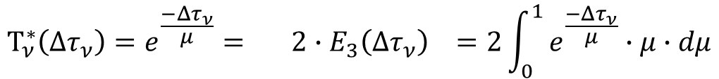
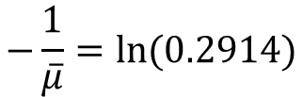

Carrying through the diffuse, 2-stream approximation
(that only Δτ=1 contributes to the integral)
$$Τ_{ν}^{∗}\left(Δτ_{ν}\right)=e^{\frac{−Δτ_{ν}}{μ}}= 2∙E_{3}\left(Δτ_{ν}\right) =2\int_{0}^{1}{e^{\frac{−Δτ_{ν}}{μ}}∙μ∙dμ}$$
Definition of transmission coefficient averaged over all μ
Set Δτ_{ν} = 1 as the only angle μ̄ that contributes
Evaluate the exponential integral = 0.2194
Solve for μ̄ ≈ 3/5 ⇒ θ ≈ 53º
$$e^{\frac{−1}{\overline{μ}}} = 2∙E_{3}\left(Δτ_{ν}=1\right)=2\int_{0}^{1}{e^{\frac{−1}{μ}}∙μ∙dμ}$$
$$e^{\frac{−1}{\overline{μ}}} = 2∙E_{3}\left(Δτ_{ν}=1\right)=0.2914$$
$$−\frac{1}{\overline{μ}}=ln⁡(0.2914)$$

Slide 7
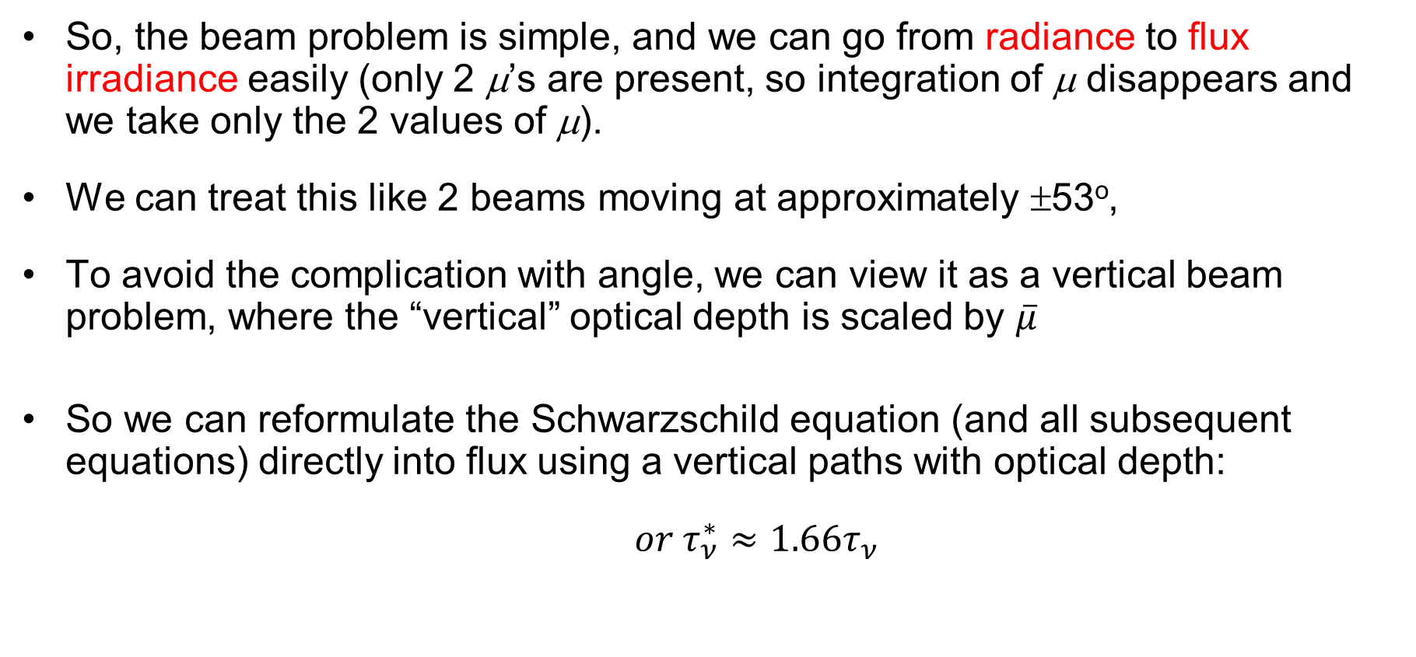
So how does this help
So, the beam problem is simple, and we can go from radiance to flux irradiance easily (only 2 μ’s are present, so integration of μ disappears and we take only the 2 values of μ).
We can treat this like 2 beams moving at approximately ±53º,
To avoid the complication with angle, we can view it as a vertical beam problem, where the “vertical” optical depth is scaled by $\overline{μ}$
So we can reformulate the Schwarzschild equation (and all subsequent equations) directly into flux using a vertical paths with optical depth:
$or τ_{ν}^{∗}≈1.66τ_{ν}$
Notes:
Looks like the short wavelength case in that integrals are delta functions at 53 degrees

Slide 8
Remember integrating over spectral intervals
And we can use the fact that at long wavelengths
we are on the gentle slope of the blackbody curves
So B_{ν}(T) ≈ constant over Δν
so that:

Slide 9
Our upward and downward flux
Integrated over angle and wavelength Using the diffuse, 2-stream approximation
All that is left is to look at the integral in altitude, dτ.

Slide 10
Today: The heating and cooling rates
Diffuse, 2-stream approximation
Isotropic blackbody emission
No sunlight contribution (Far Infrared)
Integrated over wavelength bands

Slide 11
Can use these to calculate long-wavelength heating and cooling
At every altitude, the heating will be proportional to the difference between the flux entering a volume and that leaving.
If more leaves than enters ⇒ cooling
If more enters than leaves ⇒ heating
As with short wavelength heating, need the

Slide 12
Apply to LW Heating and Cooling
Averaged over a spectral interval Δν

Slide 13
Apply to LW Heating and Cooling
We will keep everything in terms of a vertical optical depth coordinate, ͞τ*_{z}
At altitude z ⇒ ͞τ*_{͞ν} (z) = ͞τ*_{z} for shorthand

Slide 14
Apply to LW Heating and Cooling
Next few slides are the mathematical “magic” to get things in terms of quantities that we can identify physically

Slide 15
Apply to LW Heating and Cooling
Info only
Since transmission from a level to the same level =1,
and d/dτ(1) = 0.
Add this 0 (i.e. the left hand side) to our heating equation

Slide 16
Apply to LW Heating and Cooling
Info only
Since transmission from a level to the same level =1,
and d/dτ(1) = 0.
Add this zero to the heating equation

Slide 17
Apply to LW Heating and Cooling
Info only

Slide 18
LW Heating and Cooling
Info only
Can collect and re-write the terms as:
Interaction with levels below
Interaction with levels above
Signs: on the upward path, starting τ₁ > ending τ₂:
Τ(τ₁-τ₂)=exp(-(τ₁-τ₂))=exp(-τ₁+τ₂)
Thus:
dΤ/dτ₁=-exp(-τ₁+τ₂) < 0
dΤ/dτ₂=+exp(-τ₁+τ₂) > 0
Notes:
Upward path:
T(τ₁->τ₂)=exp(-(τ₁-τ₂))=exp(-τ₁+τ₂)
dT/dτ₁=-exp(-τ₁+τ₂)
dT/dτ₂=+exp(-τ₁+τ₂)

Slide 19
LW Heating and Cooling
Can collect and re-write the terms as:
Surface transmission to space
Interaction of level with surface
Interaction of level with levels below
Interaction of level with levels above
Signs: on the upward path, starting τ₁ > ending τ₂:
Τ(τ₁-τ₂)=exp(-(τ₁-τ₂))=exp(-τ₁+τ₂) ⇒ dΤ/dτ₁=-exp(-τ₁+τ₂) < 0
dΤ/dτ₂=+exp(-τ₁+τ₂) > 0
Notes:
Upward path:
T(τ₁->τ₂)=exp(-(τ₁-τ₂))=exp(-τ₁+τ₂)
dT/dτ₁=-exp(-τ₁+τ₂)
dT/dτ₂=+exp(-τ₁+τ₂)

Slide 20
Interpretation
1st term is the interaction with space
    Since ∂Τ(τ_{z}-τ∞)/∂τ_{z} < 0 (τ∞=0) this is COOLING TO SPACE of level τ_{z}.
2nd term is the interaction of level τ_{z} with the surface
    dT(τ_{B}-τ_{z})/dτ_{z} is > 0
    Negative (cooling level τ_{z}) when level τ_{z} is warmer than the ground
    Positive (warming level τ_{z}) when level τ_{z} is cooler than the ground
Higher order terms are exchange integrals
Collect contributions from levels τ’ above and below τ_{z}.
    Since ∂² Τ /∂τ² < 0, Terms are
    cooling level τ_{z} when temperature at τ_{z} exceeds that at τ’.
    warming level τ_{z} when temperature at τ_{z} is less than that at τ’.
Notes:
Upward path:
T(τ₁->τ₂)=exp(-(τ₁-τ₂))=exp(-τ₁+τ₂)
dT/dτ₁=-exp(-τ₁+τ₂)
dT/dτ₂=+exp(-τ₁+τ₂)

Slide 21
Cooling to Space Approximation
At high altitudes
Or anywhere ∂²Τ/∂τ² is small
Power lost to space dominates
Otherwise, calculate all terms
Is cooling to space a good approximation?

Slide 22
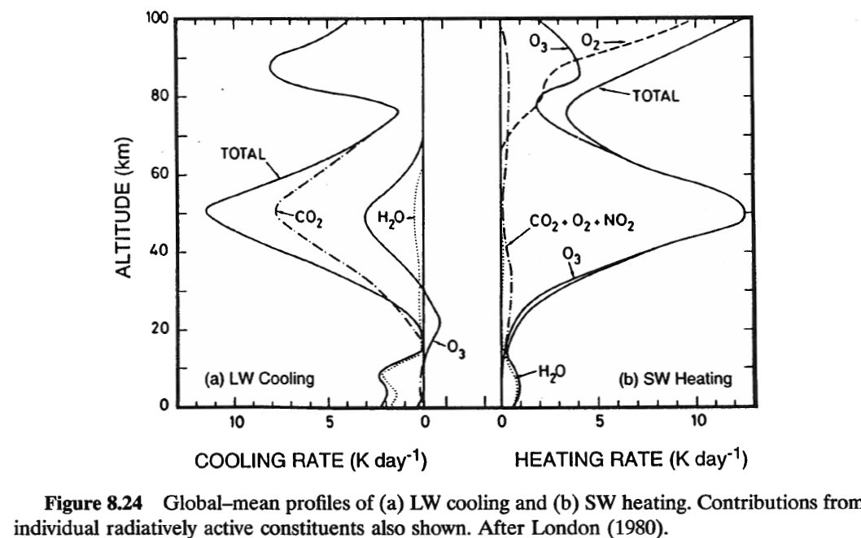
Radiative Cooling and Heating Rates per Species

Slide 23
Newtonian Cooling
What happens when temperature is driven away from radiative equilibrium?
T_{r} is the temperature where radiative energy absorbed by a level is equal to the radiatve energy emitted by that level
At radiative equilibrium, T_{r} → dQ(T_{r})/dt=0
Perturb T=T_{r} + δT

Slide 24
Newtonian Cooling Spring
τ_{r} is positive in practice
Radiative heating rate
  Opposite in sign to the deviation of temperature from radiative equilibrium
  Tries to pull the temperature back to radiative equilibrium
  Can be opposed by other processes (i.e. dynamics or latent heat) that force net heating away from 0 to maintain equilibrium
In the case of non-radiative processes, they can drive the final equilibrium temperature
If radiative cooling ≠ radiative heating, there is another non-radiative process at work

Slide 25
Can we actually use this Radiative Transfer stuff?

Slide 26
We have always asked what is L_{ν}(z_{E})?
What if we measure L_{ν}(z_{e}) and ask what the temperatures were that created L_{ν}(z_{s}) and J(τ’).
This we could do from a satellite looking at the earth.
Then we have a way of remote sensing the earth’s surface temperature or atmospheric temperature

Slide 27
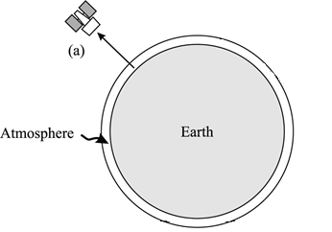
Nadir Viewing
z_{s}=0, τ_{s}= τ_{g}; z_{E}= ∞, τ_{E}= 0; dτ ∝ -dz
Atmosphere is in LTE ⇒ J(z’) = B[T(z’)]
Surface emits like a blackbody B(T_{g})
Small range of view angles, so an effective beam.
  Only L↑ to worry about at μ=1
Radiative Transfer Equation for light detected at satellite becomes
  in z and transmission coefficients:
Important assumptions

Slide 28
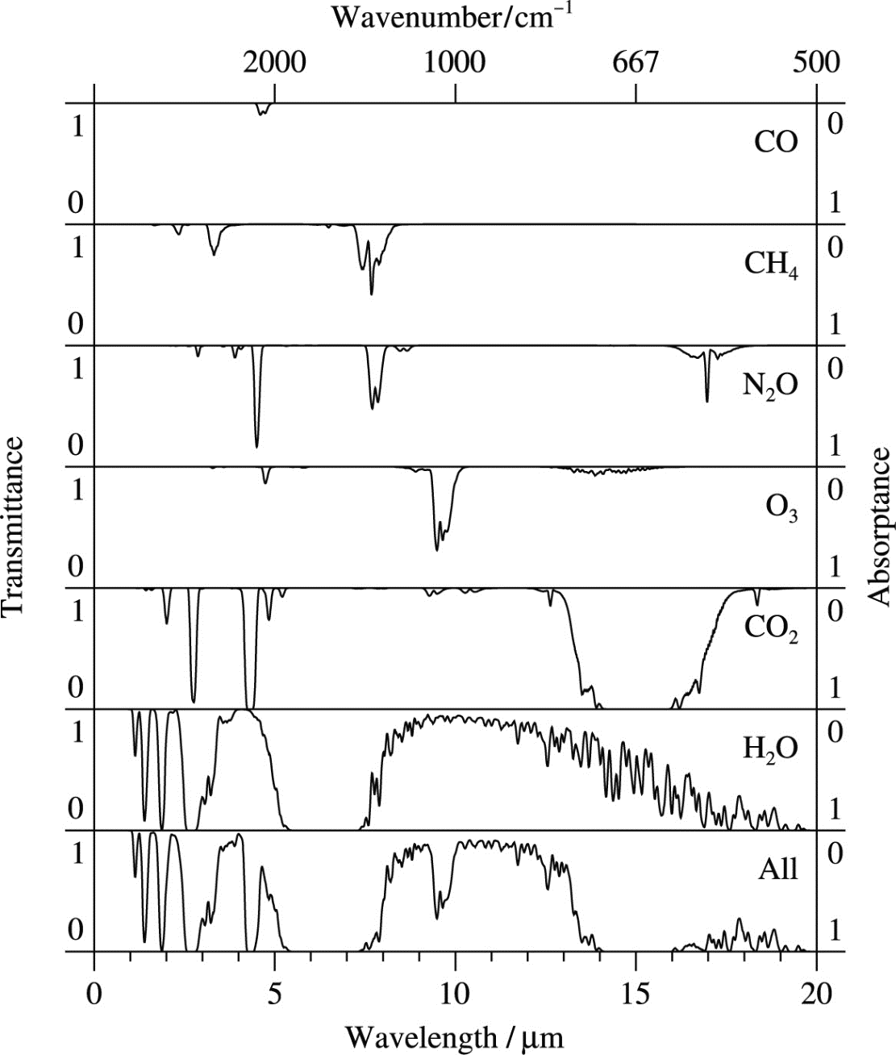
Looks through an atmosphere that has Τ_{ν} transmittance, or Aν=1- Τ_{ν} absorptance
If we look at 11μ,
or ν=900 cm⁻¹
Τ_{ν}≈1 and is constant
The integral term vanishes
Satellite just sees ground
Called a “window” region
L_{ν} = B(T_{g})

Slide 29
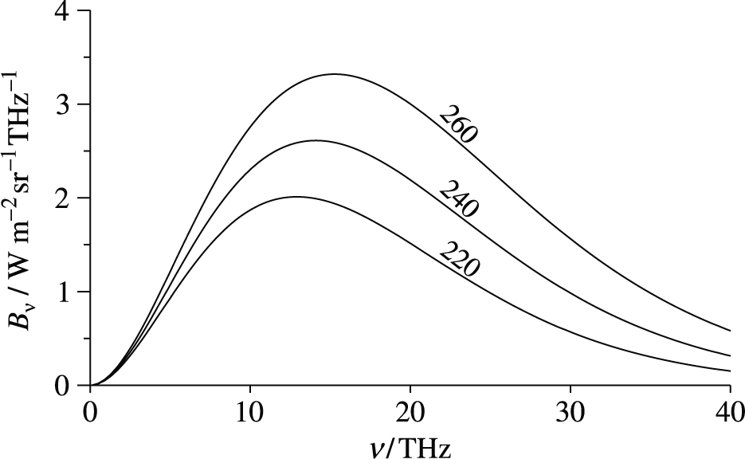
Blackbody curves give T_{g}
Pick T_{g} that gives B_{ν} equal to observed radiance, L_{ν} at 900cm⁻¹
333
667
1000
1333
ν (cm⁻¹)
30
15
10
7.5
λ (μ¹)

Slide 30
Atmospheric temperature
If we measure at frequency ν near an isolated absorption line centred at ν_{o}
If the atmosphere is at a constant T_{o} ≠ T_{g}
Can pull B_{ν}(T_{o}) outside the integral and integrate explicitly

Slide 31
Integrate over isothermal atmosphere
Ground attenuated by Τ_{ν}
+
Atmosphere ⋅A_{ν}

Slide 32
Why the B_{ν}(T_{o})*A_{ν} term?
Ground attenuated by Τ_{ν}
+
Atmosphere ⋅A_{ν}
Remember Kirchoff—a good absorber is a good emitter.
So the atmosphere will emit as a black-body only where it absorbs.

Slide 33
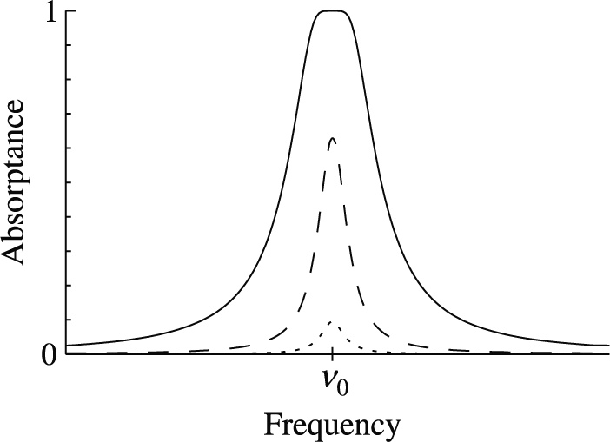
Remember Absorptance looks like
So if air temperature is greater than ground temperature, B(T_{o}) > B(T_{g}) and we see extra emission near ν_{o}
if air temperature is less than ground temperature, B(T_{o}) < B(T_{g}) and we see less emission near ν_{o}
Ground attenuated by Τ_{ν}
+
Atmosphere ⋅A_{ν}

Slide 34
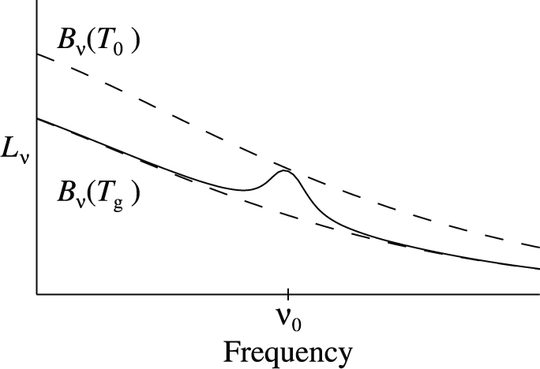
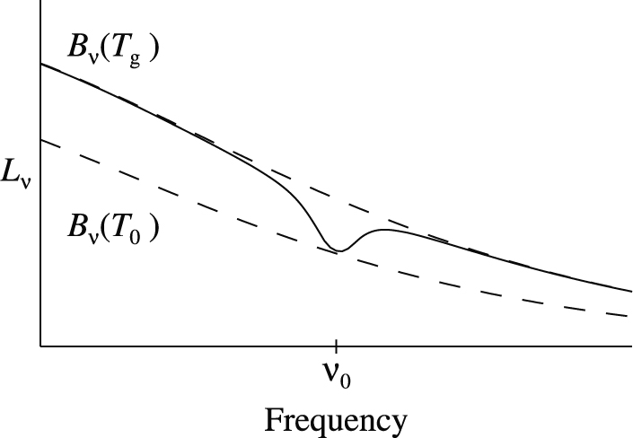
So for absorption line we see
T_{o}>T_{g}
See Ground Radiance,
And at the absorption we see extra radiance B_{v}(T_{o}) times the absorption coefficient vs. ν.
T_{o}<T_{g}
See Ground Radiance,
And at the absorption we see reduced radiance B_{v}(T_{o}) less B_{v}(T_{g}) times the absorption coefficient vs. ν.
If A<1, we don’t quite hit B_{v}(T_{o}) curve

Slide 35
So for saturated absorption we see
At ν = ν_{o} A_{ν}(0-∞)=1
B_{ν}(T_{g}) is totally absorbed
And all radiance at ν = ν_{o} is due to B_{ν}(T_{o})

Slide 36
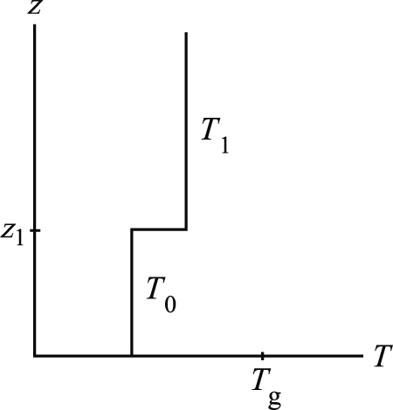
What about more complicated atmospheres: 2 temperatures
2 separate integrals, each isothermal
    0 to z₁ and z₁ to ∞
B_{ν} varies slowly around ν_{o}
    Much slower than A_{ν}
Can pull B_{ν} outside integrals and explicitly integrate

Slide 37
Virtually the same problem in 2 steps

Slide 38
Virtually the same problem-details
This “0” term is split up and underlined below

Slide 39
Interpretation
Single absorption lines are scaled by the difference of the Planck Functions (B_{ν}(T_{z})) of the 2 neighboring layers
For Lorentz (collision) broadened lines, the line widths will vary with the pressure and temperature of the layer as γ = p⋅T^{-½}
Example, take T_{o}<T₁<T_{g} (hot ground, cold “troposphere” in between, and warm “stratosphere” on top

Slide 40
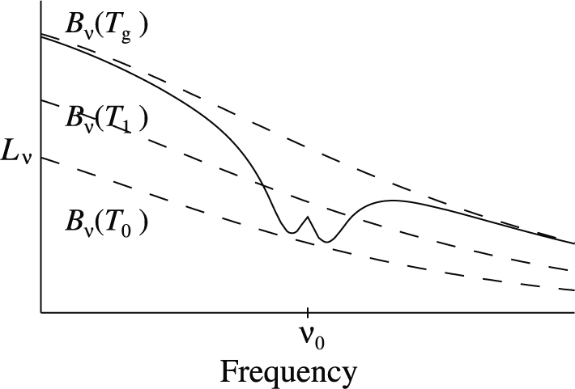
Example, take T_{o}<T₁<T_{g}
Large dip on B_{ν}(T_{g}) Planck curve approaching B_{ν}(T_{o})
  Dip because T_{o}<T_{g}
  Broad due to high pressure
  Deep due to large A_{ν}(0-∞)
Around ν_{o}, there is a small hump approaching B_{ν}(T₁)
  Hump because T_{o}<T₁
  Narrow due to lower pressure
  Small due to A_{ν}(z₁-∞)< A_{ν}(0-∞)

Slide 41
Detailed explanation of this radiance
We can build this up using our concept of equivalent width
Just build up the equation with the radiance and absorption terms!
We know the path from 0→∞ > z₁→∞
Therefore, it will have a broader absorption line (review line shape lecture!)

Slide 42
Can approximate using equivalent width
1
0
W_{o}
W₁
1
0
+
+
=
0

Slide 43
Can approximate using equivalent width
1
0
W_{o}
W₁
1
0
+
+
=
0

Slide 44
Can approximate using equivalent width
1
0
W_{o}
W₁
1
0
+
+
=
0

Slide 45
Can approximate using equivalent width
1
0
W_{o}
W₁
1
0
+
+
=
0

Slide 46
Can approximate using equivalent width
1
0
W_{o}
W₁
1
0
+
+
=
0

Slide 47
Example, take T_{o}<T₁<T_{g}
Large dip on B_{ν}(T_{g}) Planck curve approaching B_{ν}(T_{o})
  Dip because T_{o}<T_{g}
  Broad due to high pressure
  Deep due to large A_{ν}(0-∞)
Around ν_{o}, there is a small hump approaching B_{ν}(T₁)
  Hump because T_{o}<T₁
  Narrow due to lower pressure
  Small due to A_{ν}(z₁-∞)< A_{ν}(0-∞)

Slide 48
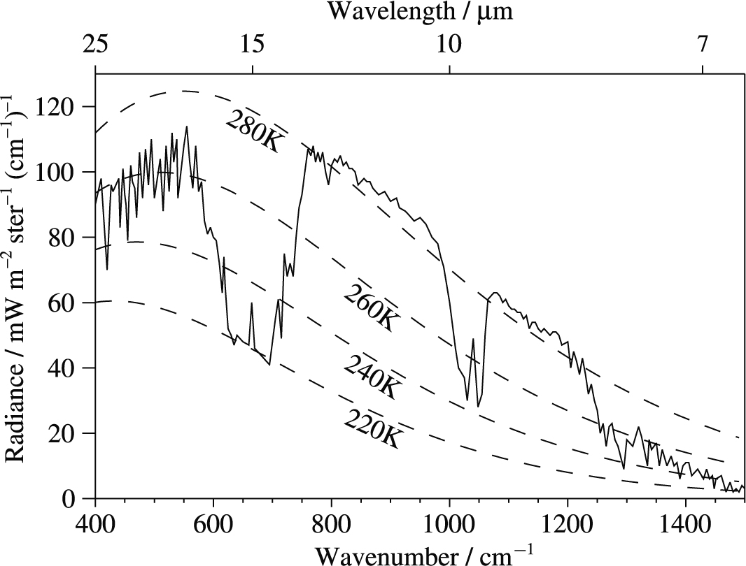
Real Earth Spectrum

Slide 49
Real Earth Spectrum
Multiple Layers
T_{g} ≈280-290K
15μCO₂
  Cold lower atmospheric layer T≈220K
  Warm upper atmospheric layer with T>230K
9.6μ O₃
  Narrower (higher) than CO2 with T≈240K
  Higher layer with T>260 K

Slide 50
Radiation Transfer and Climate Change
When we look down with a satellite, we see the energy that the Earth is shedding to space to cool itself
This will balance the energy the Sun is putting into the Earth
Remember our simple model:
    T_{E}=0 no energy emitted
    Sunlight puts energy in and warms Earth ⇒T_{E} increases
    T_{E} ≠ 0 means it radiates energy to space, σ(T_{E})⁴
    When energy in from the Sun = Energy radiated to space, T_{E} stable

Slide 51
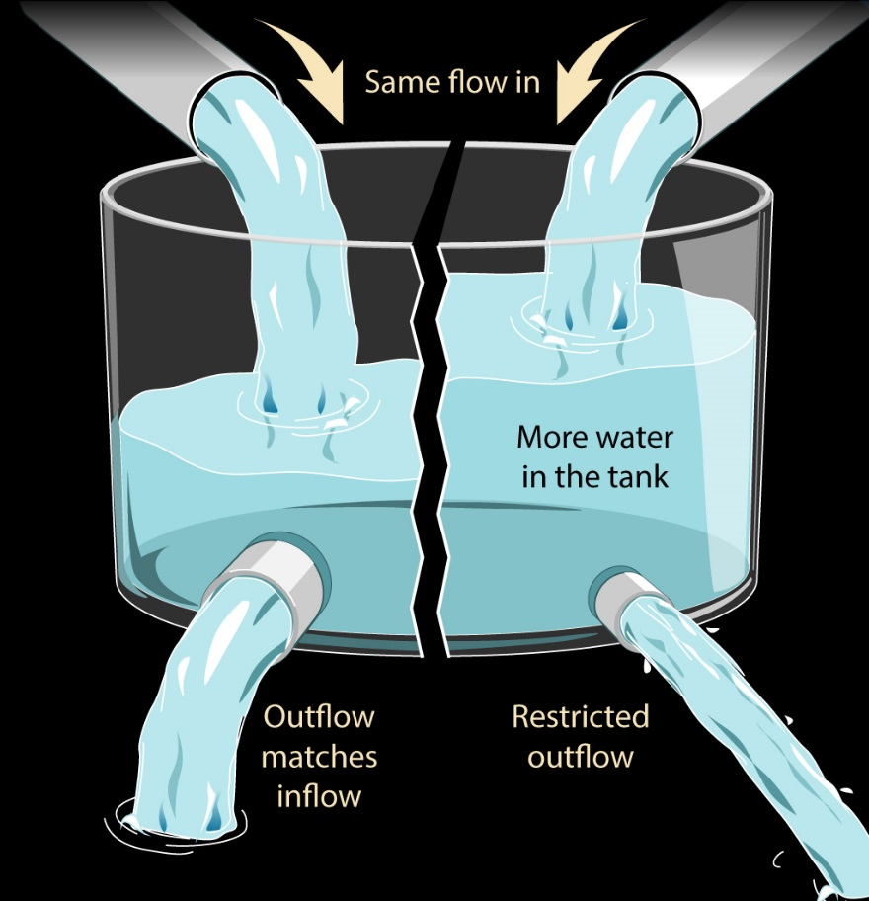
How does all this enter into climate and climate change?
The outgoing long wavelength radiation is the heat loss mechanism for the planet
But Input from the Sun must = Output from Earth
If we restrict the heat leaving,
  The body will heat up in order to radiate more (Newtonian spring)
  The extra radiation will then balance the input radiation
Notes:
After all, we see that radiating at a colder T ⇒ less radiation to space

Slide 52
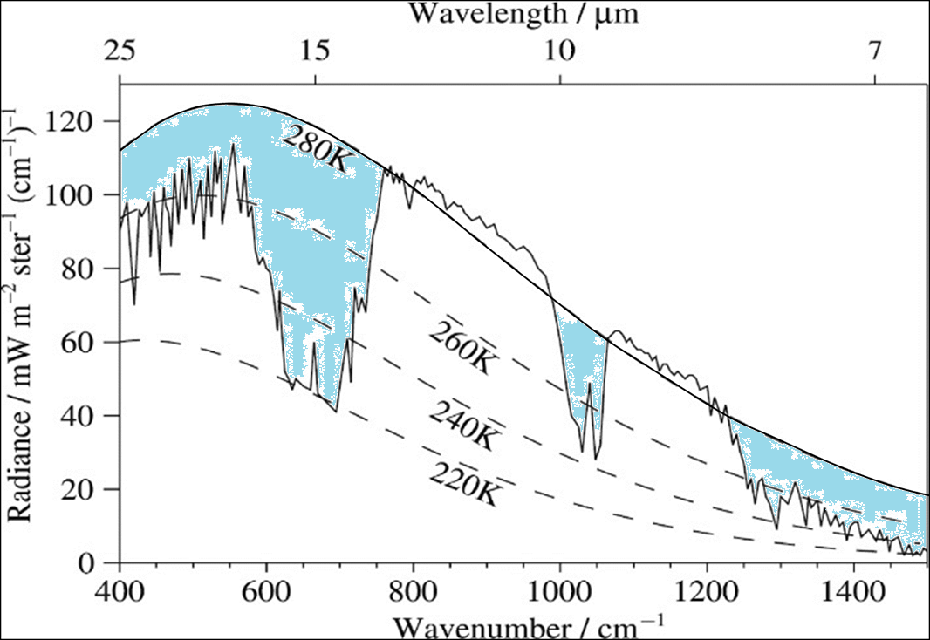
Greenhouse effect!
So, how do we restrict the energy leaving?
Gases like CO₂, O₃, H₂O, and CH₄ do that!
They absorb near the surface
Transfer that energy from layer to layer
And radiate to space from higher altitudes where T_{atm} < T_{g}
  Colder the point at which they radiate to space
  The less radiation they transfer to space
  The more T_{g} increases to balance energy

Slide 53
Greenhouse effect
Where does radiation escape to space?
From the point where the optical depth, τ =1.
Above this, τ < 1 and chance for absorption is small
So, how do we restrict the energy leaving?
Gases like CO₂, O₃, H₂O, and CH₄ do that!
They absorb near the surface
Transfer that energy from layer to layer
And radiate to space from higher altitudes where T_{atm} < T_{g}
  Colder the point at which they radiate to space
  The less radiation they transfer to space
  The more T_{g} increases to balance energy

Slide 54
Greenhouse effect

Slide 55
Can see the effect
How much radiation left the earth with no CO₂
Add 1 ppm
Go to 400 ppm
Increase to 1000 ppm

Slide 56
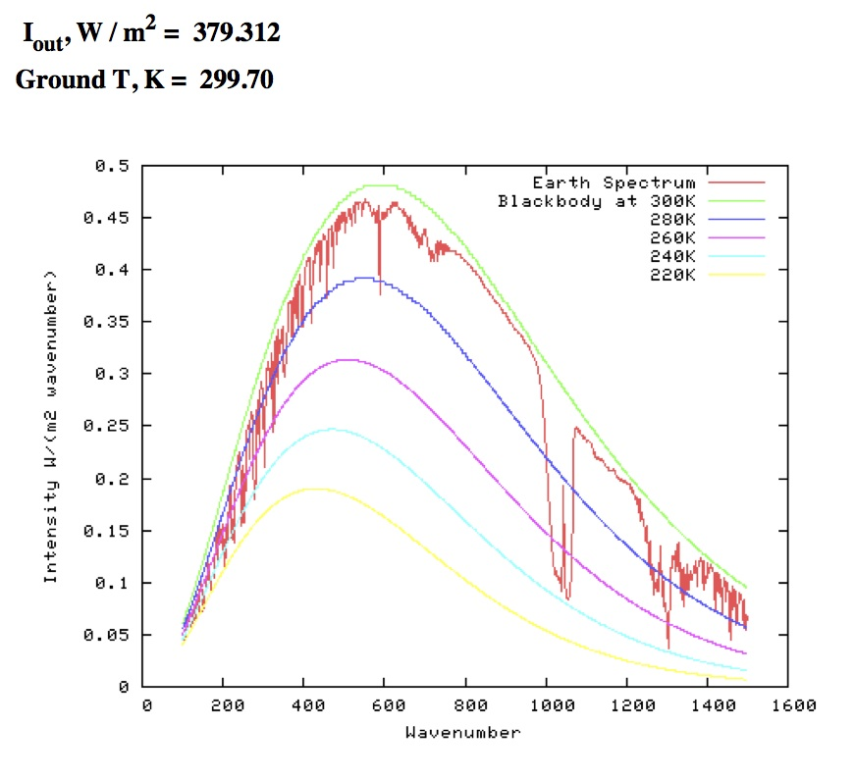
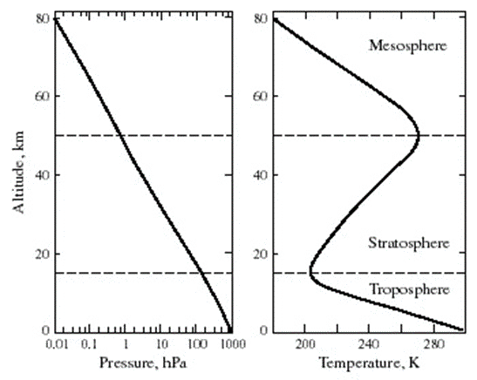
CO₂ = 0 ppmv

Slide 57
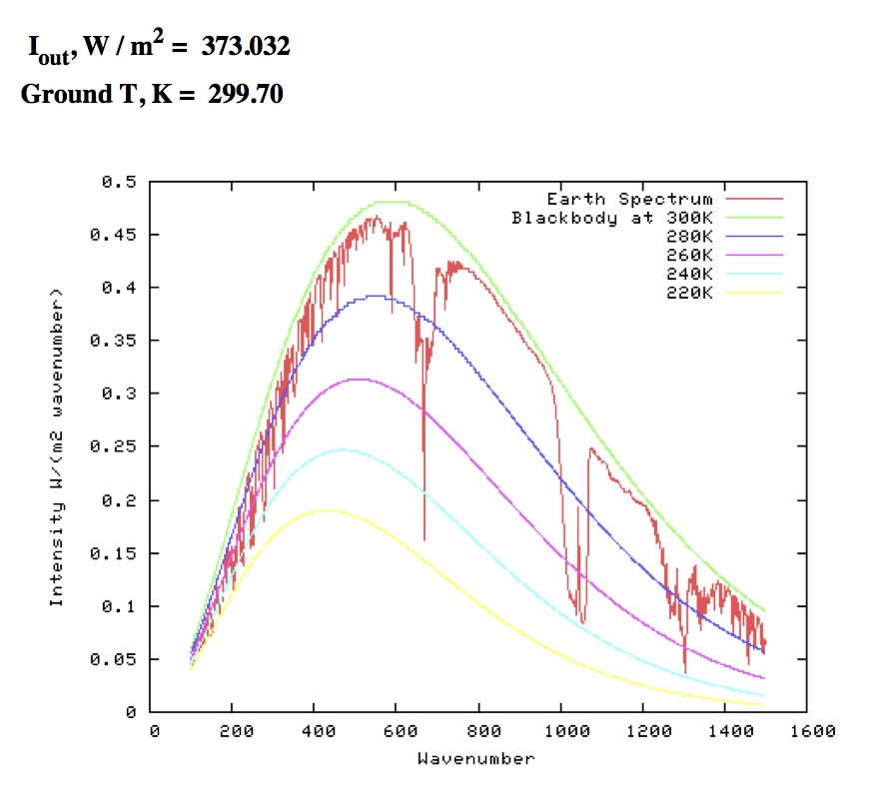

CO₂ = 1 ppmv
$$τ_{CO_{2}}=1$$

Slide 58
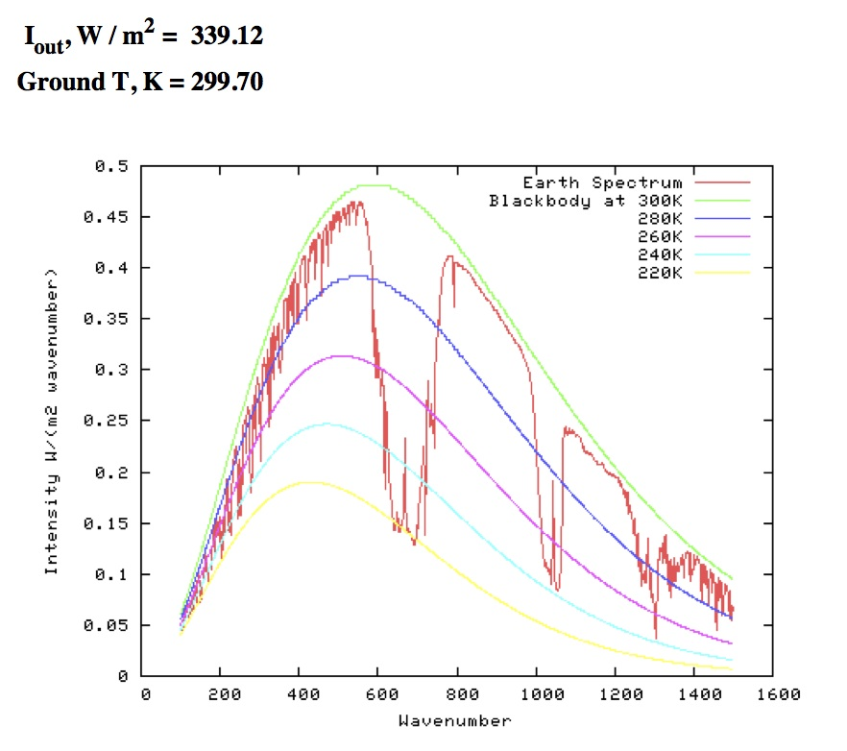
CO₂ = 400 ppmv
$$τ_{CO_{2}}=1$$

Slide 59
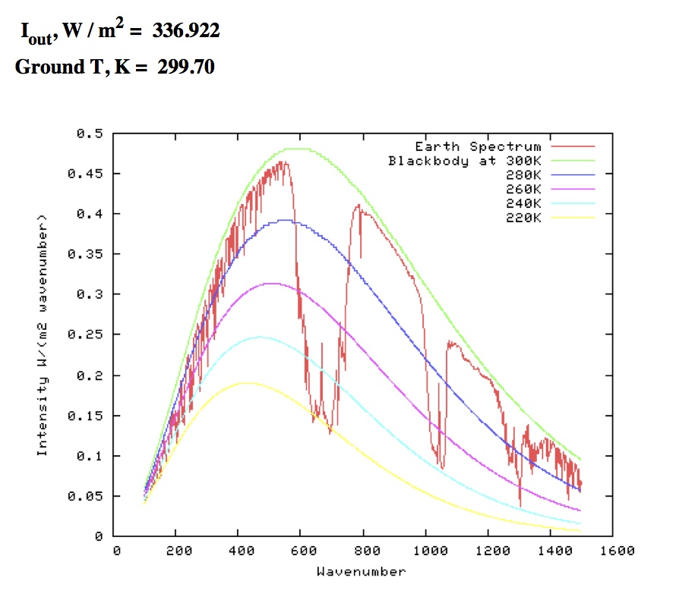
CO₂ = 1000 ppmv
$$τ_{CO_{2}}=1$$

Slide 60
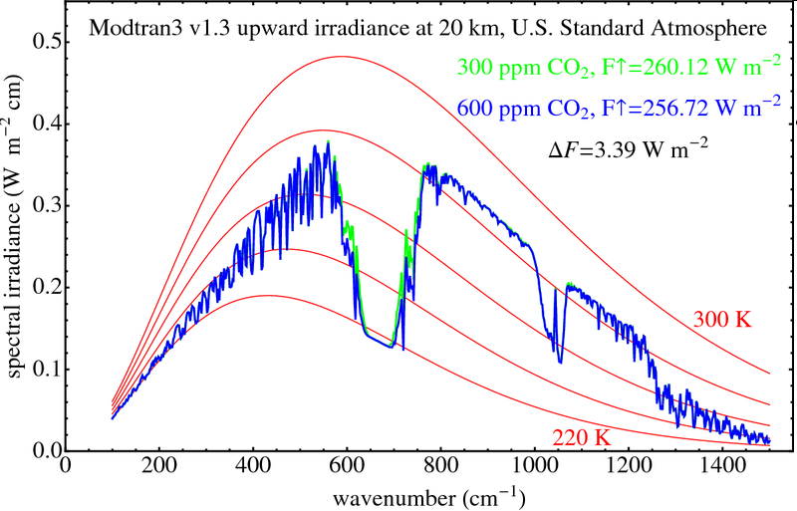
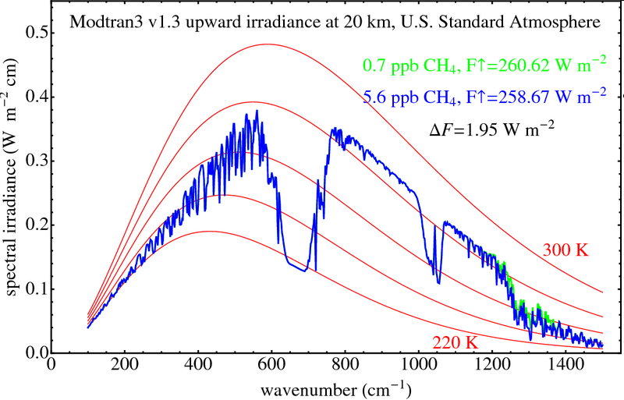
Radiative forcing of gas (ΔI)
Doubling CO₂ gives less radiative escape by ΔI = 3.39 W/m²
Increasing CH₄ by factor of 8 gives ΔI = 1.95 W/m²
Try it yourself at:
http://climatemodels.uchicago.edu/modtran/

Slide 61
All this means….
Increasing from 300 to 600 ppm_{v} CO₂ means there is an extra
3.39 W⋅m⁻² remaining in the atmospheric system
That will cause the system to heat up enough so that σ⋅T⁴ can increase by ~3.39 W⋅m⁻² to keep power-in =power-out
Starting with a surface temperature of 288 K, the temperature where power-input = power-output would be 288.7 K
So the system temperature must increase by 0.7 K to balance

Slide 62
The Physical Basis for CO₂ Induced Climate Change
Base-line absorption:
    Some rotational lines near the band centre are saturated (Τ = 0) at their line centres
    Rotational lines away from the band centre are weakly absorbed
    This is due to the population of absorbing state a is given by
    N_{a} = N(CO₂) * exp(-(E_{g}-E_{a})/(k⋅T) -- the Boltzmann distribution
Increase CO₂ concentration:
    Saturated lines broaden to absorb farther from their line centres
    Rotational lines away from the band centre begin to have appreciable absorption
    Altitude where τ=1 increases so that all radiate at temperatures less than the ground temperature
    Less radiation escapes to space ⇒ remainder heats system

Slide 63
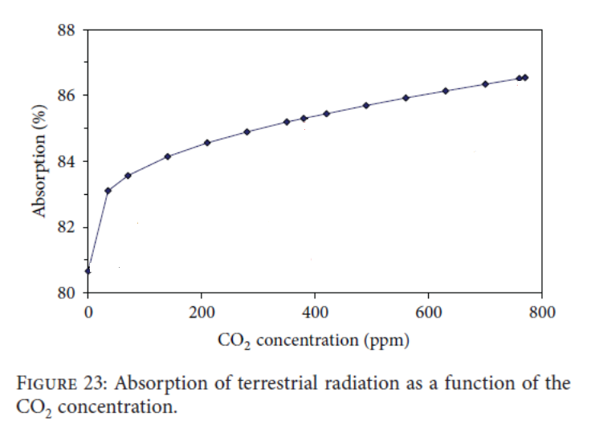
Increase CO₂, continue to increase absorption
Even after “saturation”:
Each line continues to broaden and absorb
And
Successive rotational lines, J, become optically thick (τ_{J} >1) as total CO₂ density increases

Slide 64
Increase CO2 throughout atmosphere
We have seen that it restricts surface radiation from escaping to space and leads to T_{troposphere} increasing.
Hadley Centre Report, Dec 2003
http://www.met-office.gov.uk/research/hadleycentre/index.html
Notes:
Have demonstrated that since τ at 15 μ >>1 troposphere,
Increasing CO2 means escape altitude moves to higher altitude
Cooler temperatures there lead to less radiation
Newtonian spring:
decreasing T ⇒ decreasing radiation ⇒ less cooling ⇒ increasing T
Until we balance

Slide 65

Increase CO2 throughout atmosphere
We have seen that it restricts surface radiation from escaping to space and leads to T_{troposphere} increasing.
But, what happens in the stratosphere where we have increased cooling to space (τ<<1 so more [CO₂] increases cooling)
Hadley Centre Report, Dec 2003
http://www.met-office.gov.uk/research/hadleycentre/index.html
Notes:
We have direct heating of the stratosphere from the sun
Since τ at 15 μ << 1, Increasing CO2 means more radiation
Newtonian spring:
more cooling ⇒ decreasing T ⇒ decreasing radiation ⇒ less cooling
Until we balance

Slide 66
Radiative transfer and climate change
Greenhouse gases do not affect the incoming solar energy
But they do absorb the outgoing long-wavelength energy the Earth is trying to radiate to space to cool.
That means τ > 1 at the altitudes where these gases absorb.
They can transfer some of that energy to surrounding gas by collisions, or radiate it away.
As long as τ > 1, that radiation will just be absorbed by a nearby greenhouse gas molecule
But photons in the upward direction see lower τ than those going downward (since density is decreasing in altitude), so they travel farther upward than downward before being absorbed.
Eventually they “diffuse” upward to the point where τ ≤ 1
From that point, they can escape to space

Slide 67
Radiative transfer and climate change
Eventually they “diffuse” upward to the point where τ ≤ 1
From that point, they can escape to space
If the temperature of the atmosphere is also decreasing with altitude, the gas at the τ ≤ 1 point will radiate fewer photons per second, σ(T_{atm})⁴ into space
The higher in altitude the τ ≤ 1 point, the greater the radiative “restriction”.
H₂O is precipitatable and only present from the surface to about 3 km, where its mixing ratio drops sharply. So it radiates at a temperature near to the surface temperature
CO₂ (not very chemically reactive or precipitatable) has the same mixing ratio from 0 to 80 km, and they reach their τ ≤ 1 at 7 to 10 km where temperatures are << surface temperature

Slide 68

Radiative transfer and climate change
H₂O is precipitatable and only present from the surface to about 3 km, where its mixing ratio drops sharply. So it radiates at a temperature near to the surface temperature
CO₂ (not very chemically reactive or precipitatable) has the same mixing ratio from 0 to 80 km, and they reach their τ ≤ 1 at 7 to 10 km where temperatures are << surface temperature
The CO₂ therefore radiates much less energy into space (T_{BB} = 220 K)
than the water vapour (T_{BB} = 260 K)
Additionally, CO₂ absorbs near the peak of the Earth’s blackbody radiation whereas H₂O is off peak
H₂O
H₂O
O₃
CO₂
H₂O and CH₄

Slide 69
Radiative transfer and climate change
H₂O is precipitatable and only present from the surface to about 3 km, where its mixing ratio drops sharply. So it radiates at a temperature near to the surface temperature
CO₂ (not very chemically reactive or precipitatable) has the same mixing ratio from 0 to 80 km, and they reach their τ ≤ 1 at 7 to 10 km where temperatures are << surface temperature
The CO₂ therefore radiates much less energy into space (T_{BB} = 220 K)
than the water vapour (T_{BB} = 260 K)
Additionally, CO₂ absorbs near the peak of the Earth’s blackbody radiation whereas H₂O is off peak
Note O₃ radiates to space in lower stratosphere where T_{stratosphere} > T_{tropopause}
And T_{stratosphere} > T_{7 km} the T where CO₂ radiates
O₃
CO₂

